Slide 1
Office of the Police and Crime Commissioner Information Document for
April 2026
Author: Office of the Police and Crime Commissioner
Sign Off – Force Exec : Katy Watts
Changed to quarterly publication in line with Performance and Governance Performance Meetings.

Slide 2
Specified Information Order
Police and Crime Commissioners (PCCs) are required to publish certain information to allow the public to hold them to account.
Section 11(1) and (2) of The Police Reform and Social Responsibility Act 2011 requires an elected local policing body to publish any information specified by the Secretary of State by order.
The Elected Local Policing Bodies (Specified Information) Order 2011 (‘the Order’) sets out the information that must be published. Guidance on the order is published on gov.uk - Guidelines for PCCs on publishing information - GOV.UK (www.gov.uk)

Slide 3
Specified Information Order
https://www.bedfordshire.pcc.police.uk/specified-information-order/

Slide 4
Specified Information Order
The Elected Local Policing Bodies (Specified Information) (Amendment) Order 2021 (’the amending Order), which will come into force on 31 May 2021 provides that information relating to the force’s performance against the Government’s national priorities for policing.
National priorities for policing
The national priorities for policing are specified in the Police and Crime Measures:
reduce murder and other homicide;
reduce serious violence;
disrupt drugs supply and county lines;
reduce neighbourhood crime;
tackle cyber crime;
and improve satisfaction among victims with a particular focus on victims of domestic abuse.

Slide 5
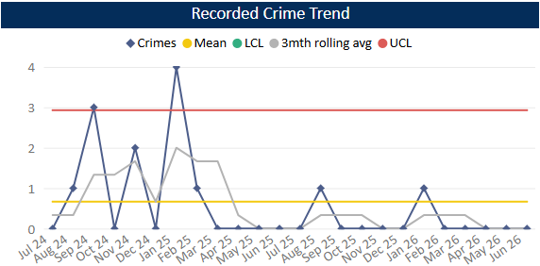
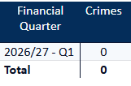
Reduce Murder and Other Homicide
Measure Summary
Local Measures | Trend / Outlook | Benchmark
Police recorded Homicide offences | Improving
Planned Action to Drive Performance
1. Homicide and joint Serious Violence reduction strategy has been collated into one and sits within the Force Performance Board – strands include Mental Health, DA and Serious Violence.
Comments
1. There were no Homicides recorded in Q1 26-27.
2. In the same period last year, we recorded 0 homicides also.
This is in comparison to the previous quarter, where one homicide was recorded.
The force in ranked 4th for the Homicide crime rate per 1000 population in the 12mths to May 2026. This means our homicide rate has reduced since the last update.
Caveat: this data is based on local Bedfordshire force data and may not match nationally published data (police.uk or published stats from HO)

Slide 6
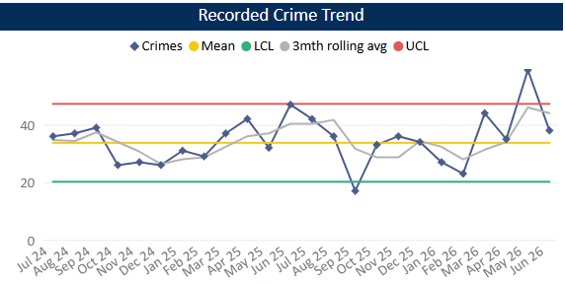
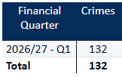
Reduce Serious Violence
Measure Summary
Local Measures | Trend / Outlook | Benchmark
Police recorded Most Serious Violence offences | Increasing
Solved Crimes | Increasing
Planned Action to Drive Performance
1. Habitual Knife Carriers is refreshed quarterly. We are working in conjunction with Cambs to look at implementing a new methodology soon.
2. Knife Crime Concentration Fund – 4 hotspots identified, 2 in Luton and 2 in Bedford. Geographical analysts assigned to each. Scanning process is now complete and information is being shared with the Community Teams.
Comments
1. Most Serious Violence levels increased during Q1 and are now just above the average. It should be noted that Q2 25-26 was exceptionally low compared to previous quarters. The average for Q1 26-27 is 44 crimes per month.
2. Beds is equal to the MSG average.
Caveat: this data is based on local Bedfordshire force data and may not match nationally published data (police.uk or published stats from HO)

Slide 7
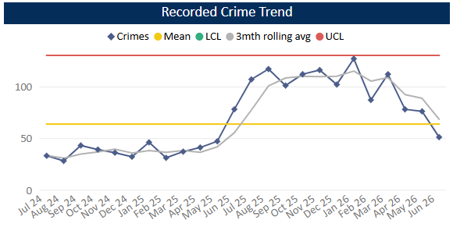

Disrupt Drugs Supply and County Lines
Measure Summary
Local Measures | Trend / Outlook | Benchmark
Number of Drug Trafficking offences | Reflects policing activity
Planned Action to Drive Performance
1. COSTELLO – this is a dedicated team which works on enforcements for large scale drug activity. A key focus for the team is professional enablers, linking into SOC.
2. Scanning processes continue as business as usual in order to identify new lines.
3. The work covered by the Drugs Focus Desk has now moved to CID and is continually being monitored in terms of impact. At the moment the demand is increasingly hard to manage and workloads in CID are high (overall not just in relation to Drugs).
Trafficking of Drugs
Comments
1. Q1 recorded 205 Trafficking of Drugs offences, averaging 68 crimes per month in the quarter This is down on the previous quarter but up on the same time last year. Trafficking offences tend to reflect proactive police activity.
2. Bedfordshire currently has 21 mapped OCGs – this is the same as last quarter. 14 of the OCGs have their primary threat recorded as drugs. The number of Street Gangs has increased slightly to 10 (as of July 26).
3. Currently there are 52 county lines. This is a decrease from the last quarter due to enforcement and archiving.
Caveat: this data is based on local Bedfordshire force data and may not match nationally published data (police.uk or published stats from HO)

Slide 8
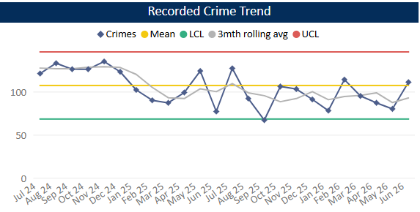
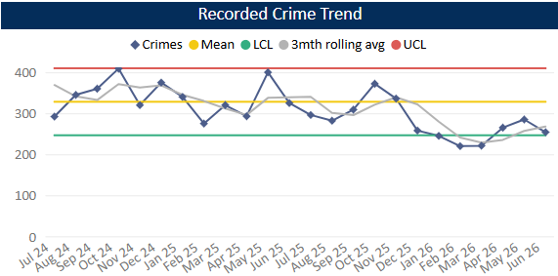
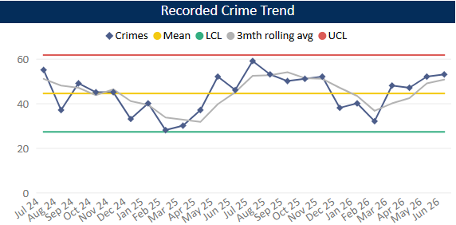
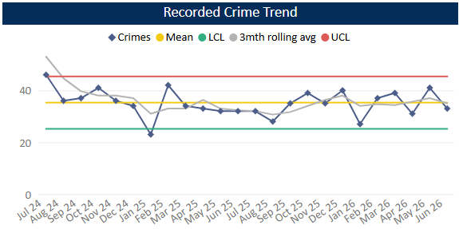
Reduce Neighbourhood Crime
Measure Summary
Local Measures | Trend / Outlook | Benchmark
Police recorded Residential Burglary offences (pre-April 23 definition) | Stable
Police recorded Vehicle Crime offences | Decreasing
Police recorded Personal Robbery offences | Increasing
Police recorded Theft from Person offences | Stable
Planned Action to Drive Performance
1. Op Vadar remains a force priority – geographical issue primarily affecting Biggleswade including youth-related violence offences and ASB.
2. Op Lunq was a force priority relating to TOMV offences in Central Beds.
Burglary Residential
Vehicle Crime
Comments
1. In Q1 278 Residential Burglaries were recorded, averaging 93 crimes a month. This is similar to Q4 25-26 but is below the same period in the previous year. Solved rate for Q1 26-27 was 10.8%.
2. Vehicle Crime has increased compared to Q4. The average in Q1 is 268 crimes per month. The solved rate was 4.2%.
3. Personal Robbery has increased compared to Q4. Q1 was higher (by around 20 crimes) than the same quarter in the 25-26 year. The average was 51 crimes per month in Q1 26-27 and the solved rate was 6.6%.
4. 105 Theft from a Person crimes were recorded during Q1, this is a slight increase compared to Q4 and is slightly above this time last year. Levels have been around the average across the quarter as a whole.
Personal Robbery
Theft from Person

Slide 9
Tackle Cyber Crime
Measure Summary
Local Measures | Trend / Outlook | Benchmark
Investigate 100% of all cyber dependant crime disseminated to force | Stable [100%] | Not available
Provide 100% of all cyber dependant crime victims with specialist advice | Stable [100%] | Not available
Action Fraud offences | Stable [100%] | Not available
Planned Action to Drive Performance
1. 1. Project Darklink continues to drive investigations into the grey market online with illegal knife sales and a warrant was executed on the back of this during this quarter. A second investigation commenced shortly afterwards in relation to a Luton based gang nominal and is about to be enforced on by the Community teams. COM investigations are having an impact on the wider Cyber team and no doubt the wider organisation moving forwards. The Darklink team will expand into this open-source area to support the investigation teams that own the investigations due to the risk to vulnerable members of the community and to support an international response.
2. Cyber presentations have been provided by the DMI's to the entire BCH SOCO team, this was to expand each team's knowledge on boundaries and the understanding of opportunities and tactics. In addition, the DMI Sgt and ICAIT Sgt having raised the risk around COM investigations to the Exec have commenced a force wide delivery of an awareness presentation, delivered to 60 colleagues so far
3. The team carried out 19 Protect and Prevent engagements overall this quarter
Protect Engagements Q4 25-26
Delivered 19 Protect events to 369 members of the local community The Bedfordshire Cyber Security team have tweaked their approach to engagements within the banking sector embarking on some Protect breakfast bitesize sessions in relation to Cyber banking fraud, this has commenced initially with Metro bank based on the disproportionate number of cyber scams that involve that company. Beds Central Council invited the Protect team to deliver a protect event which was organised by them, in partnership with a private sector service provider the audience reach was over 90 attendees from local businesses and charities enhancing their ability to spot potential threats to their business areas and how to target harden any identified weakness in security.

Slide 10
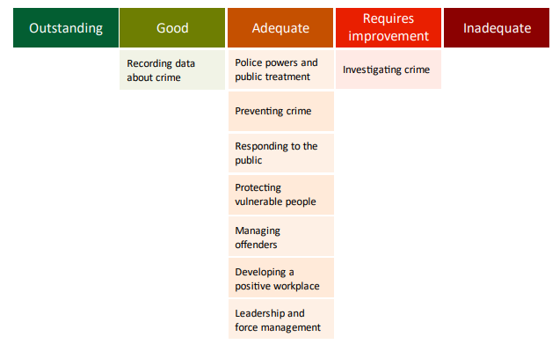
Specified Information Order
HMICFRS reporting
The amending Order requires PCCs to publish the most recent HMICFRS force-level report on the effectiveness, efficiency and legitimacy of the police force.
The Order requires that PCCs publish the PEEL report for their force on their website, within one calendar month of its publication by HMICFRS.
https://www.bedfordshire.pcc.police.uk/hmic-reports/

Slide 11
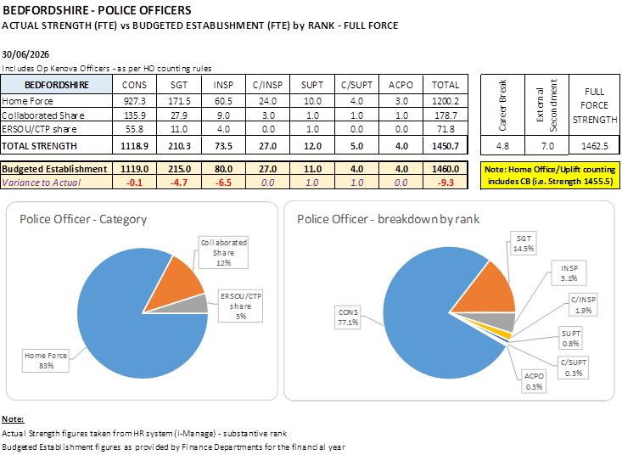
Reinvigorating local policing
Recruitment and Retention Numbers:
Police and Crime Commissioners have statutory responsibilities for delivering an efficient and effective police service. Our efficiency and effectiveness improves when the right level of resources are available and maximised.
The PCC wishes for his office to publish the monthly figures of the recruitment of officers.

Slide 12
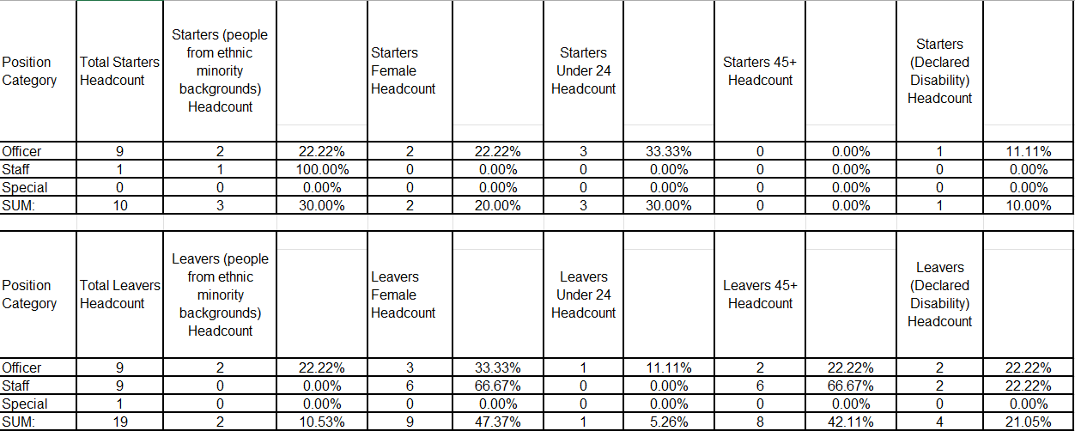
Reinvigorating local policing
Recruitment and Retention Numbers:

Slide 13
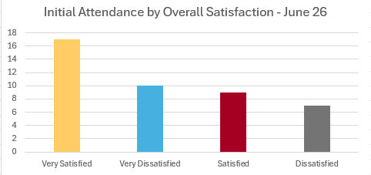
Victims at centre of the CJS
The PCC has requested information form the Force on a monthly basis surrounding Victim Satisfaction and how the Force deals with this and monitors this.
Victim Satisfaction
In Q1 26-27, 151 initial attendance surveys were completed, 43 of which were in June. The majority of those who responded were either very satisfied or satisfied (an overall rate of 66%). The satisfaction rate for June 2026 only was 60.4%

Slide 14
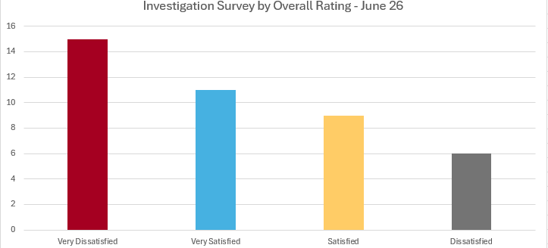
Victims at centre of the CJS
Victim Satisfaction
For the investigation surveys, 138 were completed in Q1 with an overall satisfaction rate of 51%. The satisfaction rate for June 2026 only was 48% (41 completed surveys).

Slide 15
Victims
The PCC has also requested for additional information to aid transparency of the Force and they fall under different headings in line with the pledge of being Transparent.
The PCC pledged that he would ensure that appropriate services are in place for victims within the power of the OPCC.
Clare’s Law
The Domestic Violence Disclosure Scheme(DVDS), also known as “Clare’s Law” enables the police to disclose information to a victim or potential victim of domestic abuse about their partner’s or ex-partner’s previous abusive or violent offending.
Clare's Law - number of requests and average length of time to respond to requests are on the next slide.

Slide 16
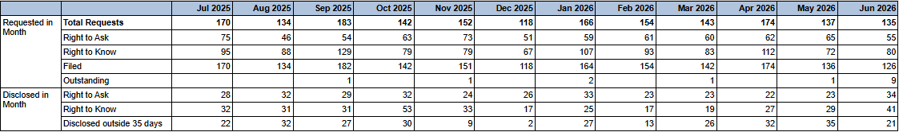

Slide 17
Excellence: an excellent police service
Force - Response times - 101 and 999 calls – JUNE
11,698 999 calls answered, 389 average per day, 82.9% answered in 10 secs, 15s average wait time
4971 received, 3764 answered - 101 Priority, 125 average per day, 3m 10s average wait time
13,273 received, 7342 answered - 101 Non-Priority, 244 average per day, 11m 7s average wait time
999 performance data | Police.uk (www.police.uk)

Slide 18
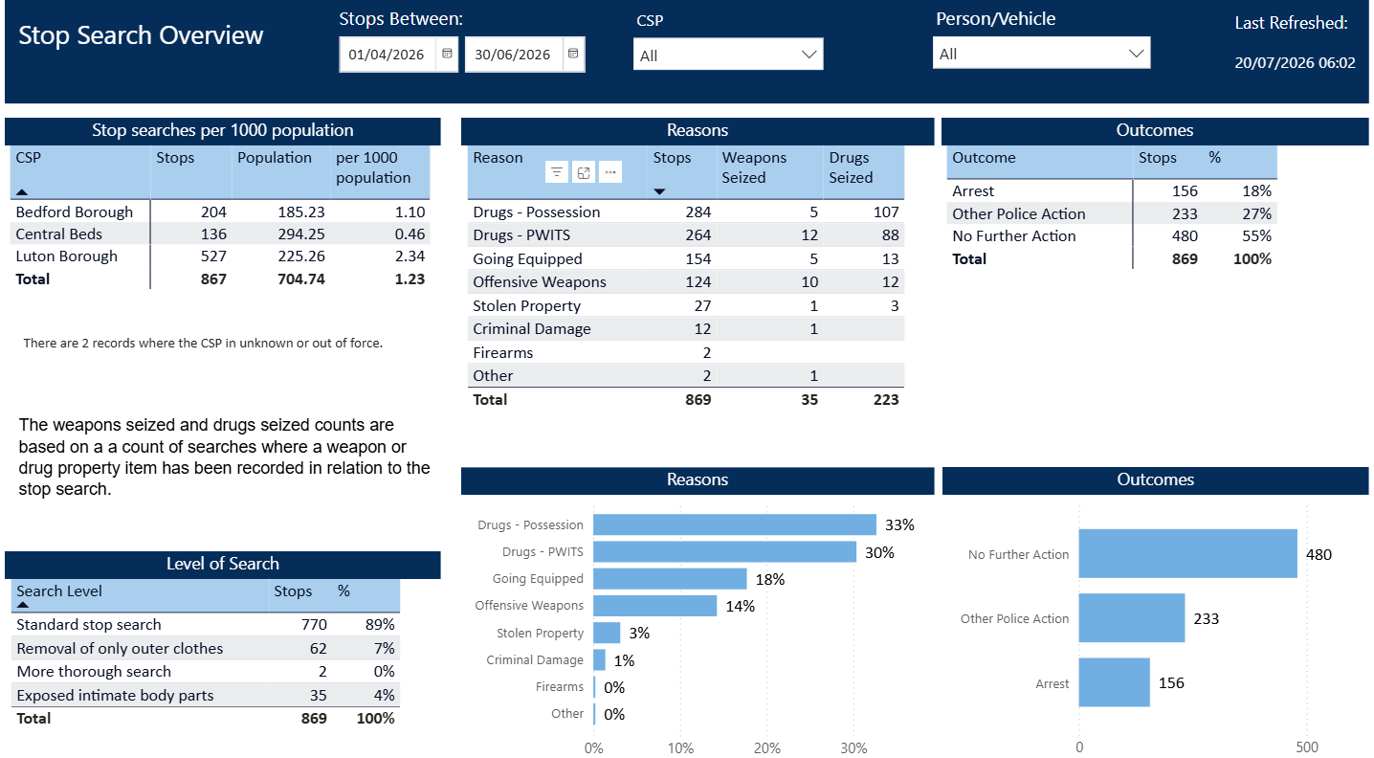
Excellence: an excellent police service
The PCC has also requested for additional information to aid transparency of the Force and they fall under different headings in line with the pledge of being Transparent.
Stop and Search Data (Q1 26-27)
Stop and search | Police.uk (www.police.uk)
Updated quarterly

Slide 19
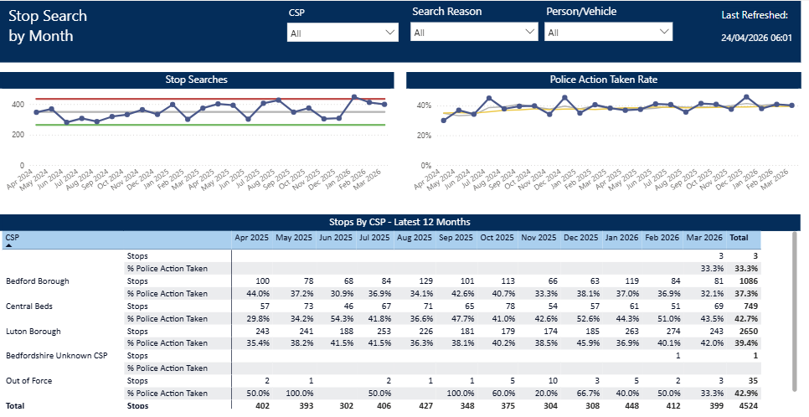
Updated quarterly

Slide 20
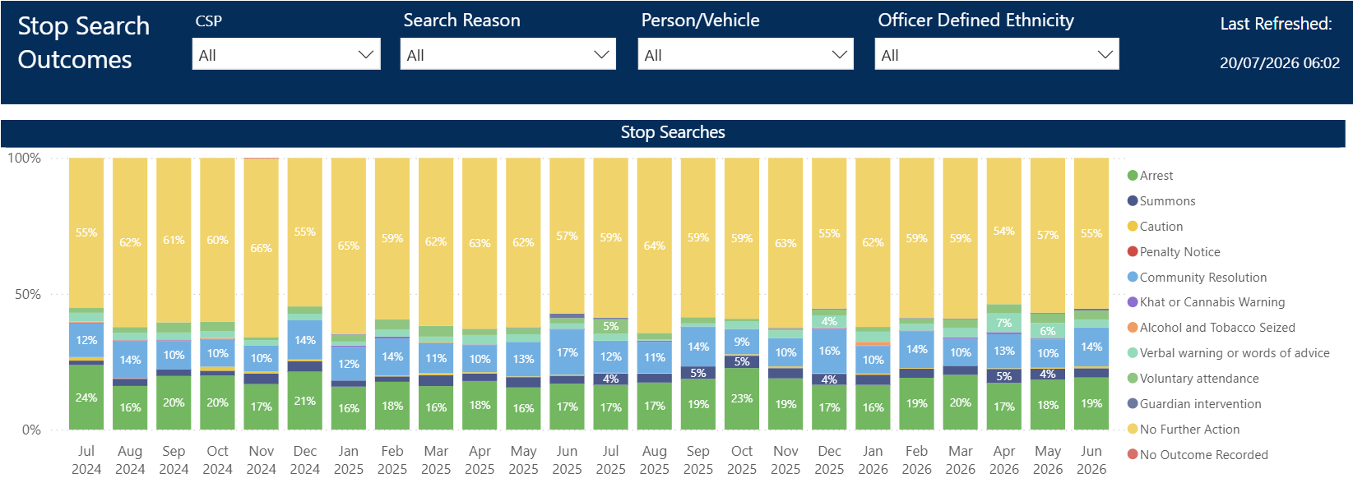
Updated quarterly

Slide 21
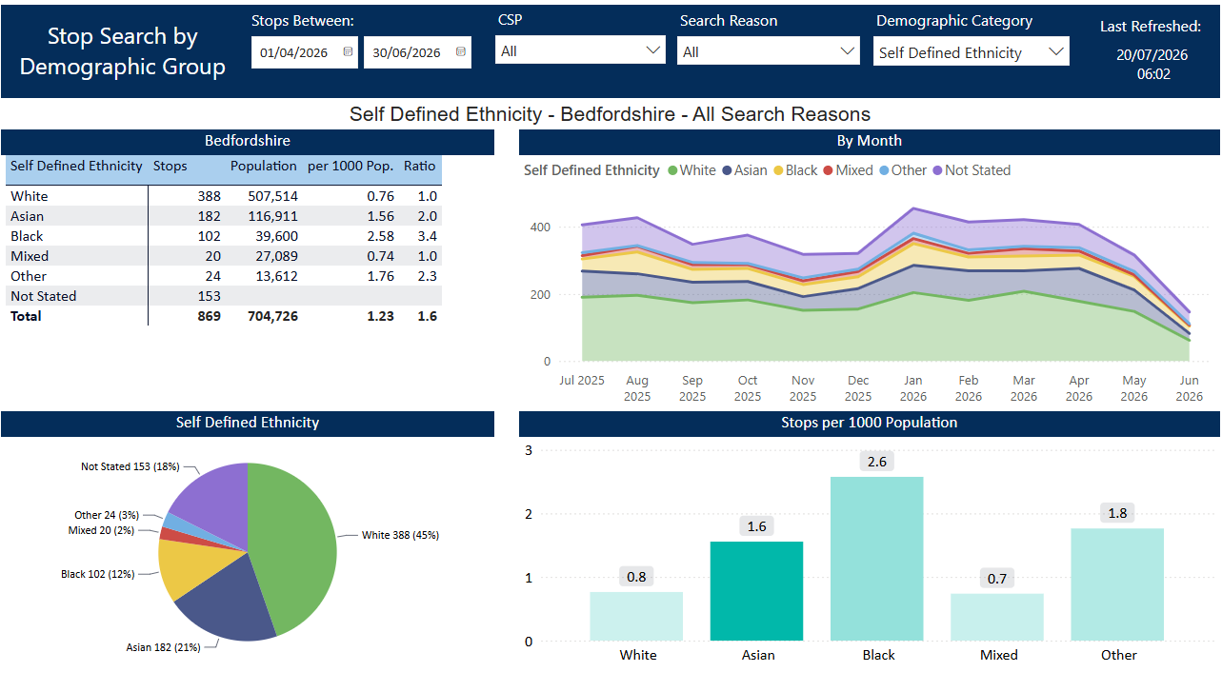
Updated quarterly

Slide 22
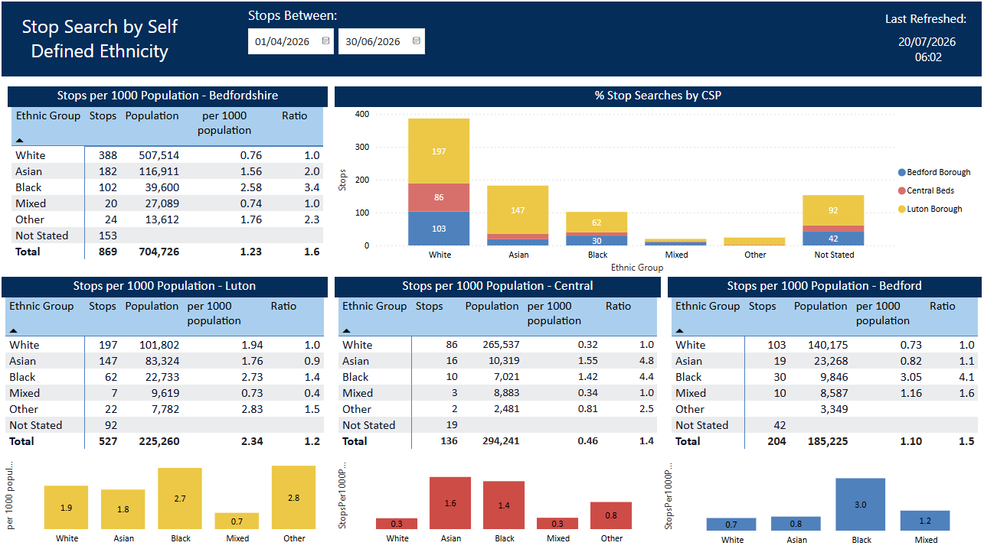
Updated quarterly

