Slide 1
Office of the Police and Crime Commissioner Information Document for
April 2025
Author: Office of the Police and Crime Commissioner
Sign Off – Force Exec : Fiona Dawson
Changed to quarterly publication in line with Performance and Governance Performance Meetings.

Slide 2
Specified Information Order
Police and Crime Commissioners (PCCs) are required to publish certain information to allow the public to hold them to account.
Section 11(1) and (2) of The Police Reform and Social Responsibility Act 2011 requires an elected local policing body to publish any information specified by the Secretary of State by order.
The Elected Local Policing Bodies (Specified Information) Order 2011 (‘the Order’) sets out the information that must be published. Guidance on the order is published on gov.uk - Guidelines for PCCs on publishing information - GOV.UK (www.gov.uk)

Slide 3
Specified Information Order
https://www.bedfordshire.pcc.police.uk/specified-information-order/

Slide 4
Specified Information Order
The Elected Local Policing Bodies (Specified Information) (Amendment) Order 2021 (’the amending Order), which will come into force on 31 May 2021 provides that information relating to the force’s performance against the Government’s national priorities for policing.
National priorities for policing
The national priorities for policing are specified in the Police and Crime Measures:
reduce murder and other homicide;
reduce serious violence;
disrupt drugs supply and county lines;
reduce neighbourhood crime;
tackle cyber crime;
and improve satisfaction among victims with a particular focus on victims of domestic abuse.

Slide 5

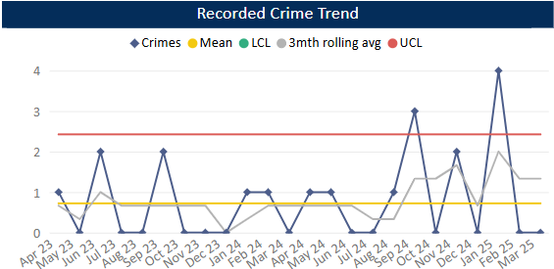
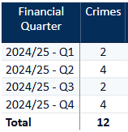
Reduce Murder and Other Homicide
Planned Action to Drive Performance
1. Homicide and joint Serious Violence reduction strategy has been collated into one and sits within the Serious Violence Board – strands include Mental Health, DA and Serious Violence.
2. The Force now has the Crest Advisory Homicide Review, and the conclusions/recommendations are being actioned via the Homicide and Serious Violence Reduction group and SV Board
3. Op Salus is the new operational name to combating Serious Violence and ASB jointly, implementing hotspot policing.
Comments
1. Four Homicides recorded in Q4, averaging around one per month in 24-25.
2. The total number of Homicides recorded in 2024-25 exceeds the number recorded in 2023-24 by 5 crimes.
This is in comparison to the previous quarter, where there were two homicides.
The force in ranked 41st for the crime rate per 1000 population in the 12mths to Jan 2025. In the OPCC report Q3 24-25 we were reporting being 33rd so have seen a deterioration in our ranking.
Caveat: this data is based on local Bedfordshire force data and may not match nationally published data (police.uk or published stats from HO)

Slide 6
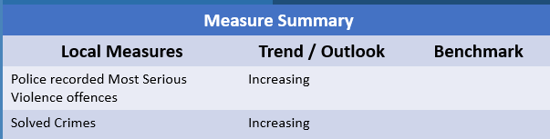
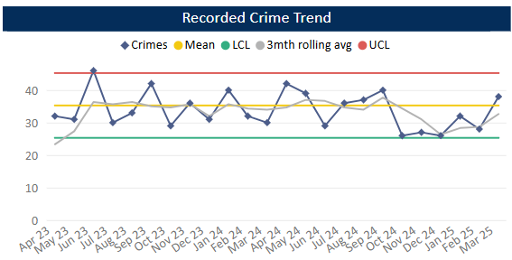
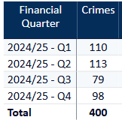
Reduce Serious Violence
Planned Action to Drive Performance
1. Quarterly review of HKC (Habitual Knife Carriers) – offenders and issues raised have been assigned to Boson, CET and CTT.
2. Implementation of the Knife Crime quarterly review.
3. Specific issues raised at Force Tasking Meeting including firearms discharges (Op Broadway) and Knife enabled theft of motorbikes so work and actions can be taken forward.
4. Working with the NHS to gain access to data relating to admissions and A&E attendances where Serious Violence may be the cause.
Comments
1. Most Serious Violence levels reduced during Q3 but have risen in Q4 and are now around the average. They are averaging 33 crimes per month.
2. Levels have been below average during Jan and Feb but rose to above average in March.
3. Beds is just below the MSG average.
Caveat: this data is based on local Bedfordshire force data and may not match nationally published data (police.uk or published stats from HO)

Slide 7
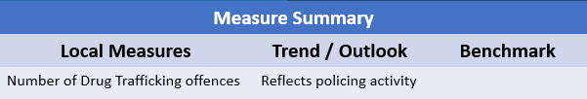
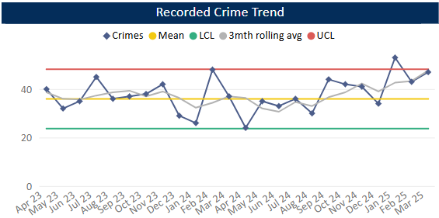
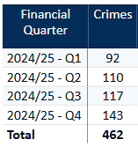
Disrupt Drugs Supply and County Lines
Planned Action to Drive Performance
1. Op COSTELLO dedicate team continues to enforce on large scale drug activity, with key focus on the professional enablers, linking into SOC
2. Op Joule scanning will continue in order to identify new lines.
3. The Drugs Focus Desk is now up and running and ensuring the Force has a focus on drug offences, particularly PWITS.
Trafficking of Drugs
Comments
1. Q4 recorded 143 Trafficking of Drugs offences, averaging 39 crimes per month in 24/25. This is up on the previous quarter and on same time last year. Trafficking offences reflects proactive police activity.
2. Bedfordshire currently has 17 OCGs – this is a decrease on Q3 24-25 where 19 were recorded. The number of Street Gangs has remained stable at 14 (as at April 25).
3. Currently there are 71 groups operating 72 county lines.
Caveat: this data is based on local Bedfordshire force data and may not match nationally published data (police.uk or published stats from HO)
There has been a lot of change over the past few months with some OCGs being archived.

Slide 8
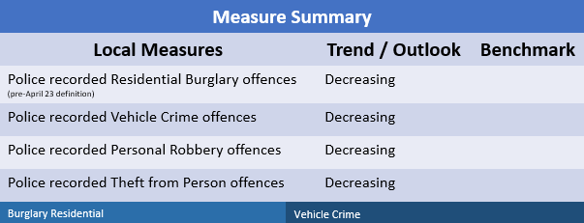
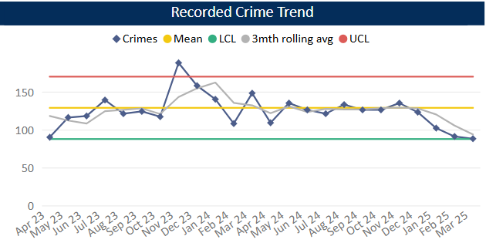
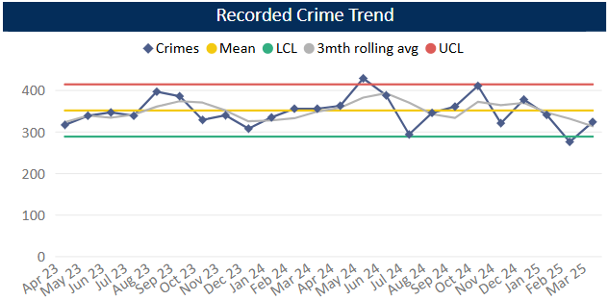
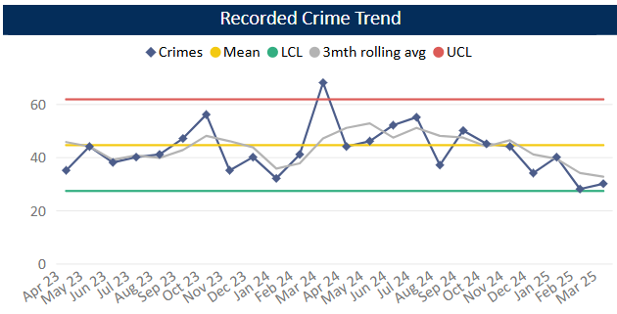
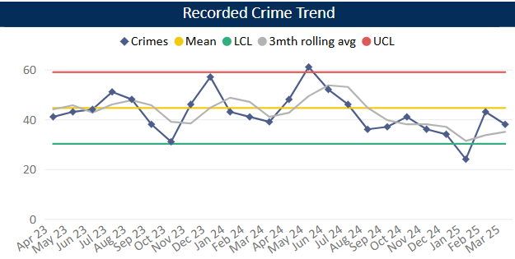
Reduce Neighbourhood Crime
Planned Action to Drive Performance
1. The Force has invested in POP training for analysts and some officers. We have worked alongside CCEBP to embed this training. Projects include Robberies in Luton Town Centre and Residential Burglary in Brook Street.
2. Op Belleville is a current force priority – HSG in Bedford supported by problem profile, development work and warrants being executed.
3. Op Despan – identifying vehicles frequently using the ANPR network with a view to ID vehicles involved in criminality, particularly Drug supply.
Burglary Residential
Vehicle Crime
Comments
1. Q4 recorded 281 Residential Burglaries averaging 118 crimes a month 24/25. This is lower than the previous quarter and below the same period in the previous year. Solved rate for Q4 24-25 was 13.9%.
2. Vehicle Crime has decreased compared to Q3, but comparable with previous quarters. Average 352 crimes per month 24/25. The solved rate has remained stable across the whole 24/25 year.
3. Personal Robbery has decreased compered to Q3. Q4 was lower than the same quarter in the 23-24 year. Average 42 crimes per month 24/25. Solved rate for Q4 24-25 was 12.2%.
4. 105 Theft from a Person during Q4, this is a decrease compared to Q3 and below this time in the previous year. Levels have been below average across the quarter as a whole.
Personal Robbery
Theft from Person

Slide 9
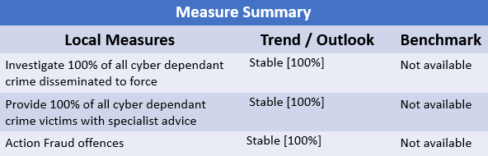
Tackle Cyber Crime
Planned Action to Drive Performance
1. The Cyber CPD that took place in February was attended by 60 colleagues from various business areas. Additionally, DMI and DFE's have attended two patrol training days to upskill/update in relation to best process at scene.
2. Cyber clinics are being arranged at both HQ and Luton – these are still being arranged but will be in place from next month. DMI and DFE representatives were present at the Workload Improvement Network on 24th April - good feedback received which reinforced the requirement for the 'clinics' to be set up.
3. In relation to Op Soteria, as of 1st April, additional support is now being provided to officers in RASSO to help with digital strategies.
Comments
The Cyber Security Advisor appeared on BBC 3 Counties Radio following a rise in Op Bromley offences (courier fraud targeting the elderly and vulnerable) and had a Q&A session with the presenter raising awareness and providing advice to potential future victims. This then generated a phone in piece where members of the public made contact and discussed their experiences/concerns.

Slide 10
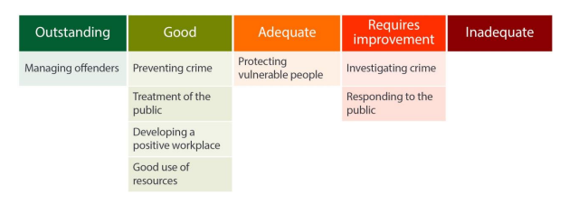
Specified Information Order
HMICFRS reporting
The amending Order requires PCCs to publish the most recent HMICFRS force-level report on the effectiveness, efficiency and legitimacy of the police force.
The Order requires that PCCs publish the PEEL report for their force on their website, within one calendar month of its publication by HMICFRS.
https://www.bedfordshire.pcc.police.uk/hmic-reports/

Slide 11
Specified Information Order
Complaints handling
The Order provides that PCCs must publish the most recent IOPC quarterly complaints data for their force and the IOPC annual statistics report, alongside a narrative setting out how the PCC is holding the chief officer to account, and the PCC’s assessment of their own performance in carrying out their other complaints handling functions.
Holding the chief officer to account
It is recommended that the narrative should include:
• How the force is measuring complainant satisfaction.
• Progress updates on implementing relevant recommendations made by the IOPC and/or HMICFRS in relation to complaints handling, or where recommendations were not accepted an explanation as to why.
• A summary of any mechanisms put in place to identify and act on themes or trends in complaints.
• A summary of systems in place to monitor and improve performance in the timeliness of complaints handling.
• The number of written communications issued by the force under regulation 13 of the Police (Complaints and Misconduct) Regulations 2020 where an investigation has not been completed within a “relevant period”.
• Quality Assurance mechanisms in place to monitor and improve the quality of its responses to complaints.
• Details of the administrative arrangements the PCC has put in place to hold the chief constable to account for complaints handling e.g. frequency of meetings and a summary of discussions.

Slide 12
Specified Information Order
Complaints handling
https://www.bedfordshire.pcc.police.uk/complaints-handling/
https://www.bedfordshire.pcc.police.uk/holding-force-to-account/

Slide 13
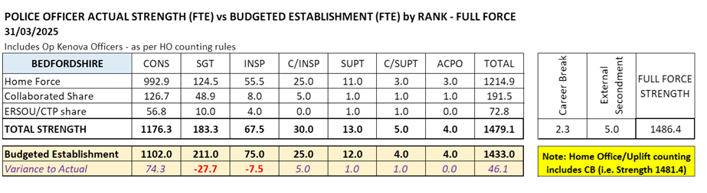
Reinvigorating local policing
Recruitment and Retention Numbers:
Police and Crime Commissioners have statutory responsibilities for delivering an efficient and effective police service. Our efficiency and effectiveness improves when the right level of resources are available and maximised.
The PCC wishes for his office to publish the monthly figures of the recruitment of officers.

Slide 14
Reinvigorating local policing
Recruitment and Retention Numbers:
Position Category | Total Starters Headcount | Starters (people from ethnic minority backgrounds) Headcount |  | Starters Female Headcount |  | Starters Under 24 Headcount |  | Starters 45+ Headcount |  | Starters (Declared Disability) Headcount
Officer | 29 | 1 | 3.45% | 8 | 27.59% | 12 | 41.38% | 0 | 0.00% | 1 | 3.45%
Staff | 8 | 1 | 12.50% | 5 | 62.50% | 2 | 25.00% | 3 | 37.50% | 1 | 12.50%
Special | 0 | 0 | 0.00% | 0 | 0.00% | 0 | 0.00% | 0 | 0.00% | 0 | 0.00%
SUM: | 37 | 2 | 5.41% | 13 | 35.14% | 14 | 37.84% | 3 | 8.11% | 2 | 5.41%
Position Category | Total Leavers Headcount | Leavers (people from ethnic minority backgrounds) Headcount |  | Leavers Female Headcount |  | Leavers Under 24 Headcount |  | Leavers 45+ Headcount |  | Leavers (Declared Disability) Headcount
Officer | 6 | 1 | 16.67% | 3 | 50.00% | 2 | 33.33% | 1 | 16.67% | 0 | 0.00%
Staff | 15 | 2 | 13.33% | 8 | 53.33% | 2 | 13.33% | 7 | 46.67% | 5 | 33.33%
Special | 1 | 1 | 100.00% | 0 | 0.00% | 0 | 0.00% | 0 | 0.00% | 0 | 0.00%
SUM: | 22 | 4 | 18.18% | 11 | 50.00% | 4 | 18.18% | 8 | 36.36% | 5 | 22.73%

Slide 15
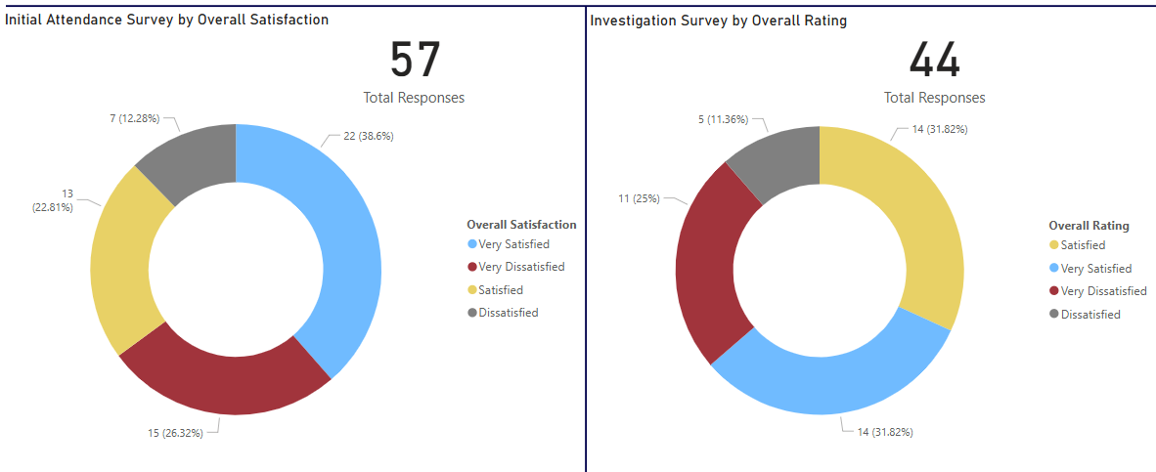
Victims at centre of the CJS
The PCC has requested information form the Force on a monthly basis surrounding Victim Satisfaction and how the Force deals with this and monitors this.
Victim Satisfaction
During March 2025, 57 Initial Attendance Surveys were completed and 44 Investigation Surveys.
Initial Attendance Surveys - 60.4% satisfaction rate. (Very satisfied + satisfied)
Investigation Surveys - 63.6% satisfaction rate.
MARCH

Slide 16
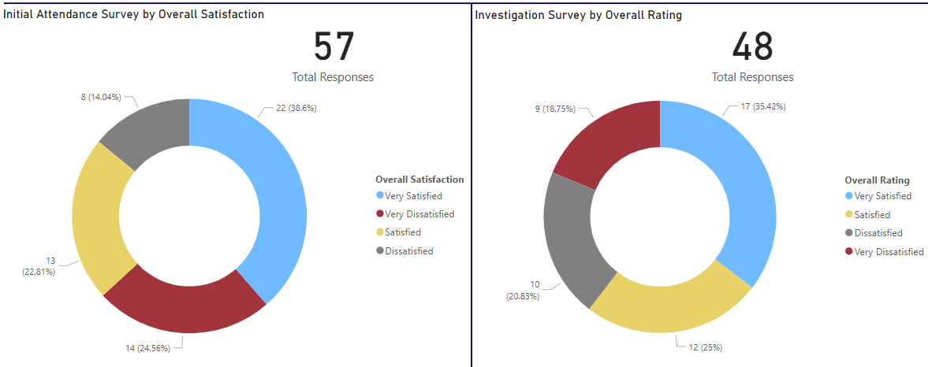
Victims at centre of the CJS
The PCC has requested information form the Force on a monthly basis surrounding Victim Satisfaction and how the Force deals with this and monitors this.
Victim Satisfaction
During February 2025, 57 Initial Attendance Surveys were completed and 48 Investigation Surveys. Initial Attendance Surveys - 61.4% satisfaction rate. (Very satisfied + satisfied). Investigation Surveys - 60.4% satisfaction rate.
FEBRUARY

Slide 17
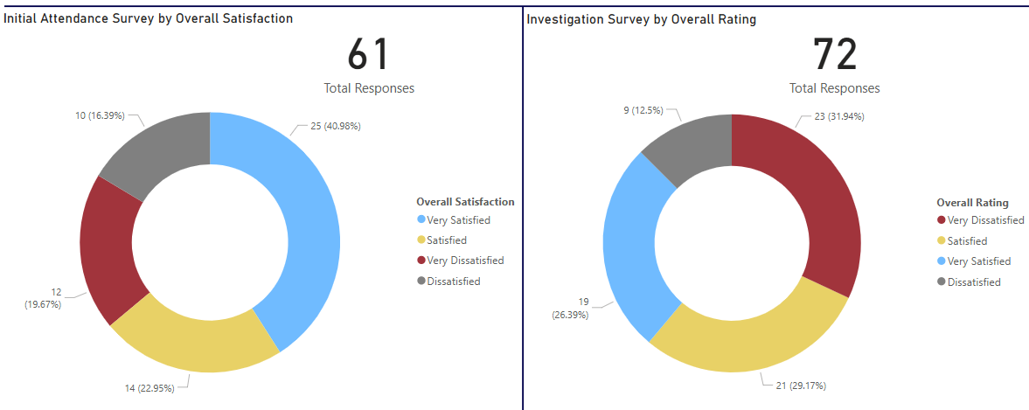
Victims at centre of the CJS
The PCC has requested information form the Force on a monthly basis surrounding Victim Satisfaction and how the Force deals with this and monitors this.
Victim Satisfaction
During January 2025, 61 Initial Attendance Surveys were completed and 72 Investigation Surveys. Initial Attendance Surveys - 63.9% satisfaction rate. (Very satisfied + satisfied). Investigation Surveys - 55.6% satisfaction rate.

Slide 18
Victims at centre of the CJS
The PCC has requested information form the Force on a monthly basis surrounding Victim Satisfaction and how the Force deals with this and monitors this.
The force is developing its IT solution to automated victim satisfaction surveys and this is progressing well against the project plan. In the meantime, the force has limited capacity to complete such surveys, however can report:
Victim Dissatisfaction
Orange – Enquiries Recorded
Blue - Dissatisfaction Recorded

Slide 19
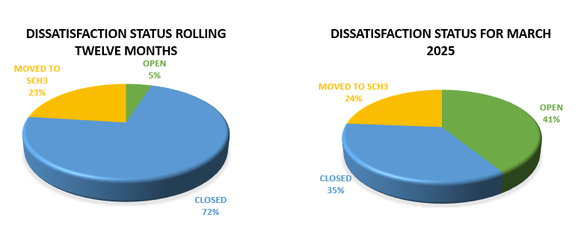
Victims at centre of the CJS.
Victim Dissatisfaction

Slide 20
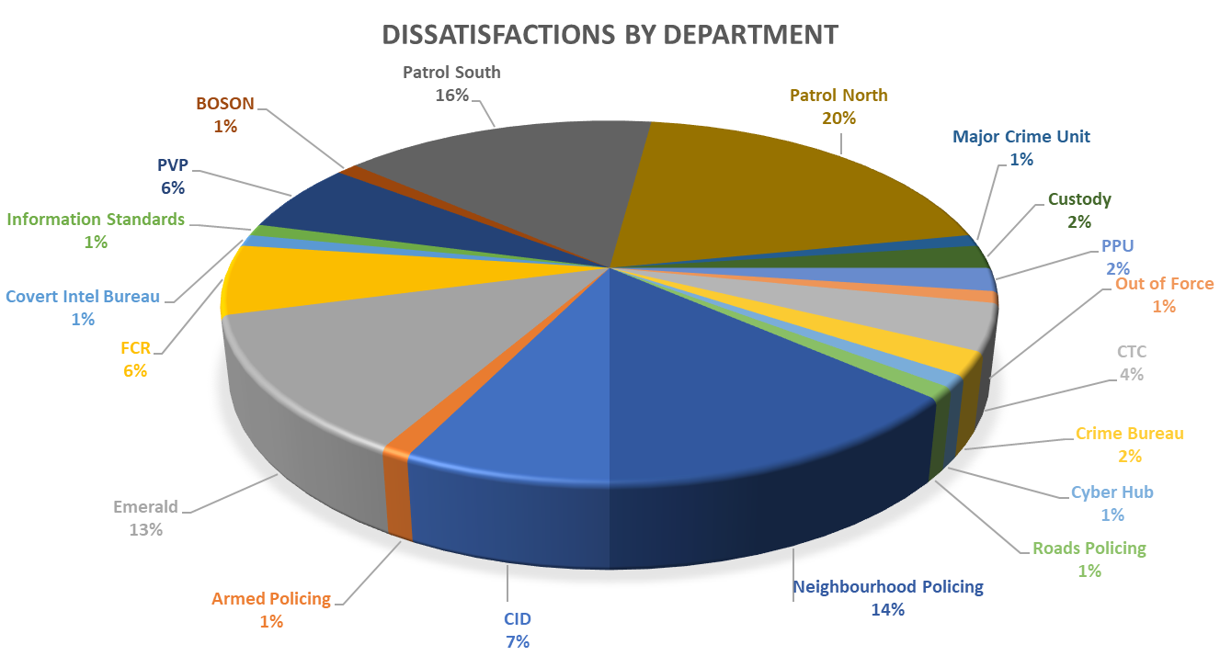
Victims at centre of the CJS
Victim Dissatisfaction

Slide 21
Victims at centre of the CJS
Victim Dissatisfaction

Slide 22
Victims at centre of the CJS
Victim Dissatisfaction

Slide 23
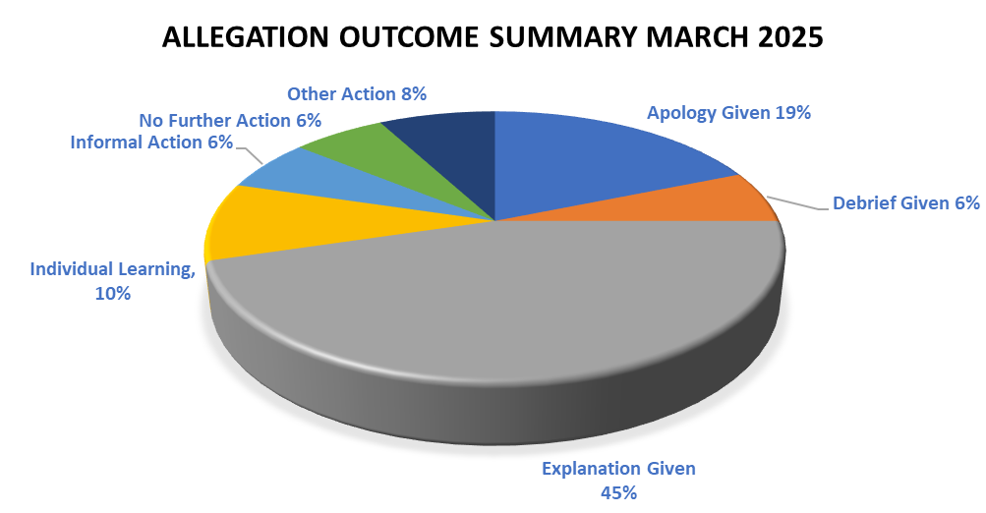
Victims at centre of the CJS
Victim Dissatisfaction

Slide 24
Victims at centre of the CJS
Victim Dissatisfaction

Slide 25
Victims at centre of the CJS
Victim Dissatisfaction

Slide 26
Victims
The PCC has also requested for additional information to aid transparency of the Force and they fall under different headings in line with the pledge of being Transparent.
The PCC pledged that he would ensure that appropriate services are in place for victims within the power of the OPCC.
Clare’s Law
The Domestic Violence Disclosure Scheme(DVDS), also known as “Clare’s Law” enables the police to disclose information to a victim or potential victim of domestic abuse about their partner’s or ex-partner’s previous abusive or violent offending.
Clare's Law - number of requests and average length of time to respond to requests are on the next slide.

Slide 27
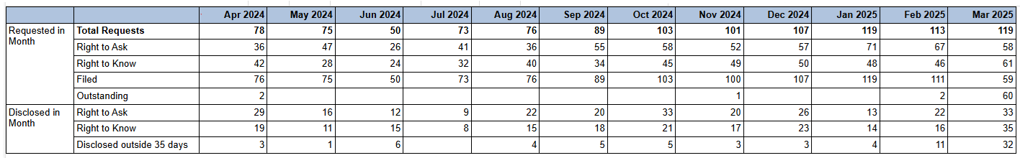
Table of Clares Law Requests

Slide 28
Excellence: an excellent police service
Force - Response times - 101 and 999 calls, March 2025
8,835 - 999 call answered, 316 average per day, 92.3% answered in 10 secs, 4s average wait time
3,060 - 101 Priority, 109 average per day, 1m 57s average wait time
5,539 - 101 Non-Priority, 198 average per day, 6m 12s average wait time
999 performance data | Police.uk (www.police.uk)

Slide 29
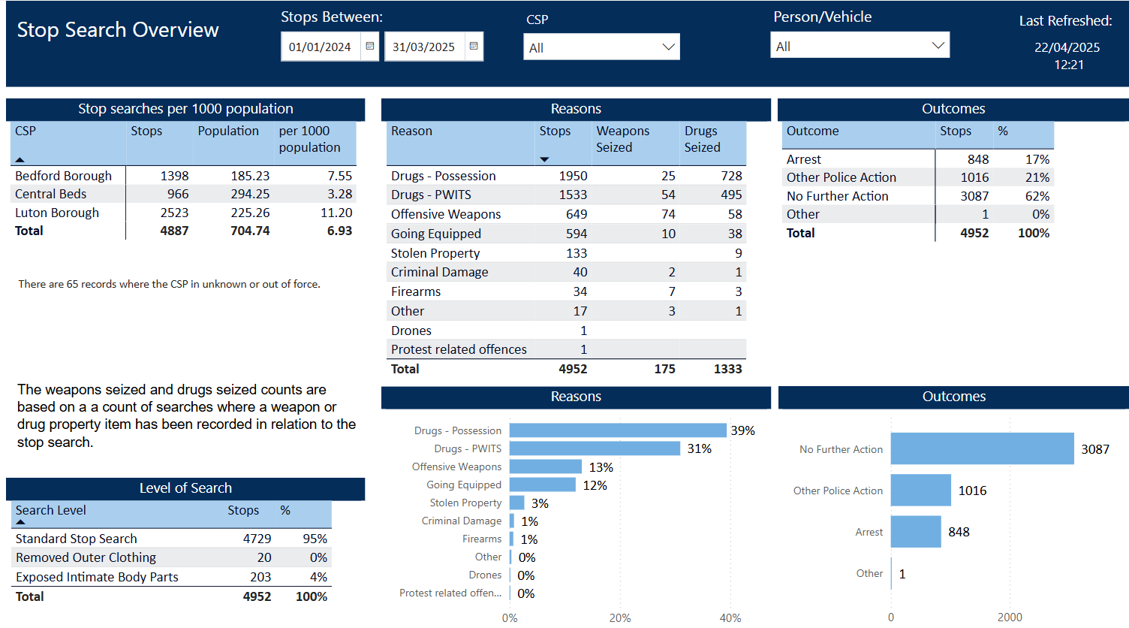
Excellence: an excellent police service
The PCC has also requested for additional information to aid transparency of the Force and they fall under different headings in line with the pledge of being Transparent.
Stop and Search Data (Q4)
Stop and search | Police.uk (www.police.uk)
Updated quarterly

Slide 30
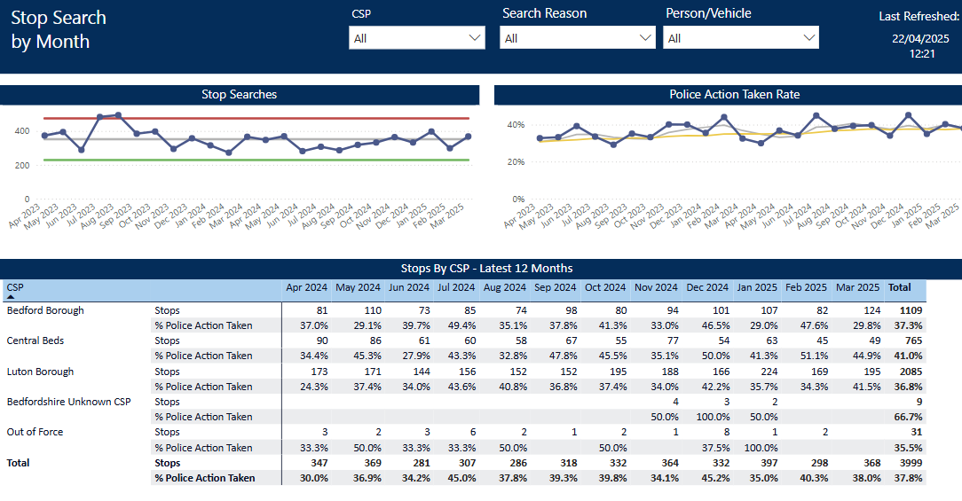
Updated quarterly

Slide 31
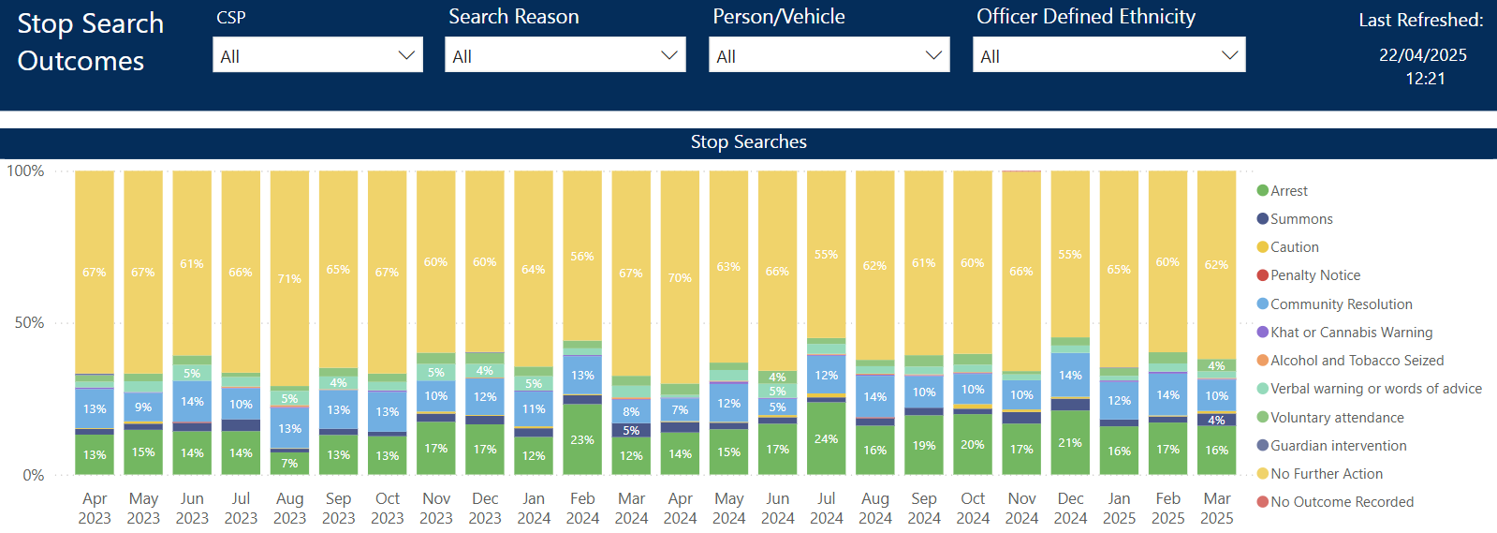
Updated quarterly

Slide 32
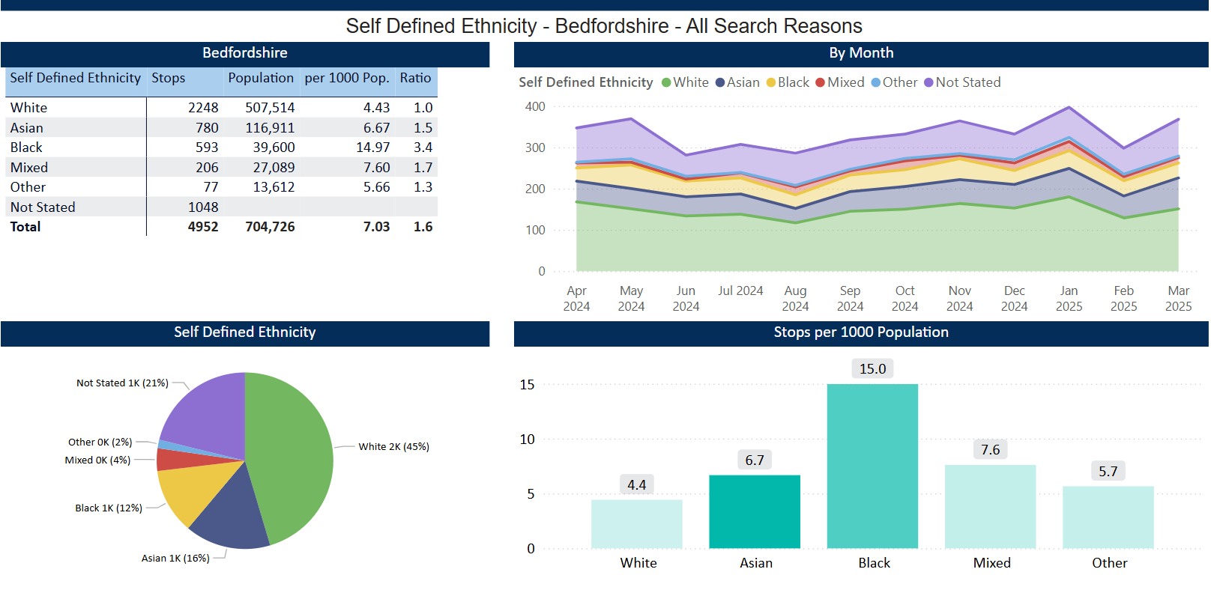
Updated quarterly

Slide 33
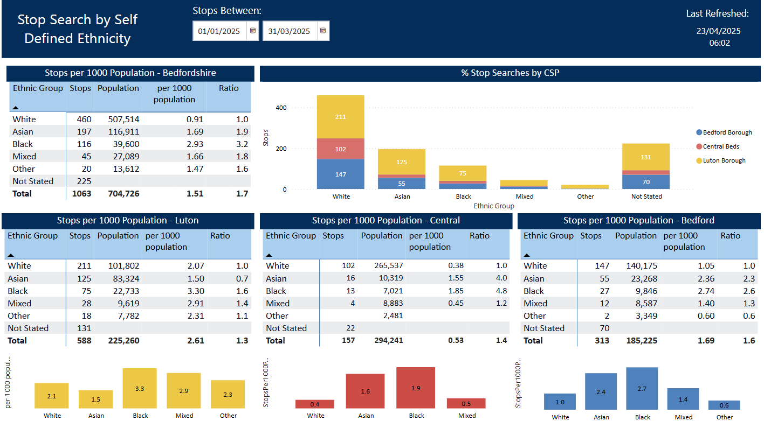
Updated quarterly

