Slide 1
Office of the Police and Crime Commissioner Information Document for
April 2026
Author: Office of the Police and Crime Commissioner
Sign Off – Force Exec : Katy Watts
Changed to quarterly publication in line with Performance and Governance Performance Meetings.

Slide 2
Specified Information Order
Police and Crime Commissioners (PCCs) are required to publish certain information to allow the public to hold them to account.
Section 11(1) and (2) of The Police Reform and Social Responsibility Act 2011 requires an elected local policing body to publish any information specified by the Secretary of State by order.
The Elected Local Policing Bodies (Specified Information) Order 2011 (‘the Order’) sets out the information that must be published. Guidance on the order is published on gov.uk - Guidelines for PCCs on publishing information - GOV.UK (www.gov.uk)

Slide 3
Specified Information Order
https://www.bedfordshire.pcc.police.uk/specified-information-order/

Slide 4
Specified Information Order
The Elected Local Policing Bodies (Specified Information) (Amendment) Order 2021 (’the amending Order), which will come into force on 31 May 2021 provides that information relating to the force’s performance against the Government’s national priorities for policing.
National priorities for policing
The national priorities for policing are specified in the Police and Crime Measures:
reduce murder and other homicide;
reduce serious violence;
disrupt drugs supply and county lines;
reduce neighbourhood crime;
tackle cyber crime;
and improve satisfaction among victims with a particular focus on victims of domestic abuse.

Slide 5
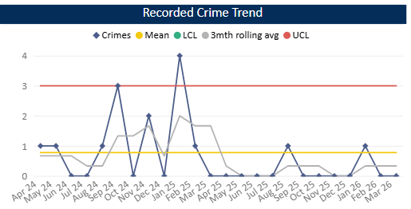
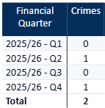
Reduce Murder and Other Homicide
Measure Summary
Local Measures | Trend / Outlook | Benchmark
Police recorded Homicide offences | Improving
Planned Action to Drive Performance
1. Homicide and joint Serious Violence reduction strategy has been collated into one and sits within the Serious Violence Board – strands include Mental Health, DA and Serious Violence.
2. The end of year position for Op Salus shows that we met the annual target for patrol hours. Various prevention work was carried out including 435 arrests and 535 stops (in the year as a whole).
Comments
1. There was one Homicide recorded in Q4 25-26.
2. By comparison, in the same period last year, we recorded 5 homicides.
This is in comparison to the previous quarter, where there were no homicides recorded.
The force in ranked 8th for the Homicide crime rate per 1000 population in the 12mths to Jan 2026. This means our homicide rate has reduced since the last update.
Caveat: this data is based on local Bedfordshire force data and may not match nationally published data (police.uk or published stats from HO)

Slide 6
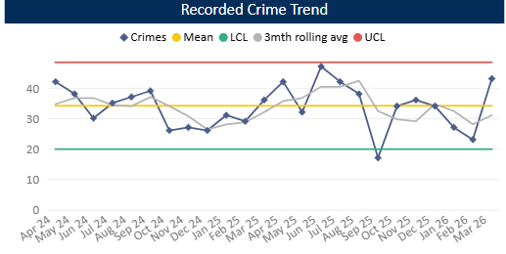
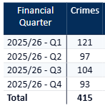
Reduce Serious Violence
Measure Summary
Local Measures | Trend / Outlook | Benchmark
Police recorded Most Serious Violence offences | Decreasing
Solved Crimes | Decreasing
Planned Action to Drive Performance
1. Habitual Knife Carriers is refreshed quarterly. We will be looking at implementing a new methodology soon.
2. Knife Crime Concentration Fund – 4 hotspots identified, 2 in Luton and 2 in Bedford. Geographical analysts assigned to each.
3. Op Pencils identified as a force priority – Wymington nominals involved in cross-border violence offences with Northants.
Comments
1. Most Serious Violence levels decreased during Q4 and are now just above the average (having increased in March 2026). It should be noted that Q2 was exceptionally low compared to previous quarters. The average for Q4 is 31 crimes per month.
2. Levels were previously below average from Oct 24 to Feb 25 but rose to above average from March – Aug 25. As mentioned above levels were exceptionally low in Q2 25-26 and decreased further in Q4.
3. Beds is equal to the MSG average.
Caveat: this data is based on local Bedfordshire force data and may not match nationally published data (police.uk or published stats from HO)

Slide 7
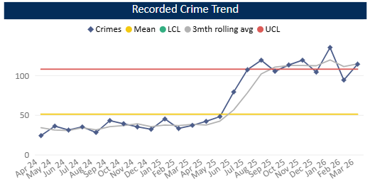
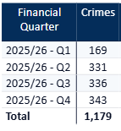
Disrupt Drugs Supply and County Lines
Measure Summary
Local Measures | Trend / Outlook | Benchmark
Number of Drug Trafficking offences | Reflects policing activity
Planned Action to Drive Performance
1. Op COSTELLO – this is a dedicated team which works on enforcements for large scale drug activity. A key focus for the team is professional enablers, linking into SOC.
2. Scanning processes continue as business as usual in order to identify new lines.
3. The work covered by the Drugs Focus Desk has now moved to CID following the merger of the CID and Emerald Teams. Increased demand particularly in relation to PWITS offences did occur in the short term but has now stabilised.
Trafficking of Drugs
Comments
1. Q4 recorded 343 Trafficking of Drugs offences, averaging 114 crimes per month in the quarter This is up on the previous quarter and on the same time last year. Trafficking offences tend to reflect proactive police activity however some of this increase will be in relation to the recording of FAST Parcels.
2. Bedfordshire currently has 21 mapped OCGs – this has decreased since last quarter. The number of Street Gangs has remained at 9 (as at Apr 26).
3. Currently there are 60 county lines. This significant decrease from the last quarter is due to enforcement and archiving, partially due to the recent County Lines Intensification week.
Caveat: this data is based on local Bedfordshire force data and may not match nationally published data (police.uk or published stats from HO)

Slide 8
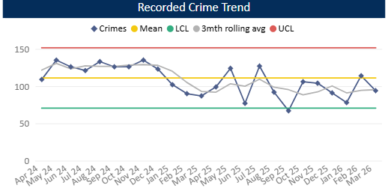
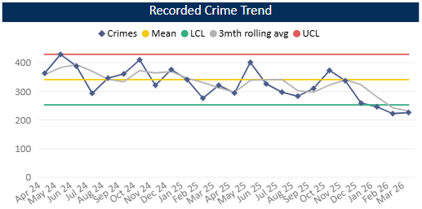
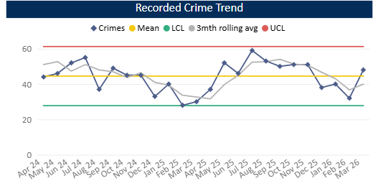
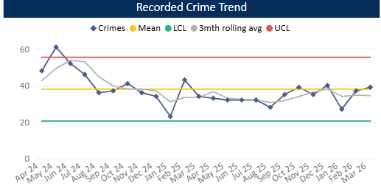
Reduce Neighbourhood Crime
Measure Summary
Local Measures | Trend / Outlook | Benchmark
Police recorded Residential Burglary offences (pre-April 23 definition) | Stable
Police recorded Vehicle Crime offences | Decreasing
Police recorded Personal Robbery offences | Decreasing
Police recorded Theft from Person offences | Stable
Planned Action to Drive Performance
1. Op Cautela – force priority closed at last FTTCG, relating to a series of overnight burglaries affecting the south of the county, mostly Luton.
2. Op Bodyline – current force priority regarding robberies in Luton, particularly with e-scooters being targeted or used by offenders.
Burglary Residential
Vehicle Crime
Comments
1. In Q4 286 Residential Burglaries were recorded, averaging 95 crimes a month. This is the same as Q2 but is above the same period in the previous year. Solved rate for Q4 25-26 was 4.5%.
2. Vehicle Crime has decreased compared to Q3. The average in Q4 is 230 crimes per month. The solved rate was 2.5%.
3. Personal Robbery has decreased compared to Q3. Q4 was higher (by around 20 crimes) than the same quarter in the 24-25 year. The average was 40 crimes per month in Q4 25-26 and the solved rate was 9.2%.
4. 103 Theft from a Person crimes were recorded during Q4, this is an decrease compared to Q3 and is slightly above this time last year. Levels have been around the average across the quarter as a whole.
Personal Robbery
Theft from Person

Slide 9
Tackle Cyber Crime
Measure Summary
Local Measures | Trend / Outlook | Benchmark
Investigate 100% of all cyber dependant crime disseminated to force | Stable [100%] | Not available
Provide 100% of all cyber dependant crime victims with specialist advice | Stable [100%] | Not available
Action Fraud offences | Stable [100%] | Not available
Planned Action to Drive Performance
1. Project Darklink continues to drive investigations into the grey market online and has expanded to targeted open source work. This resulted in the removal of a TikTok account of an individual who had been arrested in the Met for a racially motivated public order offence. This follows a fraud offence whereby he made a prank call to a vulnerable adult purporting to be a police officer. This male is a resident of Bedfordshire and known as a 'prankster/content creator' with a TikTok following of over 3 million. He was interviewed re the fraud offence and made a full admission, showing remorse for his actions.
2. Cyber presentations have been provided by the DMI's to teams across the organisation - highlighting how their skills can support investigations and widening the understanding of opportunities and tactics. This has resulted in an uplift in requests for support
3. The team carried out 21 engagements overall
Protect Engagements Q4 25-26
Delivered Protect advice to 406 victims An event at Marston Forest Centre for School Safeguarding Leads, providing awareness and encouraging reporting of talented Cyber nominals on the cusp of offending, to an audience of 100. The Bedfordshire Cyber Security team delivered a dedicated SME focused Cyber Roadshow on 4 March, providing practical, accessible guidance tailored to the needs of small and medium sized enterprises. Throughout the event, SMEs engaged with interactive demonstrations, learned about the cyber threats most commonly targeting smaller organisations, and received hands on advice to help strengthen their security posture. Key topics included phishing, password hygiene, secure device management, and understanding affordable protective measures.

Slide 10
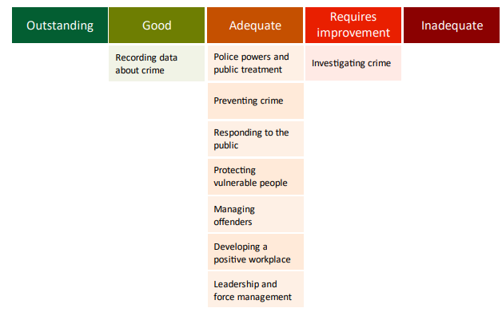
Specified Information Order
HMICFRS reporting
The amending Order requires PCCs to publish the most recent HMICFRS force-level report on the effectiveness, efficiency and legitimacy of the police force.
The Order requires that PCCs publish the PEEL report for their force on their website, within one calendar month of its publication by HMICFRS.
https://www.bedfordshire.pcc.police.uk/hmic-reports/

Slide 11
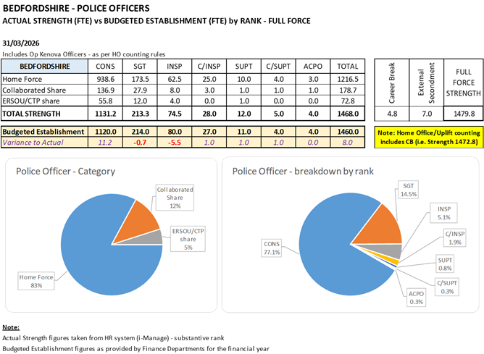
Reinvigorating local policing
Recruitment and Retention Numbers:
Police and Crime Commissioners have statutory responsibilities for delivering an efficient and effective police service. Our efficiency and effectiveness improves when the right level of resources are available and maximised.
The PCC wishes for his office to publish the monthly figures of the recruitment of officers.

Slide 12
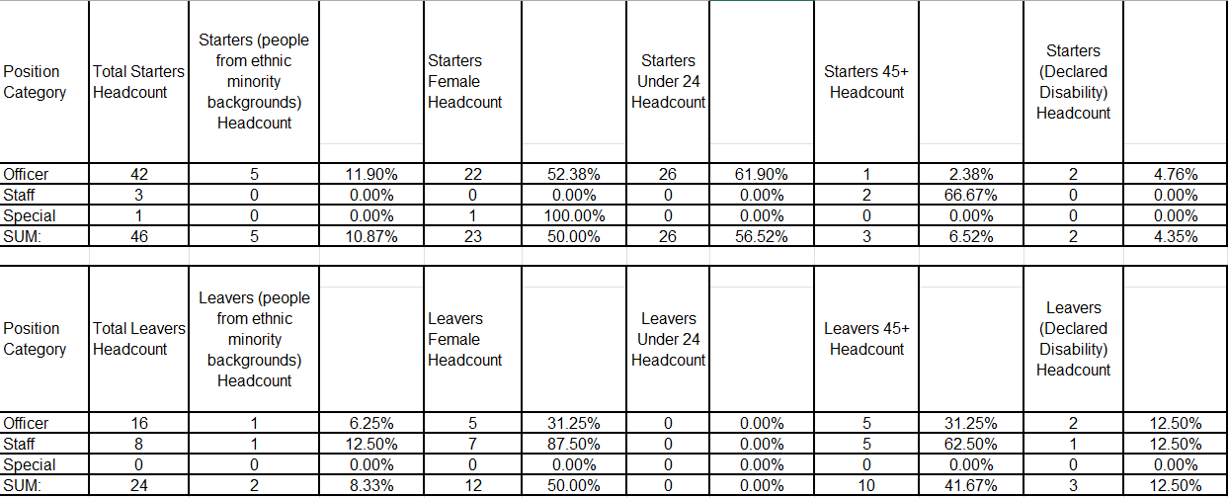
Reinvigorating local policing
Recruitment and Retention Numbers:

Slide 13
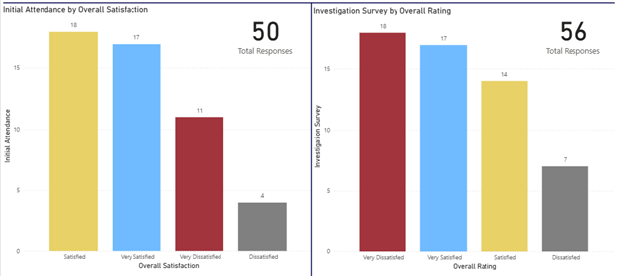
Victims at centre of the CJS
The PCC has requested information form the Force on a monthly basis surrounding Victim Satisfaction and how the Force deals with this and monitors this.
Victim Satisfaction
January
During January 2026, 50 Initial attendance surveys were completed alongside 56 Investigation surveys.
Initial Attendance – 70% Satisfaction rate (Very Satisfied + Satisfied)
Investigation – 55% Satisfaction rate

Slide 14
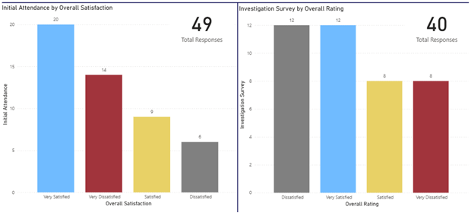
Victims at centre of the CJS
Victim Satisfaction
During February 2026, 49 Initial attendance surveys were completed alongside 40 Investigation surveys.
Initial Attendance – 59% Satisfaction rate (Very Satisfied + Satisfied)
Investigation – 50% Satisfaction rate

Slide 15
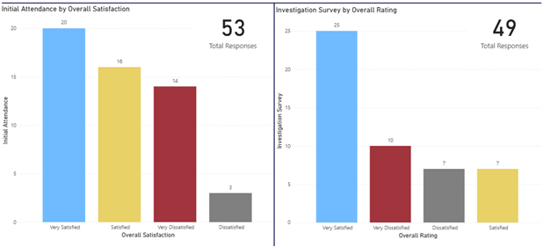
Victims at centre of the CJS
Victim Satisfaction
March
During March 2026, 53 Initial attendance surveys were completed alongside 49 Investigation surveys.
Initial Attendance – 68% Satisfaction rate (Very Satisfied + Satisfied)
Investigation – 65% Satisfaction rate

Slide 16
Victims
The PCC has also requested for additional information to aid transparency of the Force and they fall under different headings in line with the pledge of being Transparent.
The PCC pledged that he would ensure that appropriate services are in place for victims within the power of the OPCC.
Clare’s Law
The Domestic Violence Disclosure Scheme(DVDS), also known as “Clare’s Law” enables the police to disclose information to a victim or potential victim of domestic abuse about their partner’s or ex-partner’s previous abusive or violent offending.
Clare's Law - number of requests and average length of time to respond to requests are on the next slide.

Slide 17
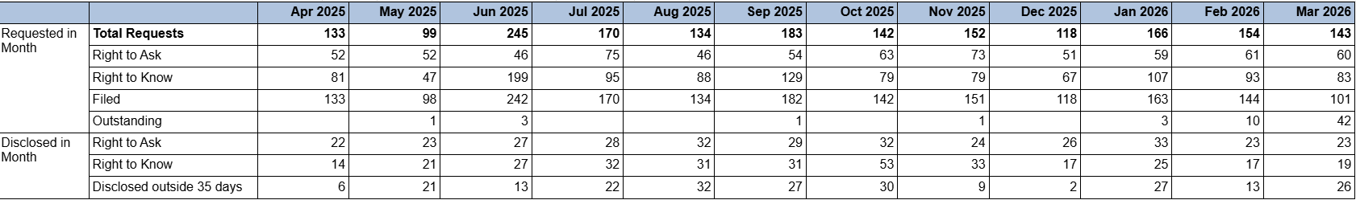
Clare’s Law requests

Slide 18
Excellence: an excellent police service
Force - Response times - 101 and 999 calls – MARCH
10,143 - 999 call answered, 327 average per day, 92.8% answered in 10 secs, 4s average wait time
4154 received, 2949 answered - 101 Priority, 95 average per day, 2m 22s average wait time
12,168 received, 3652 answered - 101 Non-Priority, 118 average per day, 9m 13s average wait time
999 performance data | Police.uk (www.police.uk)

Slide 19
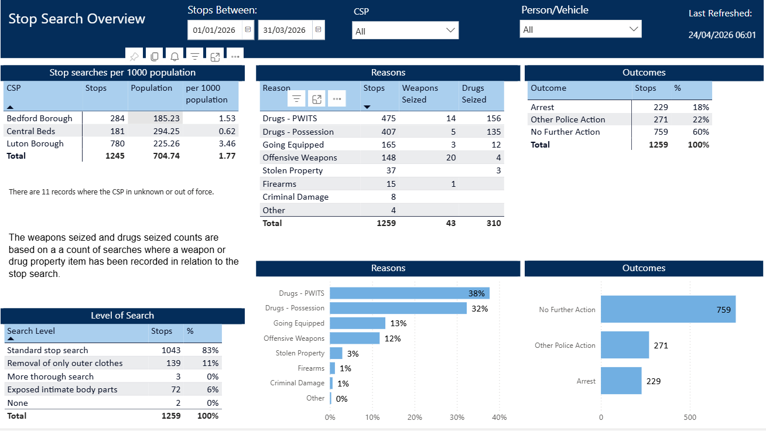
Excellence: an excellent police service
The PCC has also requested for additional information to aid transparency of the Force and they fall under different headings in line with the pledge of being Transparent.
Stop and Search Data (Q4 25-26)
Stop and search | Police.uk (www.police.uk)
Updated quarterly

Slide 20
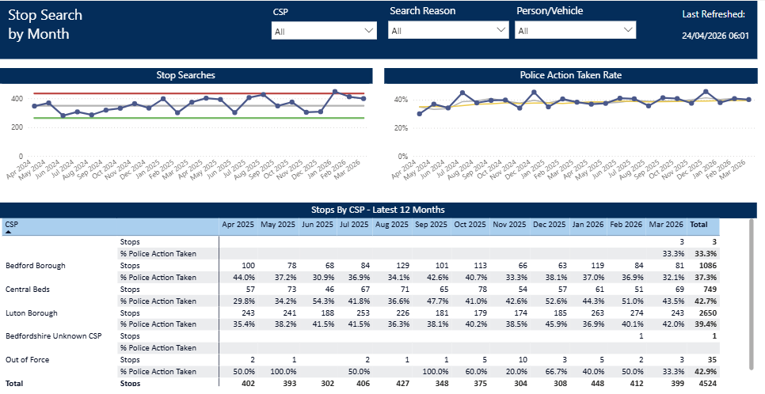
Updated quarterly

Slide 21
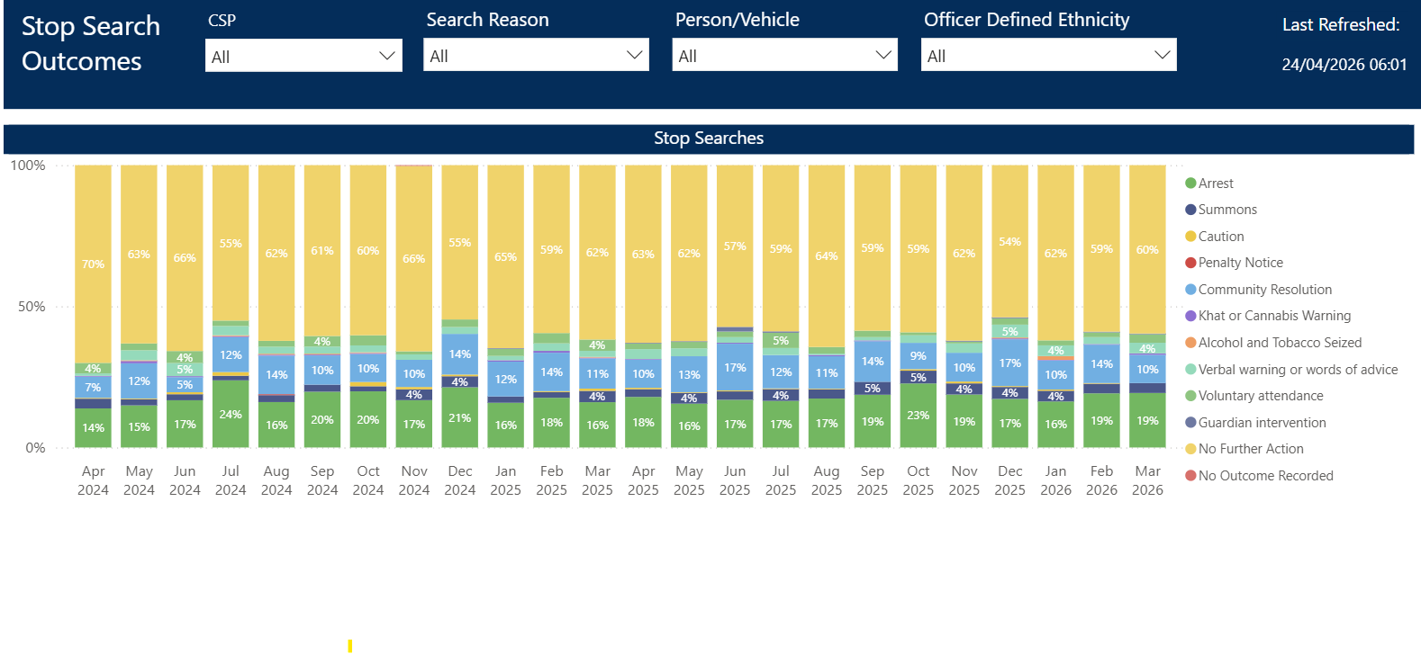
Updated quarterly

Slide 22
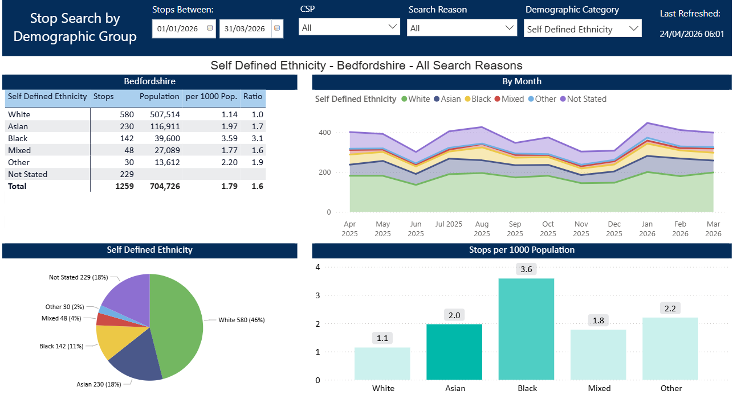
Updated quarterly

Slide 23
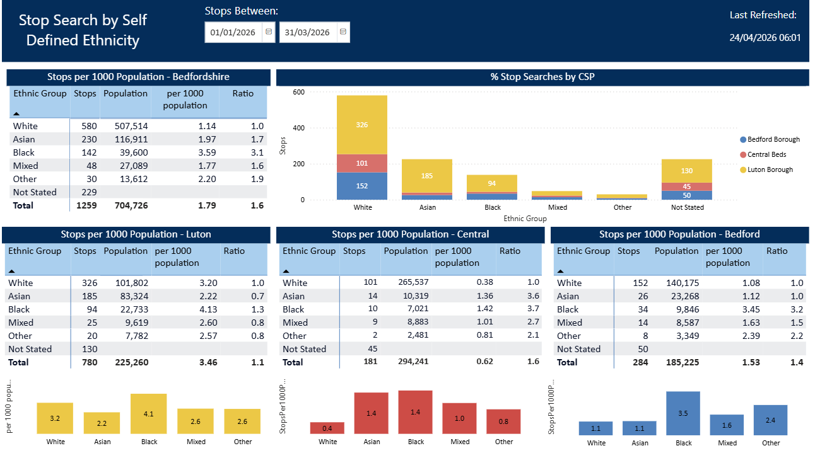
Updated quarterly

