Slide 1
Office of the Police and Crime Commissioner Information Document for
January 2026
Author: Office of the Police and Crime Commissioner
Sign Off – Force Exec : Staff Officer
Changed to quarterly publication in line with Performance and Governance Performance Meetings.

Slide 2
Specified Information Order
Police and Crime Commissioners (PCCs) are required to publish certain information to allow the public to hold them to account.
Section 11(1) and (2) of The Police Reform and Social Responsibility Act 2011 requires an elected local policing body to publish any information specified by the Secretary of State by order.
The Elected Local Policing Bodies (Specified Information) Order 2011 (‘the Order’) sets out the information that must be published. Guidance on the order is published on gov.uk - Guidelines for PCCs on publishing information - GOV.UK (www.gov.uk)

Slide 3
Specified Information Order
https://www.bedfordshire.pcc.police.uk/specified-information-order/

Slide 4
Specified Information Order
The Elected Local Policing Bodies (Specified Information) (Amendment) Order 2021 (’the amending Order), which will come into force on 31 May 2021 provides that information relating to the force’s performance against the Government’s national priorities for policing.
National priorities for policing
The national priorities for policing are specified in the Police and Crime Measures:
reduce murder and other homicide;
reduce serious violence;
disrupt drugs supply and county lines;
reduce neighbourhood crime;
tackle cyber crime;
and improve satisfaction among victims with a particular focus on victims of domestic abuse.

Slide 5
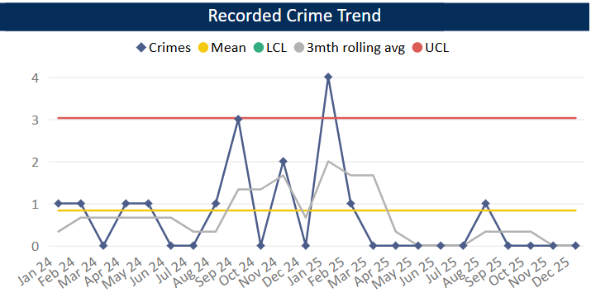
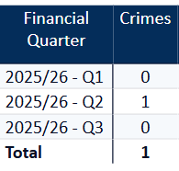
Reduce Murder and Other Homicide
Measure Summary
Local Measures | Trend / Outlook | Benchmark
Police recorded Homicide offences | Improving
Planned Action to Drive Performance
1. Homicide and joint Serious Violence reduction strategy has been collated into one and sits within the Serious Violence Board – strands include Mental Health, DA and Serious Violence.
2. Work under Op Salus continues with the number of hours increasing again in October and November across all the funded operations. Reporting shows a variety of prevention work that has taken place – 75 arrests were carried out in Oct and Nov alone. 98 Stop Searches were also carried out.
Comments
1. There were no Homicides recorded in Q3 25-26.
2. By comparison, in the same period last year, we recorded 2 homicides.
This is in comparison to the previous quarter, where there were one homicide recorded.
The force in ranked 33rd for the crime rate per 1000 population in the 12mths to Oct 2025. This is an improvement in our ranking as in the previous OPCC report we were ranked 41st.
Caveat: this data is based on local Bedfordshire force data and may not match nationally published data (police.uk or published stats from HO)

Slide 6
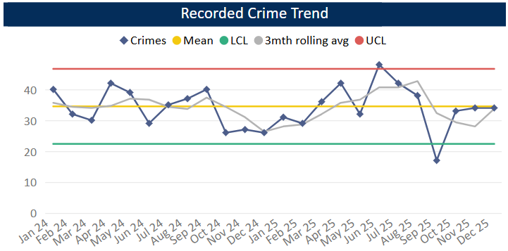
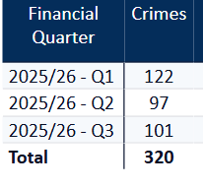
Reduce Serious Violence
Measure Summary
Local Measures | Trend / Outlook | Benchmark
Police recorded Most Serious Violence offences | Decreasing
Solved Crimes | Decreasing
Planned Action to Drive Performance
1. Quarterly review of HKC (Habitual Knife Carriers) – this is ongoing with offenders and issues raised to the relevant teams to action and problem-solve.
2. Knife Crime quarterly review - a revised version is provided for monthly interim meetings with trends and any emerging issues or intel highlighted.
Comments
1. Most Serious Violence levels increased during Q3 and are now around the average. It should be noted that Q2 was exceptionally low compared to previous quarters. The average for Q3 is 34 crimes per month.
2. Levels were previously below average from Oct 24 to Feb 25 but rose to above average from March onwards. As mentioned above levels were exceptionally low in Q2 25-26.
3. Beds is equal to the MSG average.
Caveat: this data is based on local Bedfordshire force data and may not match nationally published data (police.uk or published stats from HO)

Slide 7
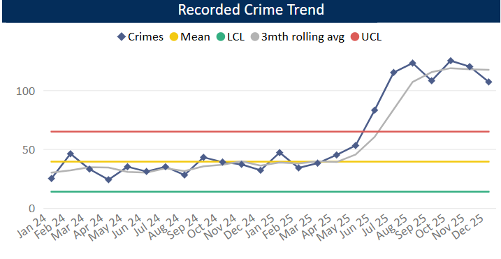
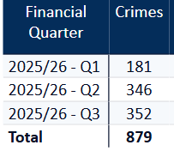
Disrupt Drugs Supply and County Lines
Measure Summary
Local Measures | Trend / Outlook | Benchmark
Number of Drug Trafficking offences | Reflects policing activity
Planned Action to Drive Performance
1. Op COSTELLO – this is a dedicated team which works on enforcements for large scale drug activity. A key focus for the team is professional enablers, linking into SOC.
2. Scanning processes continue as business as usual in order to identify new lines.
3. The Drugs Focus Desk continues to see positive outcomes for drug related crimes. In Q3 their rate for Outcome 1 (Charge/Summons) was 45%. Their overall solved rate was 46.4%
Trafficking of Drugs
Comments
1. Q3 recorded 352 Trafficking of Drugs offences, averaging 117 crimes per month in the quarter or 98 per month across 25-26 so far. This is up on the previous quarter and on the same time last year. Trafficking offences tend to reflect proactive police activity however some of this increase will be in relation to the recording of FAST Parcels.
2. Bedfordshire currently has 24 OCGs – this has increased since last quarter. The number of Street Gangs has remained at 10 (as at Jan 26).
3. Currently there are 79 county lines. This increase is due to better identification of potential lines through telecoms work and an increase in the Central Beds area.
Caveat: this data is based on local Bedfordshire force data and may not match nationally published data (police.uk or published stats from HO)
There has been a lot of change over the past few months with some OCGs being archived.

Slide 8
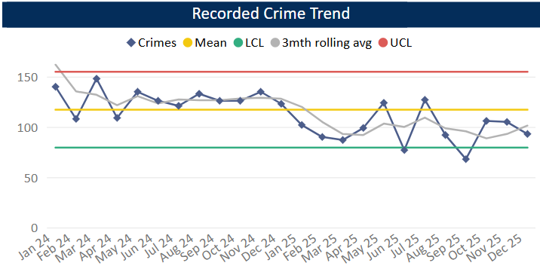
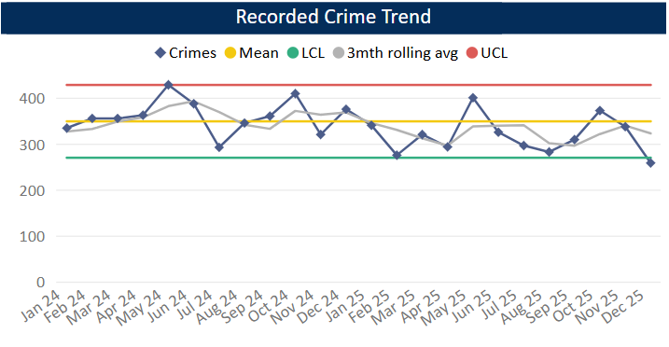
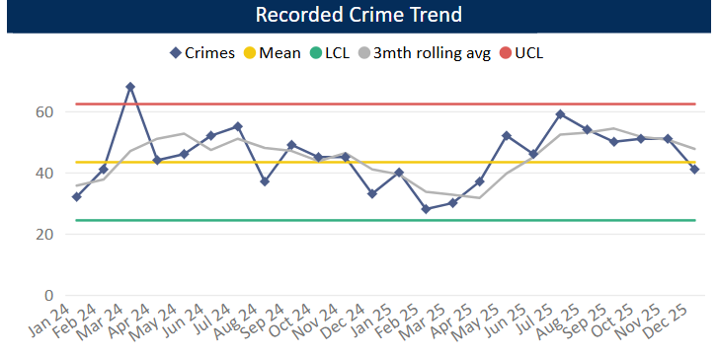
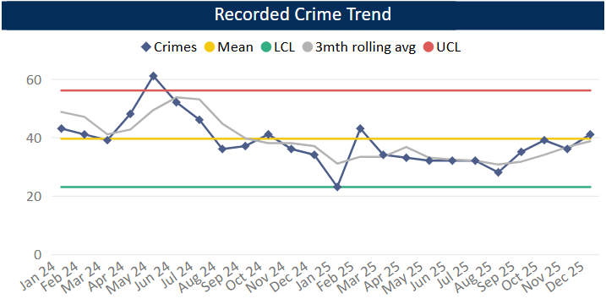
Reduce Neighbourhood Crime
Measure Summary
Local Measures | Trend / Outlook | Benchmark
Police recorded Residential Burglary offences (pre-April 23 definition) | Decreasing
Police recorded Vehicle Crime offences | Decreasing
Police recorded Personal Robbery offences | Decreasing
Police recorded Theft from Person offences | Increasing
Planned Action to Drive Performance
1. Op Masterball was made a force geographical priority due to an increase in SAC offending including robberies in Dunstable.
2. Neighbourhood Crime has been added to the Community Policing Team framework with top locations being monitored each month. Town Centres are also being looked at in terms of specific offences (Shoplifting, Street Theft and Business Robbery).
Burglary Residential
Vehicle Crime
Comments
1. In Q3 304 Residential Burglaries were recorded, averaging 101 crimes a month. This is similar to Q1 and slightly higher than Q2 but is below the same period in the previous year. Solved rate for Q3 25-26 was 18.1%.
2. Vehicle Crime has increased compared to Q2 primarily due to levels in Oct being high compared to Nov and Dec. The average in Q3 is 322 crimes per month. The solved rate was 2.4%.
3. Personal Robbery has decreased compared to Q2. Q3 was higher (by around 20 crimes) than the same quarter in the 24-25 year. The average was 48 crimes per month in Q3 25-26 and the solved rate was 19.6%.
4. 116 Theft from a Person crimes were recorded during Q3, this is an increase compared to Q2 and is slightly above this time last year. Levels have been below average across the quarter as a whole.
Personal Robbery
Theft from Person

Slide 9
Tackle Cyber Crime
Measure Summary
Local Measures | Trend / Outlook | Benchmark
Investigate 100% of all cyber dependant crime disseminated to force | Stable [100%] | Not available
Provide 100% of all cyber dependant crime victims with specialist advice | Stable [100%] | Not available
Action Fraud offences | Stable [100%] | Not available
Planned Action to Drive Performance
1. Op DARKLINK has been created linking into a network of Open Source trained officers looking at knife crime and or supply of knives on social media, since its inception over the last quarter one warrant executed on a BOSON gang nominal where no weapons were found but package material found which was consistent of supply of weapons and onward postage.
2. Cyber Clinics - this event has continued biweekly North and South and on average bespoke advice is given to 20 colleagues per month. Also, Cyber education internal events have taken place with SSID, PSD and planned to take place in SOCO and Emerald.
3. Protect Work - this has continued along with other engagements. A large event funded by TCUK is planned for 4th March and is currently being advertised to local businesses via Corporate Comms and the PCC network with an anticipated audience of 200 local business owners.
4. OP DURIN – was enforced upon following suspicious dark web activity and related to the sale of cannabis edibles. The defendant was a teacher.
Protect Engagements Q3 25-26
Cyber Protect and a new strand of Prepare training. 46 Local business totalling 600 attendees have been reached this quarter.

Slide 10
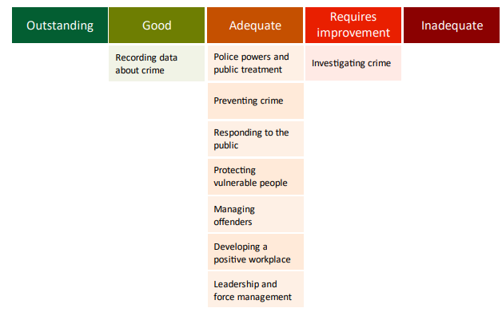
Specified Information Order
HMICFRS reporting
The amending Order requires PCCs to publish the most recent HMICFRS force-level report on the effectiveness, efficiency and legitimacy of the police force.
The Order requires that PCCs publish the PEEL report for their force on their website, within one calendar month of its publication by HMICFRS.
https://www.bedfordshire.pcc.police.uk/hmic-reports/

Slide 11
Specified Information Order
Complaints handling
The Order provides that PCCs must publish the most recent IOPC quarterly complaints data for their force and the IOPC annual statistics report, alongside a narrative setting out how the PCC is holding the chief officer to account, and the PCC’s assessment of their own performance in carrying out their other complaints handling functions.
Holding the chief officer to account
It is recommended that the narrative should include:
• How the force is measuring complainant satisfaction.
• Progress updates on implementing relevant recommendations made by the IOPC and/or HMICFRS in relation to complaints handling, or where recommendations were not accepted an explanation as to why.
• A summary of any mechanisms put in place to identify and act on themes or trends in complaints.
• A summary of systems in place to monitor and improve performance in the timeliness of complaints handling.
• The number of written communications issued by the force under regulation 13 of the Police (Complaints and Misconduct) Regulations 2020 where an investigation has not been completed within a “relevant period”.
• Quality Assurance mechanisms in place to monitor and improve the quality of its responses to complaints.
• Details of the administrative arrangements the PCC has put in place to hold the chief constable to account for complaints handling e.g. frequency of meetings and a summary of discussions.

Slide 12
Specified Information Order
Complaints handling
https://www.bedfordshire.pcc.police.uk/public-info/specified-information-order/complaints-handling-specified-information-order/
https://www.bedfordshire.pcc.police.uk/public-info/specified-information-order/holding-bedfordshire-police-to-account/

Slide 13
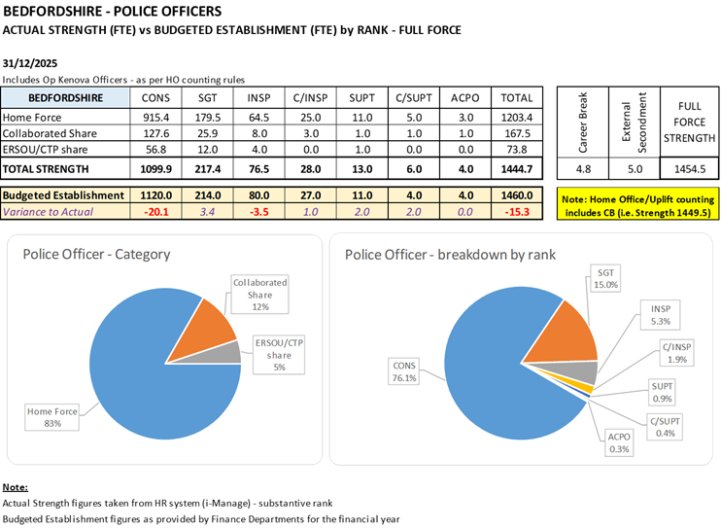
Reinvigorating local policing
Recruitment and Retention Numbers:
Police and Crime Commissioners have statutory responsibilities for delivering an efficient and effective police service. Our efficiency and effectiveness improves when the right level of resources are available and maximised.
The PCC wishes for his office to publish the monthly figures of the recruitment of officers.

Slide 14
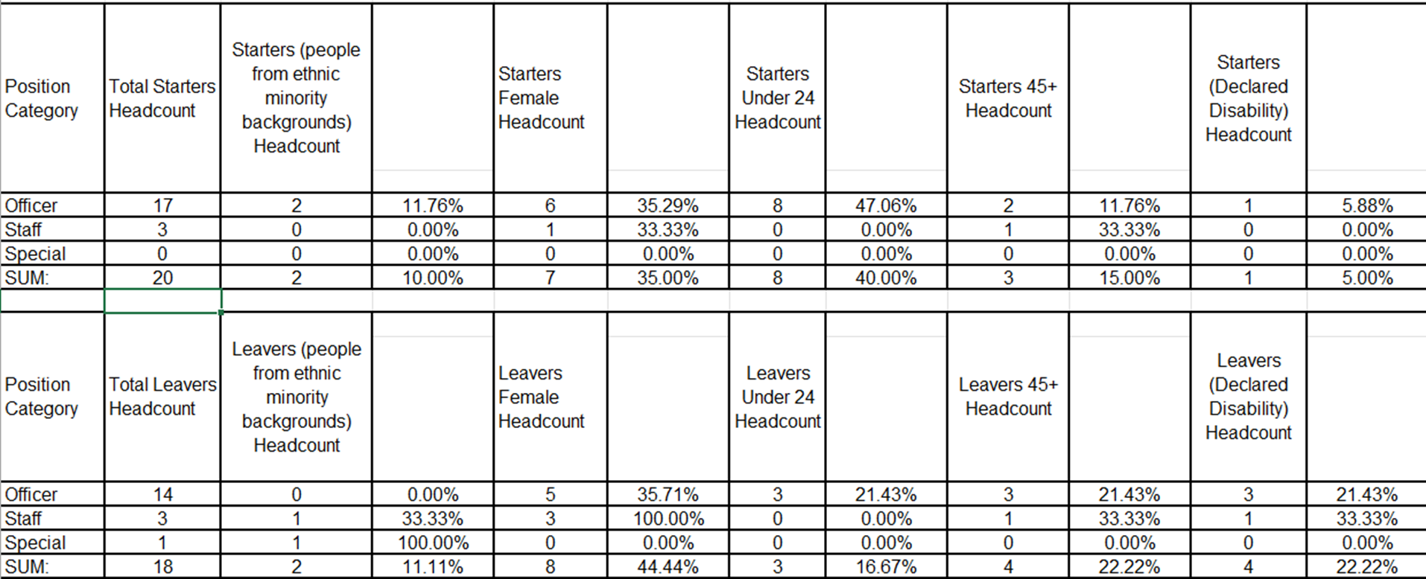
Reinvigorating local policing
Recruitment and Retention Numbers:

Slide 15
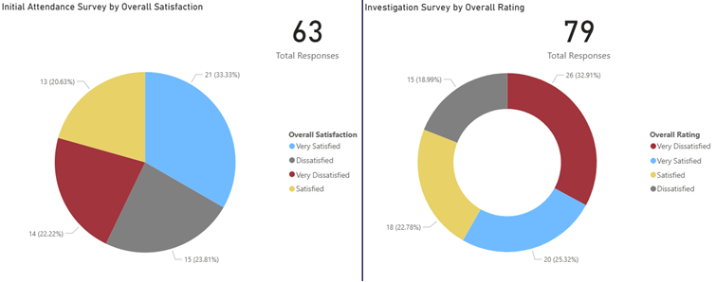
Victims at centre of the CJS
Victim Satisfaction
September
During July 2025, 63 Initial Attendance Surveys were completed and 79 Investigation Surveys.
Initial Attendance Surveys – 53.96% satisfaction rate (Very satisfied + satisfied)
Investigation Surveys – 48.1% satisfaction rate.

Slide 16
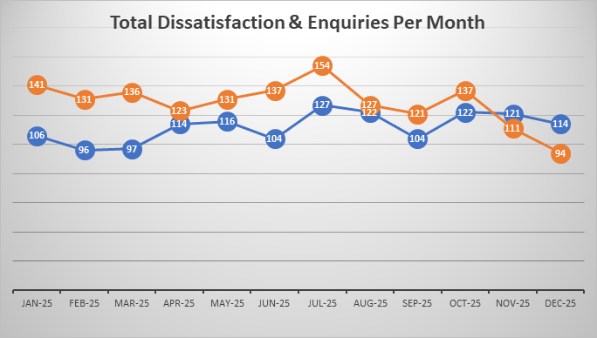
Victims at centre of the CJS
The PCC has requested information form the Force on a monthly basis surrounding Victim Satisfaction and how the Force deals with this and monitors this.
The force is developing its IT solution to automated victim satisfaction surveys and this is progressing well against the project plan. In the meantime, the force has limited capacity to complete such surveys, however can report:
Victim Dissatisfaction
Orange – Enquiries Recorded
Blue - Dissatisfaction Recorded

Slide 17
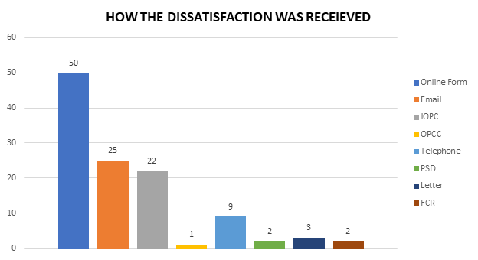
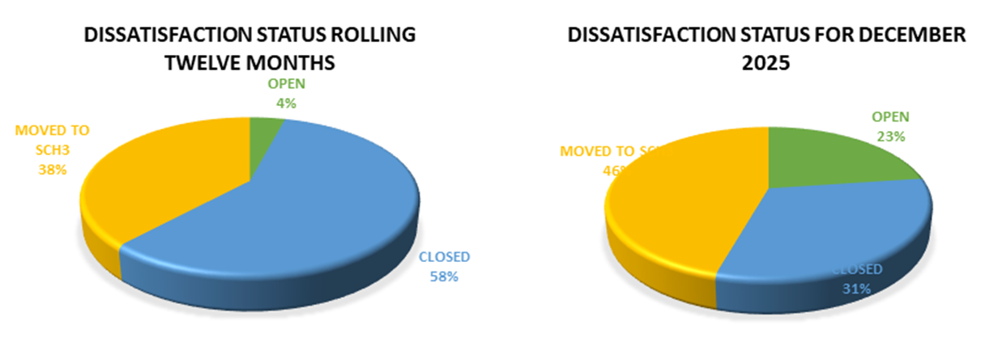
Victims at centre of the CJS.
Victim Dissatisfaction

Slide 18
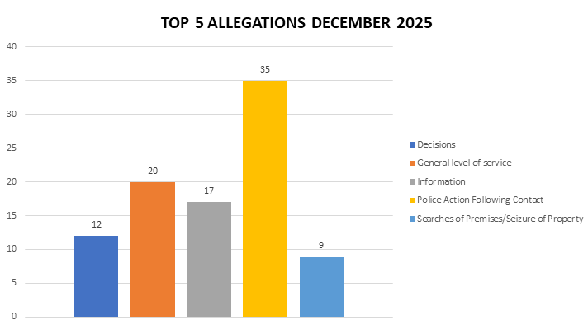
Victims at centre of the CJS
Victim Dissatisfaction

Slide 19
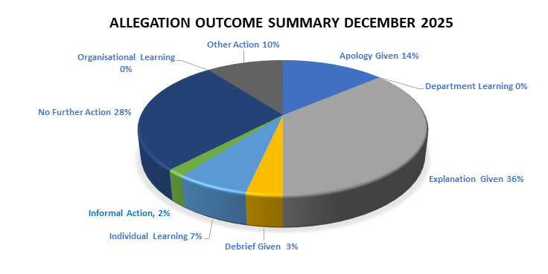
Victims at centre of the CJS
Victim Dissatisfaction

Slide 20
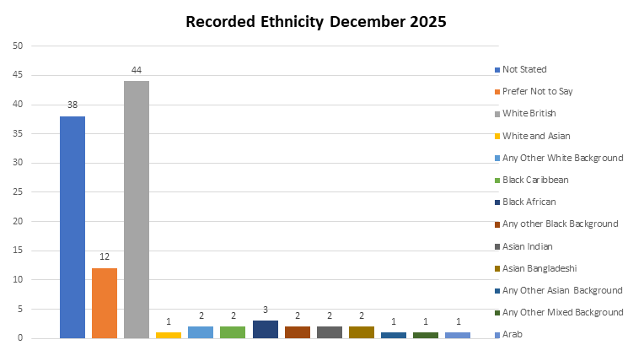
Victims at centre of the CJS
Victim Dissatisfaction

Slide 21
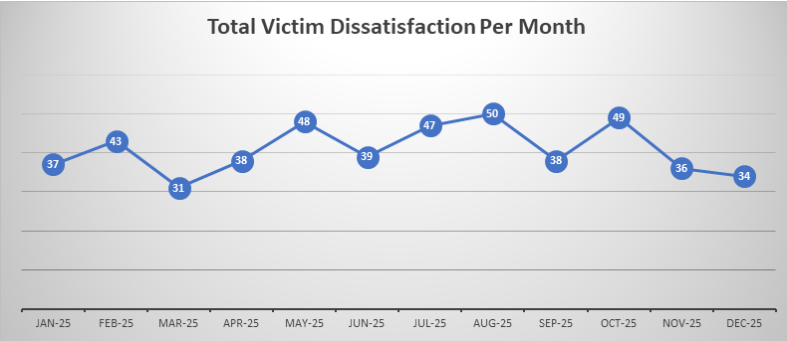
Victims at centre of the CJS
Victim Dissatisfaction

Slide 22
Victims
The PCC has also requested for additional information to aid transparency of the Force and they fall under different headings in line with the pledge of being Transparent.
The PCC pledged that he would ensure that appropriate services are in place for victims within the power of the OPCC.
Clare’s Law
The Domestic Violence Disclosure Scheme(DVDS), also known as “Clare’s Law” enables the police to disclose information to a victim or potential victim of domestic abuse about their partner’s or ex-partner’s previous abusive or violent offending.
Clare's Law - number of requests and average length of time to respond to requests are on the next slide.

Slide 23
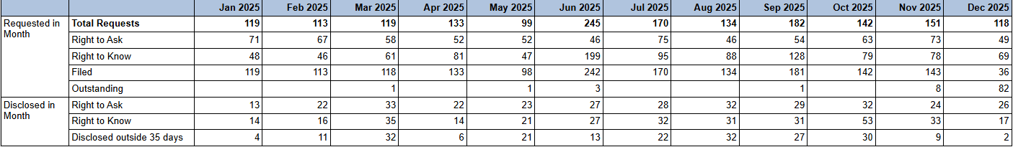

Slide 24
Excellence: an excellent police service
Force - Response times - 101 and 999 calls, December 2025
10,111 - 999 call answered, 326 average per day, 93.6% answered in 10 secs, 4s average wait time
3,810 - 101 Priority, 90 average per day, 2m 16s average wait time
10,664 - 101 Non-Priority, 159 average per day, 6m 37s average wait time
999 performance data | Police.uk (www.police.uk)

Slide 25
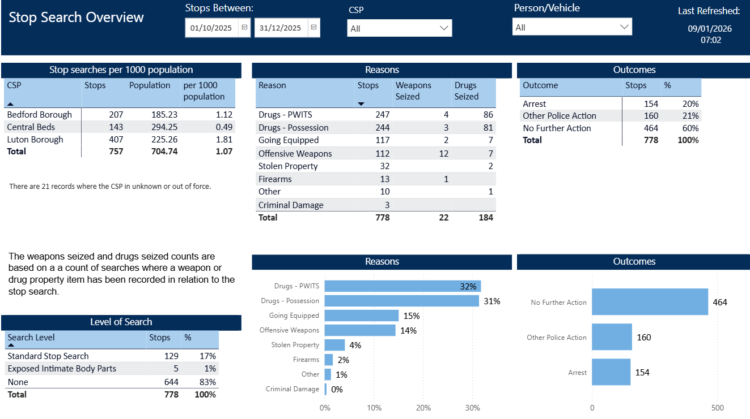
Excellence: an excellent police service
The PCC has also requested for additional information to aid transparency of the Force and they fall under different headings in line with the pledge of being Transparent.
Stop and Search Data (Q3 25-26)
Stop and search | Police.uk (www.police.uk)
Updated quarterly

Slide 26
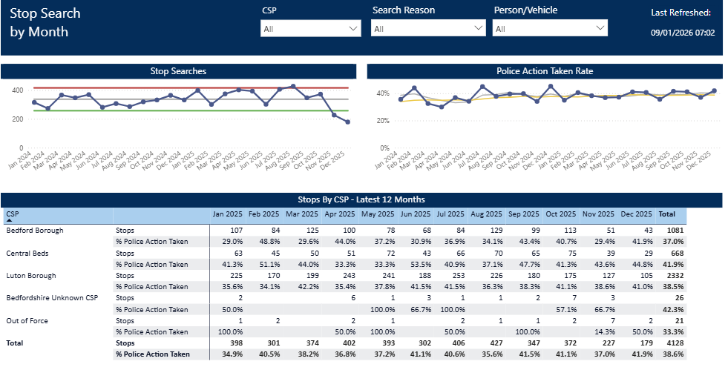
Updated quarterly

Slide 27
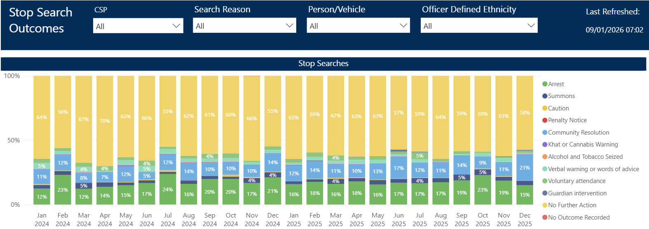
Updated quarterly

Slide 28
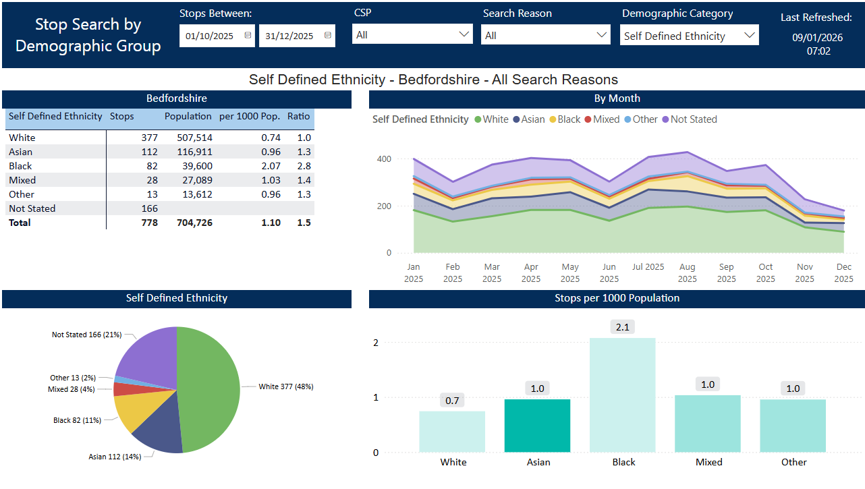
Updated quarterly

Slide 29
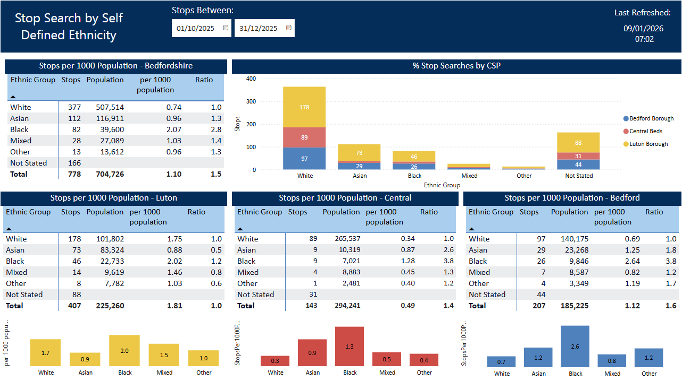
Updated quarterly

