Slide 1
Office of the Police and Crime Commissioner Information Document for
January 2025
Author: Office of the Police and Crime Commissioner
Sign Off – Force Exec : Fiona Dawson

Slide 2
Specified Information Order
Police and Crime Commissioners (PCCs) are required to publish certain information to allow the public to hold them to account.
Section 11(1) and (2) of The Police Reform and Social Responsibility Act 2011 requires an elected local policing body to publish any information specified by the Secretary of State by order.
The Elected Local Policing Bodies (Specified Information) Order 2011 (‘the Order’) sets out the information that must be published. Guidance on the order is published on gov.uk - Guidelines for PCCs on publishing information - GOV.UK (www.gov.uk)

Slide 3
Specified Information Order
Specified Information Order

Slide 4
Specified Information Order
The Elected Local Policing Bodies (Specified Information) (Amendment) Order 2021 (’the amending Order), which will come into force on 31 May 2021 provides that information relating to the force’s performance against the Government’s national priorities for policing.
National priorities for policing
The national priorities for policing are specified in the Police and Crime Measures:
reduce murder and other homicide;
reduce serious violence;
disrupt drugs supply and county lines;
reduce neighbourhood crime;
tackle cyber crime;
and improve satisfaction among victims with a particular focus on victims of domestic abuse.

Slide 5
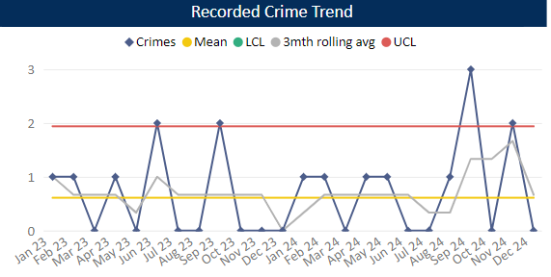
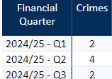
Reduce Murder and Other Homicide
Measure Summary
Local Measures | Trend / Outlook | Benchmark
Police recorded Homicide offences | Deterioration
Planned Action to Drive Performance
1. Homicide and joint Serious Violence reduction strategy has been collated into one and sits within the Serious Violence Board – strands include Mental Health, DA and Serious Violence.
2. The Force now has the Crest Advisory Homicide Review, and the conclusions/recommendations are being actioned via the Homicide and Serious Violence Reduction group and SV Board
3. Op Salus is the new operational name to combating Serious Violence and ASB jointly, implementing hotspot policing.
Comments
1. Two Homicides recorded in Q3, averaging around one per month in 24-25.
2. The total number of Homicides recorded in 2024-25 so far exceeds last year by 1 crime.
This is in comparison to the previous quarter, where there were four homicides.
The force in ranked 33rd for the crime rate per 1000 population in the 12mths to Oct 2024. In the OPCC report Q2 24-25 we were reporting being 28th so have seen a deterioration in our ranking.
Caveat: this data is based on local Bedfordshire force data and may not match nationally published data (police.uk or published stats from HO)

Slide 6
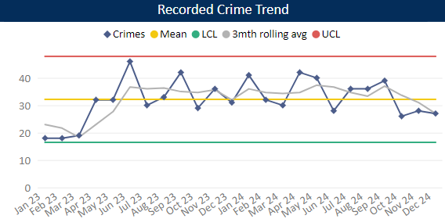
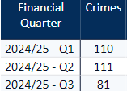
Reduce Serious Violence
Measure Summary
Local Measures | Trend / Outlook | Benchmark
Police recorded Most Serious Violence offences | Reducing
Solved Crimes | Stable
Planned Action to Drive Performance
1. Op SOTERIA implementation is progressing to address Rape and SSO
2. VERU - Introduction of 2 new pilot projects – Focused Deterrence partnered with Police Force and Community Navigators partnered with the Probation Service. ​
Comments
1. Most Serious Violence levels have remained around the average over the year so far, averaging 34 crimes per month.
2. For the last 3 months levels have been below average.
3. Beds is still equal to the MSG average.
Caveat: this data is based on local Bedfordshire force data and may not match nationally published data (police.uk or published stats from HO)

Slide 7
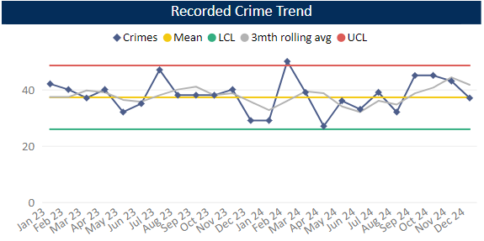
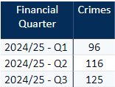
Disrupt Drugs Supply and County Lines
Measure Summary
Local Measures | Trend / Outlook | Benchmark
Number of Drug Trafficking offences | Reflects policing activity
Planned Action to Drive Performance
1. Op COSTELLO dedicate team continues to enforce on large scale drug activity, with key focus on the professional enablers, linking into SOC
2. Op Joule scanning will continue in order to identify new lines.
Trafficking of Drugs
Comments
1. Q3 recorded 125 Trafficking of Drugs offences, averaging 37 crimes per month in 24/25. This is up on the previous quarter and on same time last year. Trafficking offences reflects proactive police activity.
2. Bedfordshire currently has 19 OCGs – this is a decrease on Q2 24-25 where 24 were recorded. The number of Street Gangs has remained stable at 14 (as at Dec 24).
3. Currently there are 81 groups operating 84 county lines.
Caveat: this data is based on local Bedfordshire force data and may not match nationally published data (police.uk or published stats from HO)
There has been a lot of change over the past few months with new lines coming in under Op Joule (where we actively scan for and identify new lines). From now on in, it is likely that these numbers will stabilise.

Slide 8
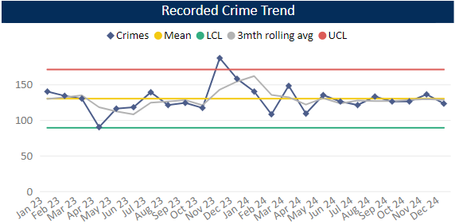
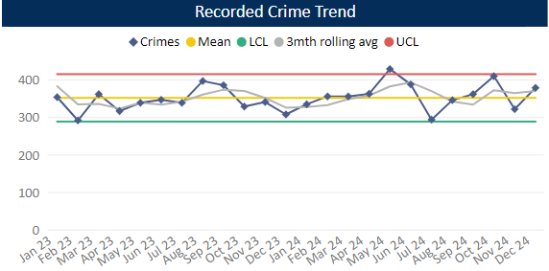
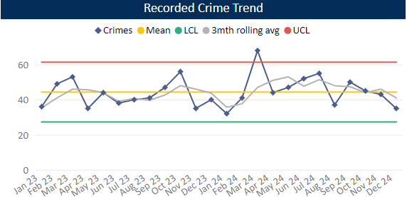
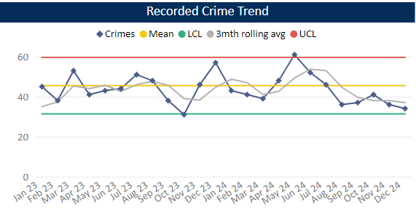
Reduce Neighbourhood Crime
Measure Summary
Local Measures | Trend / Outlook | Benchmark
Police recorded Residential Burglary offences (pre-April 23 definition) | Stable
Police recorded Vehicle Crime offences | Stable
Police recorded Personal Robbery offences | Decreasing
Police recorded Theft from Person offences | Decreasing
Planned Action to Drive Performance
1. Two problem solving projects have been taken forward to the NHC meeting, both in Luton, relating to robbery and residential burglary.
2. Annual neighbourhood crime problem profile was completed in August 2024 – it identified a number of longer-term hotspots for personal robbery and residential burglary.
Comments
1. Q3 recorded 385 Residential Burglaries averaging 126 crimes a month 24/25. This is slightly higher than the previous quarter and below the same period in the previous year. Solved rate for Q3 24-25 was 9.4%.
2. Vehicle Crime has decreased compared to Q2, but comparable with previous quarters. Average 353 crimes per month 24/25.
3. Personal Robbery has decreased compered to Q2. Q3 was lower than the same quarter in the 23-24 year. Average 44 crimes per month 24/25. Solved rate for Q3 24-25 was 9.8%.
4. 111 Theft from a Person during Q3, this is a decrease compared to Q2 and below this time in the previous year. Levels have been below average across the quarter as a whole.
Burglary Residential
Vehicle Crime
Personal Robbery
Theft from Person

Slide 9
Tackle Cyber Crime
Measure Summary
Local Measures | Trend / Outlook | Benchmark
Investigate 100% of all cyber dependant crime disseminated to force | Stable [100%] | Not available
Provide 100% of all cyber dependant crime victims with specialist advice | Stable [100%] | Not available
Action Fraud offences | Stable [100%] | Not available
Planned Action to Drive Performance
1. Cyber CPD organised for the 20th February - to provide Cyber advice to all business areas covering best practice, identifying digital opportunities, how to use digital evidence in investigations and cryptocurrency.
2. Cyber clinics being arranged at both HQ and Luton to enable OIC's to seek advice from cyber SME's to identify how the cyber team can support their investigations.
Comments
4 DMI's attended the first NPCC Cyber Pursue conference in Birmingham which focussed on best practice when investigating Cyber Dependent and Cyber enabled crime and how the cyber teams can support the investigation teams.

Slide 10
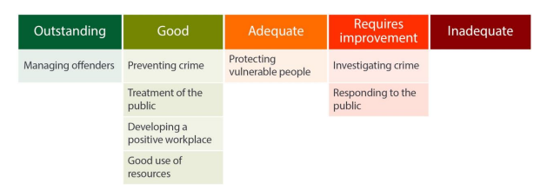
Specified Information Order
HMICFRS reporting
The amending Order requires PCCs to publish the most recent HMICFRS force-level report on the effectiveness, efficiency and legitimacy of the police force.
The Order requires that PCCs publish the PEEL report for their force on their website, within one calendar month of its publication by HMICFRS.
https://www.bedfordshire.pcc.police.uk/hmic-reports/

Slide 11
Specified Information Order
Complaints handling
The Order provides that PCCs must publish the most recent IOPC quarterly complaints data for their force and the IOPC annual statistics report, alongside a narrative setting out how the PCC is holding the chief officer to account, and the PCC’s assessment of their own performance in carrying out their other complaints handling functions.
Holding the chief officer to account
It is recommended that the narrative should include:
• How the force is measuring complainant satisfaction.
• Progress updates on implementing relevant recommendations made by the IOPC and/or HMICFRS in relation to complaints handling, or where recommendations were not accepted an explanation as to why.
• A summary of any mechanisms put in place to identify and act on themes or trends in complaints.
• A summary of systems in place to monitor and improve performance in the timeliness of complaints handling.
• The number of written communications issued by the force under regulation 13 of the Police (Complaints and Misconduct) Regulations 2020 where an investigation has not been completed within a “relevant period”.
• Quality Assurance mechanisms in place to monitor and improve the quality of its responses to complaints.
• Details of the administrative arrangements the PCC has put in place to hold the chief constable to account for complaints handling e.g. frequency of meetings and a summary of discussions.

Slide 12
Specified Information Order
Complaints handling
Holding Bedfordshire police to account
Complaints Police and Crime Commissioner

Slide 13
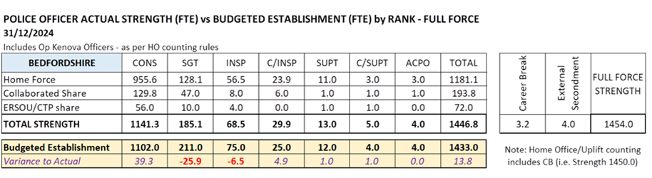
Recruitment and retention of police officers
Recruitment and Retention Numbers:
Police and Crime Commissioners have statutory responsibilities for delivering an efficient and effective police service. Our efficiency and effectiveness improves when the right level of resources are available and maximised.
The PCC wishes for his office to publish the monthly figures of the recruitment of officers.

Slide 14
Recruitment and Retention Numbers:
Position Category | Total Starters Headcount | Starters (people from ethnic minority backgrounds) Headcount | Starters (people from ethnic minority backgrounds) Headcount |  |  | Starters Female Headcount |  |  | Starters Under 24 Headcount |  | Starters 45+ Headcount |  |  | Starters (Declared Disability) Headcount
Officer | 2 | 0 | 0 | 0.00% | 0.00% | 1 | 50.00% | 50.00% | 0 | 0.00% | 1 | 50.00% | 50.00% | 0 | 0.00% | 0.00%
Staff | 3 | 0 | 0 | 0.00% | 0.00% | 3 | 100.00% | 100.00 | 0 | 0.00% | 1 | 33.33% | 33.33% | 0 | 0.00% | 0.00%
Special | 0 | 0 | 0 | 0.00% | 0.00% | 0 | 0.00% | 0.00% | 0 | 0.00% | 0 | 0.00% | 0.00% | 0 | 0.00% | 0.00%
Position Category | Total Leavers Headcount | Leavers (people from ethnic minority backgrounds) Headcount |  |  |  | Leavers Female Headcount |  |  | Leavers Under 24 Headcount |  | Leavers 45+ Headcount |  |  | Leavers (Declared Disability) Headcount
Officer | 6 | 1 |  | 16.67% |  | 2 | 33.33% |  | 0 | 0 | 2 | 33.33% |  | 0 | 0%
Staff | 3 | 1 |  | 33.33% |  | 2 | 66.67% |  | 0 | 0 | 2 | 66.67% |  | 1 | 33.33%
Special | 2 | 0 |  | 0 |  | 1 | 50% |  | 0 | 0 | 2 | 100% |  | 0 | 0%
SUM: | 11 | 2 |  | 18.18% |  | 5 | 45.45% |  | 0 | 0 | 6 | 54.55% |  | 1 | 9.09%

Slide 15
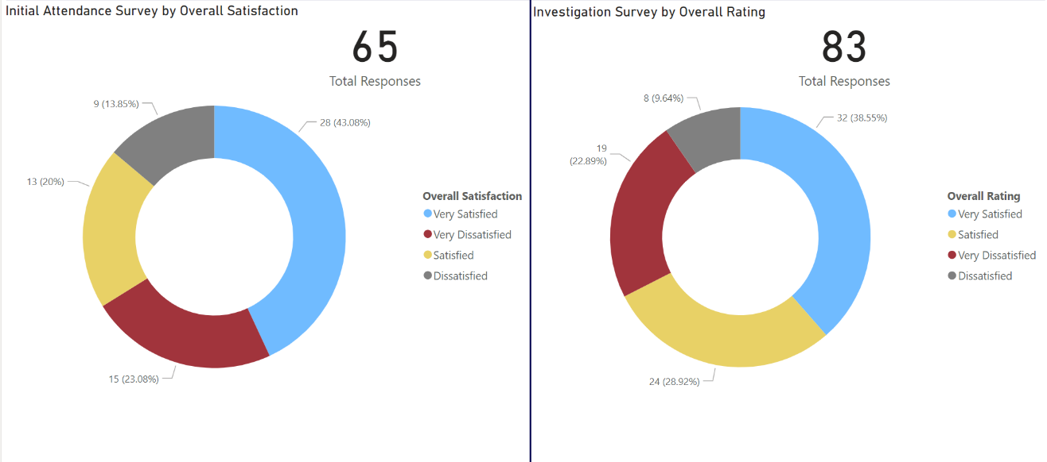
Victims at centre of the CJS
The PCC has requested information form the Force on a monthly basis surrounding Victim Satisfaction and how the Force deals with this and monitors this.
Victim Satisfaction
During December 2024, 65 Initial Attendance Surveys were completed and 83 Investigation Surveys.
Initial Attendance Surveys – 63% satisfaction rate. (Very satisfied + satisfied)
Investigation Surveys – 67.5% satisfaction rate.

Slide 16
Victims at centre of the CJS
The PCC has requested information form the Force on a monthly basis surrounding Victim Satisfaction and how the Force deals with this and monitors this.
The force is developing its IT solution to automated victim satisfaction surveys and this is progressing well against the project plan. In the meantime, the force has limited capacity to complete such surveys, however can report:
Victim Dissatisfaction
Orange – Enquiries Recorded
Blue - Dissatisfaction Recorded

Slide 17
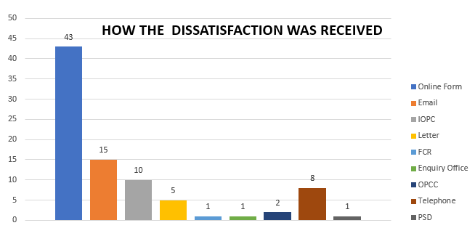
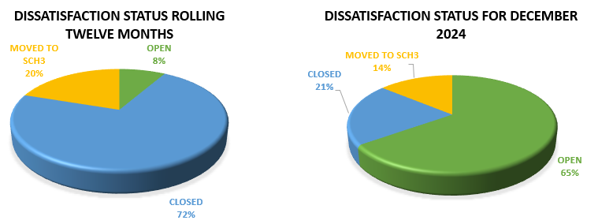
Victims at centre of the CJS.
Victim Dissatisfaction

Slide 18
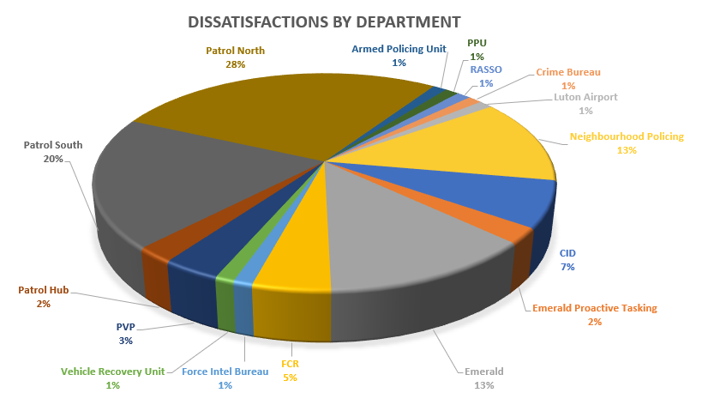
Victims at centre of the CJS
Victim Dissatisfaction

Slide 19
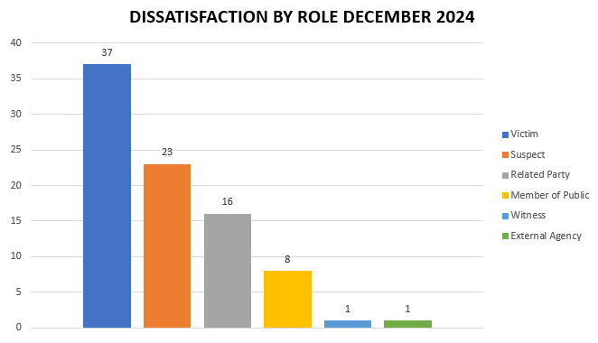
Victims at centre of the CJS
Victim Dissatisfaction

Slide 20
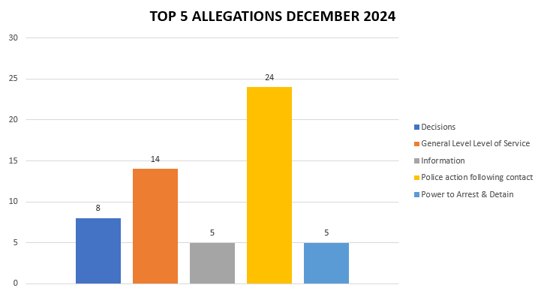
Victims at centre of the CJS
Victim Dissatisfaction

Slide 21
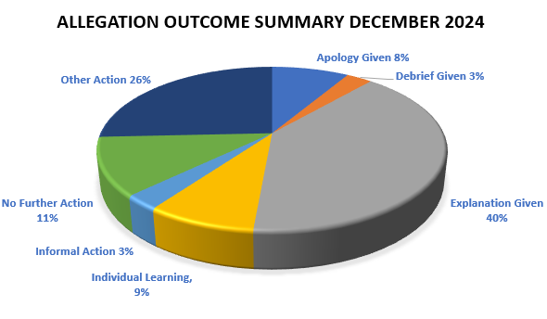
Victims at centre of the CJS
Victim Dissatisfaction

Slide 22
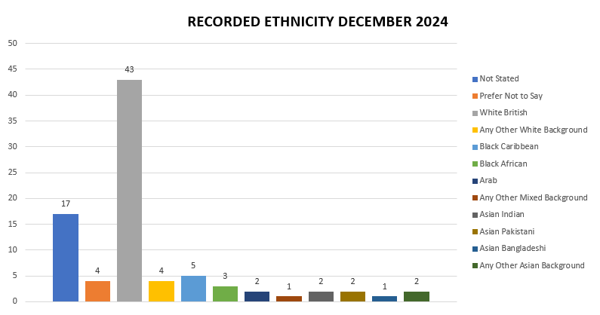
Victims at centre of the CJS
Victim Dissatisfaction

Slide 23
Victims at centre of the CJS
Victim Dissatisfaction

Slide 24
Transparency
The PCC has also requested for additional information to aid transparency of the Force and they fall under different headings in line with the pledge of being Transparent.
The PCC has pledged to invest to improve performance and wellbeing of staff in our Force Control Room
Force - Response times - 101 and 999 calls, December 2024
9,765 - 999 call answered, 315 average per day, 93.2% answered in 10 secs, 4s average wait time
3,005 - 101 Priority, 97 average per day, 1m 45s average wait time
6,888 - 101 Non-Priority, 222 average per day, 4m 27s average wait time
999 performance data | Police.uk (www.police.uk)

Slide 25
Transparency
The PCC has also requested for additional information to aid transparency of the Force and they fall under different headings in line with the pledge of being Transparent.
The PCC pledged that he would ensure that appropriate services are in place for victims within the power of the OPCC.
Clare’s Law
The Domestic Violence Disclosure Scheme(DVDS), also known as “Clare’s Law” enables the police to disclose information to a victim or potential victim of domestic abuse about their partner’s or ex-partner’s previous abusive or violent offending.
Clare's Law - number of requests and average length of time to respond to requests are on the next slide.

Slide 26
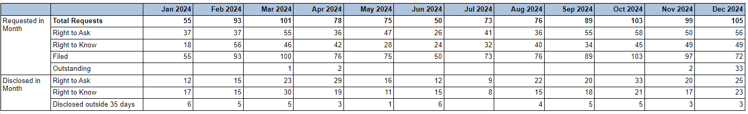

Slide 27
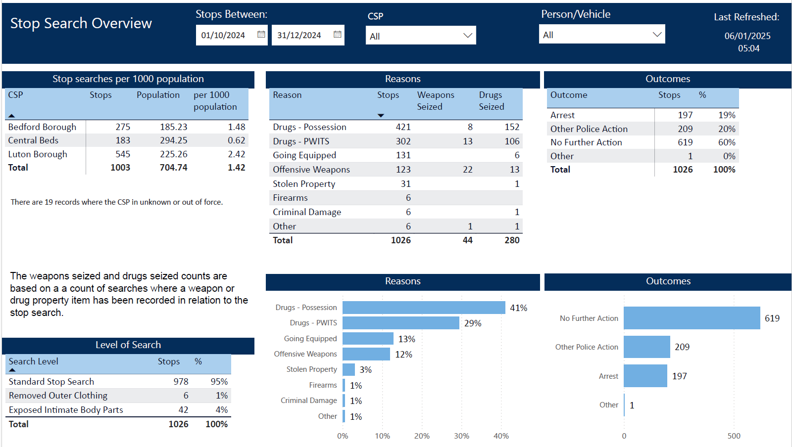
Scrutiny
The PCC has also requested for additional information to aid transparency of the Force and they fall under different headings in line with the pledge of being Transparent.
Stop and Search Data (Q2)
Stop and search | Police.uk (www.police.uk)
Updated quarterly

Slide 28
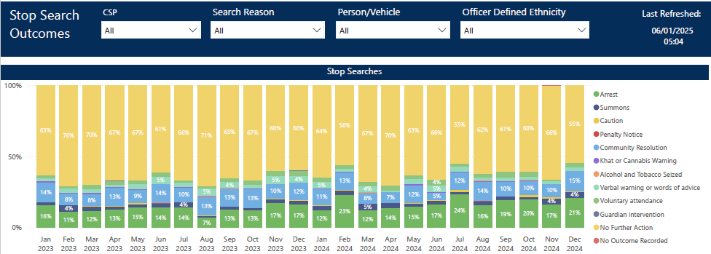
Updated quarterly

Slide 29
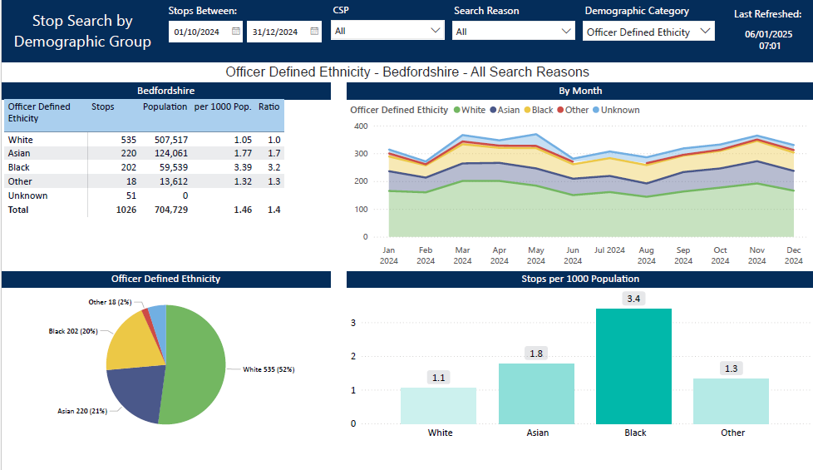
Updated quarterly

Slide 30
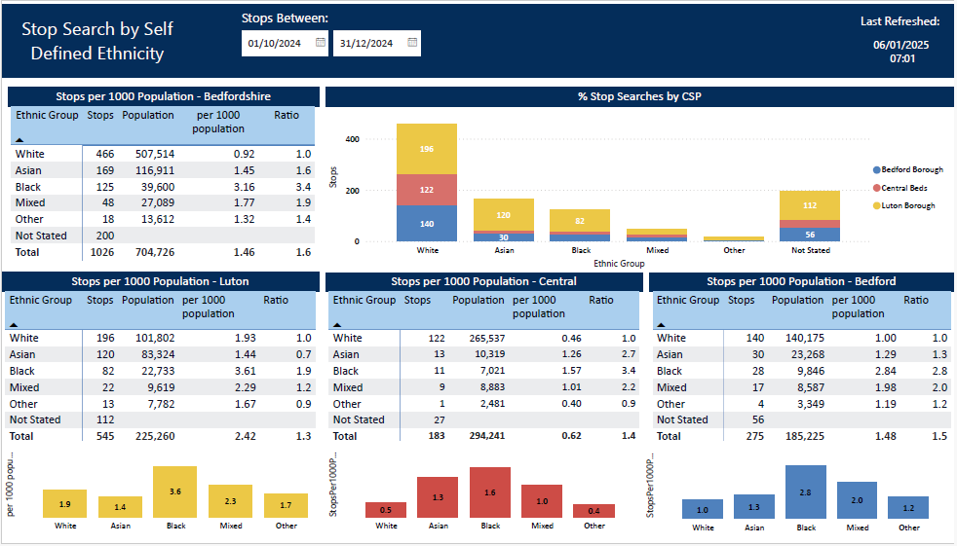
Updated quarterly

