Slide 1
Office of the Police and Crime Commissioner Information Document for
July 2025
Author: Office of the Police and Crime Commissioner
Sign Off – Force Exec : Fiona Dawson
Changed to quarterly publication in line with Performance and Governance Performance Meetings.

Slide 2
Specified Information Order
Police and Crime Commissioners (PCCs) are required to publish certain information to allow the public to hold them to account.
Section 11(1) and (2) of The Police Reform and Social Responsibility Act 2011 requires an elected local policing body to publish any information specified by the Secretary of State by order.
The Elected Local Policing Bodies (Specified Information) Order 2011 (‘the Order’) sets out the information that must be published. Guidance on the order is published on gov.uk - Guidelines for PCCs on publishing information - GOV.UK (www.gov.uk)

Slide 3
Specified Information Order
https://www.bedfordshire.pcc.police.uk/specified-information-order/

Slide 4
Specified Information Order
The Elected Local Policing Bodies (Specified Information) (Amendment) Order 2021 (’the amending Order), which will come into force on 31 May 2021 provides that information relating to the force’s performance against the Government’s national priorities for policing.
National priorities for policing
The national priorities for policing are specified in the Police and Crime Measures:
reduce murder and other homicide;
reduce serious violence;
disrupt drugs supply and county lines;
reduce neighbourhood crime;
tackle cyber crime;
and improve satisfaction among victims with a particular focus on victims of domestic abuse.

Slide 5
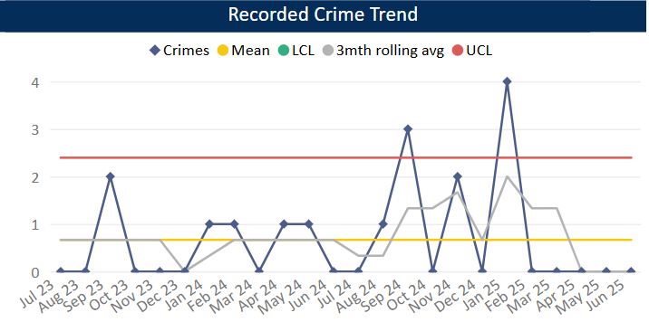
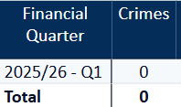
Reduce Murder and Other Homicide
Measure Summary
Local Measures | Trend / Outlook | Benchmark
Police recorded Homicide offences | Improving
Planned Action to Drive Performance
1. Homicide and joint Serious Violence reduction strategy has been collated into one and sits within the Serious Violence Board – strands include Mental Health, DA and Serious Violence.
2. Op Salus is the new operational name to combating Serious Violence and ASB jointly, implementing hotspot policing.
3. Sudden death data (non crimes recorded as N300) has been reviewed as part of a recommendation to fully understand the scale of and types of sudden deaths the force is responding to.
Comments
1. There were no Homicides recorded in Q1 25-26.
2. By comparison, in the same period last year, we recorded 2 homicides. In Q4 24-25 we recorded 4 homicides.
This is in comparison to the previous quarter, where there were four homicides.
The force in ranked 40th for the crime rate per 1000 population in the 12mths to April 2025. This is a small improvement in our ranking as in the previous OPCC report we were ranked 41^{st.}
Caveat: this data is based on local Bedfordshire force data and may not match nationally published data (police.uk or published stats from HO)

Slide 6
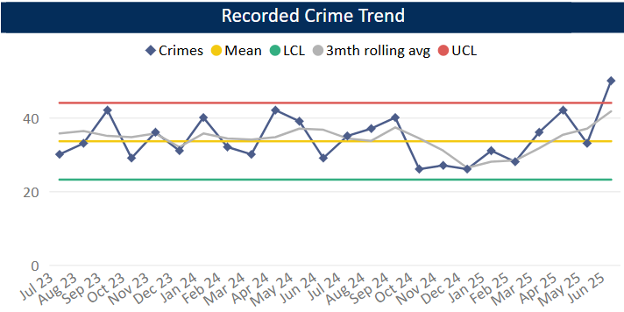
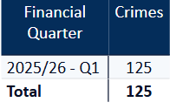
Reduce Serious Violence
Measure Summary
Local Measures | Trend / Outlook | Benchmark
Police recorded Most Serious Violence offences | Increasing
Solved Crimes | Decreasing
Planned Action to Drive Performance
1. Quarterly review of HKC (Habitual Knife Carriers) – this is ongoing with offenders and issues raised to the relevant teams to action and problem-solve.
2. Ongoing implementation of the Knife Crime quarterly review.
3. Specific issues raised at the Force Tasking Meeting include previous knife-enabled theft of motorbike nominals mapped as OCGs and Personal Robberies (Robberies is currently a force priority).
Comments
1. Most Serious Violence levels increased during Q1 compared to Q4 and are now above the upper threshold. They are averaging 42 crimes per month.
2. Levels have been below average from Oct 24 to Feb 25 but rose to above average in March.
3. Beds is equal to the MSG average.
Caveat: this data is based on local Bedfordshire force data and may not match nationally published data (police.uk or published stats from HO)

Slide 7
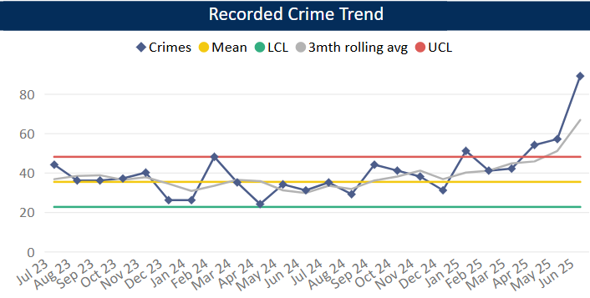
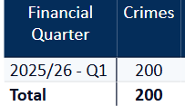
Disrupt Drugs Supply and County Lines
Measure Summary
Local Measures | Trend / Outlook | Benchmark
Number of Drug Trafficking offences | Reflects policing activity
Planned Action to Drive Performance
1. Op COSTELLO – this is a dedicated team which works on enforcements for large scale drug activity. A key focus for the team is professional enablers, linking into SOC
2. Scanning processes continue as business as usual in order to identify new lines.
3. The Drugs Focus Desk is now up and running and ensuring the Force has a focus on drug offences, particularly PWITS. Performance data is being provided on a regular basis so the team can monitor their activity and processes.
4. Op Talos relating to the L7 Dingers and various issues in Leighton Buzzard is a current force priority.
Trafficking of Drugs
Comments
1. Q1 recorded 200 Trafficking of Drugs offences, averaging 67 crimes per month in 25-26 so far. This is up on the previous quarter and on same time last year. Trafficking offences reflects proactive police activity.
2. Bedfordshire currently has 17 OCGs – this is the same as last quarter. The number of Street Gangs has decreased slightly to 11 (as at July 25).
3. Currently there are 57 groups operating 57 county lines.
Caveat: this data is based on local Bedfordshire force data and may not match nationally published data (police.uk or published stats from HO)
There has been a lot of change over the past few months with some OCGs being archived.

Slide 8
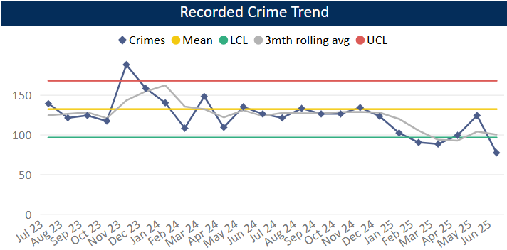
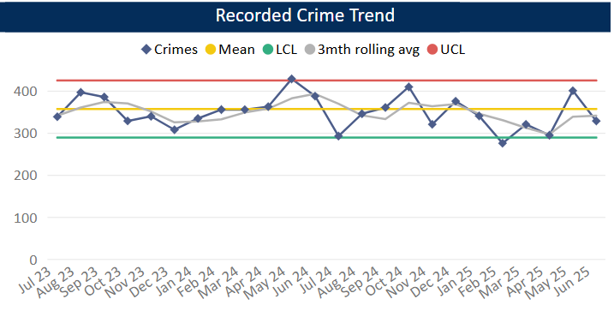
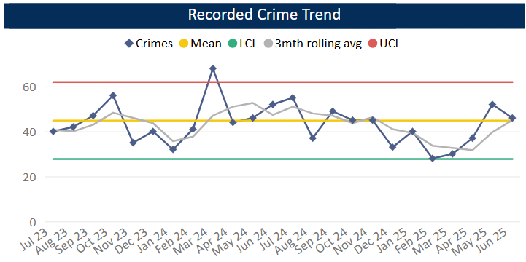
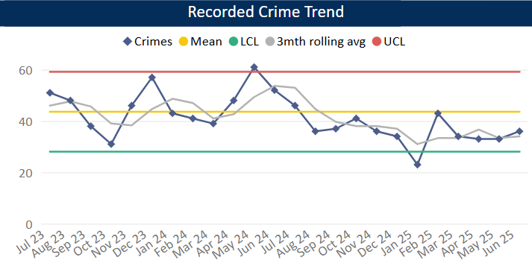
Reduce Neighbourhood Crime
Planned Action to Drive Performance
1. POP training continues for analysts and some officers. Projects now include The Rose Public House (NTE) and Bedford Bus Station (Serious Violence).
2. HSG continues as business as usual within the Neighbourhood Crime analytical work.
3. Op Despan – this is still running in order to identify vehicles frequently using the ANPR network, particularly those vehicles involved in criminality (mainly drug supply). This is helping to support Op Pandilla.
Measure Summary
Local Measures | Trend / Outlook | Benchmark
Police recorded Residential Burglary offences (pre-April 23 definition) | Decreasing
Police recorded Vehicle Crime offences | Stable
Police recorded Personal Robbery offences | Increasing
Police recorded Theft from Person offences | Decreasing
Burglary Residential
Vehicle Crime
Comments
1. Q1 recorded 300 Residential Burglaries averaging 100 crimes a month. This is slightly above Q4 24-25 but below the same period in the previous year. Solved rate for Q1 25-26 was 28.3%.
2. Vehicle Crime has increased compared to Q4, but is still comparable with previous quarters. The average in Q1 is 341 crimes per month. The solved rate has decreased and was 1.7% in Q1.
3. Personal Robbery has increased compared to Q4. Q1 was lower than the same quarter in the 24-25 year. The average was 45 crimes per month in Q1 25-26 and the solved rate was 7.4%.
4. 102 Theft from a Person during Q1, this is a slight increase compared to Q4 and below this time in the previous year. Levels have been below average across the quarter as a whole.
Personal Robbery
Theft from Person

Slide 9
Tackle Cyber Crime
Measure Summary
Local Measures | Trend / Outlook | Benchmark
Investigate 100% of all cyber dependant crime disseminated to force | Stable [100%] | Not available
Provide 100% of all cyber dependant crime victims with specialist advice | Stable [100%] | Not available
Action Fraud offences | Stable [100%] | Not available
Planned Action to Drive Performance
Dedicated DMIT staff will prioritise and investigate Cyber Dependent crimes, providing specialist focus and expertise to on-going and future investigations. In addition, dedicated staff will develop open-source material specific to force control priorities, providing valuable opportunity for targeted force wide disruptions.
2. The cyber clinics commence on 2nd August 25 North providing support / guidance / digital strategies including Soteria, RASSO who are in the process of having inputs to all staff and supervisors There will be a formal news article on the intranet to advertise these clinics. This will improve Beds overall performance in Regional Cyber KPI monthly returns, which drives our funding into the next 3-year cycle commencing April 2026.
3- Protect Work A monthly Black Cat local radio slot has commenced for 45 mins per month for cyber related topics with online engagement. This will likely provide useful up-to date advice, guidance and signposting for those listeners.
Protect Engagements Q1=26
Audience reached 305 combination of local businesses and individuals at events 106 victims of Cyber criminality received bespoke Protect advice 1 Cyber Choices Referral 1 Cyber Choices investigation result and Cease and Desist notice Given

Slide 10
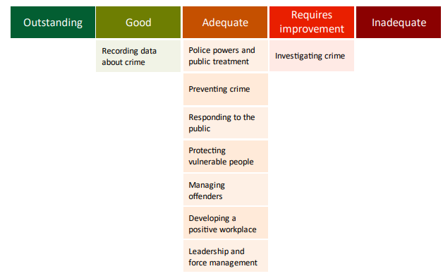
Specified Information Order
HMICFRS reporting
The amending Order requires PCCs to publish the most recent HMICFRS force-level report on the effectiveness, efficiency and legitimacy of the police force.
The Order requires that PCCs publish the PEEL report for their force on their website, within one calendar month of its publication by HMICFRS.
https://www.bedfordshire.pcc.police.uk/hmic-reports/

Slide 11
Specified Information Order
Complaints handling
The Order provides that PCCs must publish the most recent IOPC quarterly complaints data for their force and the IOPC annual statistics report, alongside a narrative setting out how the PCC is holding the chief officer to account, and the PCC’s assessment of their own performance in carrying out their other complaints handling functions.
Holding the chief officer to account
It is recommended that the narrative should include:
• How the force is measuring complainant satisfaction.
• Progress updates on implementing relevant recommendations made by the IOPC and/or HMICFRS in relation to complaints handling, or where recommendations were not accepted an explanation as to why.
• A summary of any mechanisms put in place to identify and act on themes or trends in complaints.
• A summary of systems in place to monitor and improve performance in the timeliness of complaints handling.
• The number of written communications issued by the force under regulation 13 of the Police (Complaints and Misconduct) Regulations 2020 where an investigation has not been completed within a “relevant period”.
• Quality Assurance mechanisms in place to monitor and improve the quality of its responses to complaints.
• Details of the administrative arrangements the PCC has put in place to hold the chief constable to account for complaints handling e.g. frequency of meetings and a summary of discussions.

Slide 12
Specified Information Order
Complaints handling
https://www.bedfordshire.pcc.police.uk/public-info/specified-information-order/complaints-handling-specified-information-order/
https://www.bedfordshire.pcc.police.uk/public-info/specified-information-order/holding-bedfordshire-police-to-account/

Slide 13
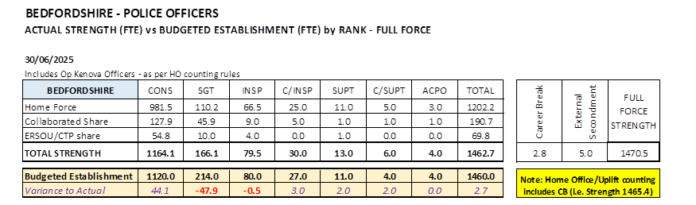
Reinvigorating local policing
Recruitment and Retention Numbers:
Police and Crime Commissioners have statutory responsibilities for delivering an efficient and effective police service. Our efficiency and effectiveness improves when the right level of resources are available and maximised.
The PCC wishes for his office to publish the monthly figures of the recruitment of officers.

Slide 14
Reinvigorating local policing
Recruitment and Retention Numbers:
Position Category | Total Starters Headcount | Starters (people from ethnic minority backgrounds) Headcount |  | Starters Female Headcount |  | Starters Under 24 Headcount |  | Starters 45+ Headcount |  | Starters (Declared Disability) Headcount
Officer | 73 | 4 | 5.48% | 37 | 50.68% | 40 | 54.79% | 3 | 4.11% | 4 | 5.48%
Staff | 5 | 1 | 20.00% | 5 | 100.00% | 0 | 0.00% | 0 | 0.00% | 1 | 20.00%
Special | 2 | 0 | 0.00% | 0 | 0.00% | 0 | 0.00% | 0 | 0.00% | 0 | 0.00%
SUM: | 80 | 5 | 6.25% | 42 | 52.50% | 40 | 50.00% | 3 | 3.75% | 5 | 6.25%
Position Category | Total Leavers Headcount | Leavers (people from ethnic minority backgrounds) Headcount |  | Leavers Female Headcount |  | Leavers Under 24 Headcount |  | Leavers 45+ Headcount |  | Leavers (Declared Disability) Headcount
Officer | 11 | 0 | 0.00% | 3 | 27.27% | 4 | 36.36% | 3 | 27.27% | 0 | 0.00%
Staff | 11 | 0 | 0.00% | 5 | 45.45% | 1 | 9.09% | 4 | 36.36% | 1 | 9.09%
Special | 1 | 0 | 0.00% | 1 | 100.00% | 0 | 0.00% | 0 | 0.00% | 0 | 0.00%
SUM: | 23 | 0 | 0.00% | 9 | 39.13% | 5 | 21.74% | 7 | 30.43% | 1 | 4.35%

Slide 15
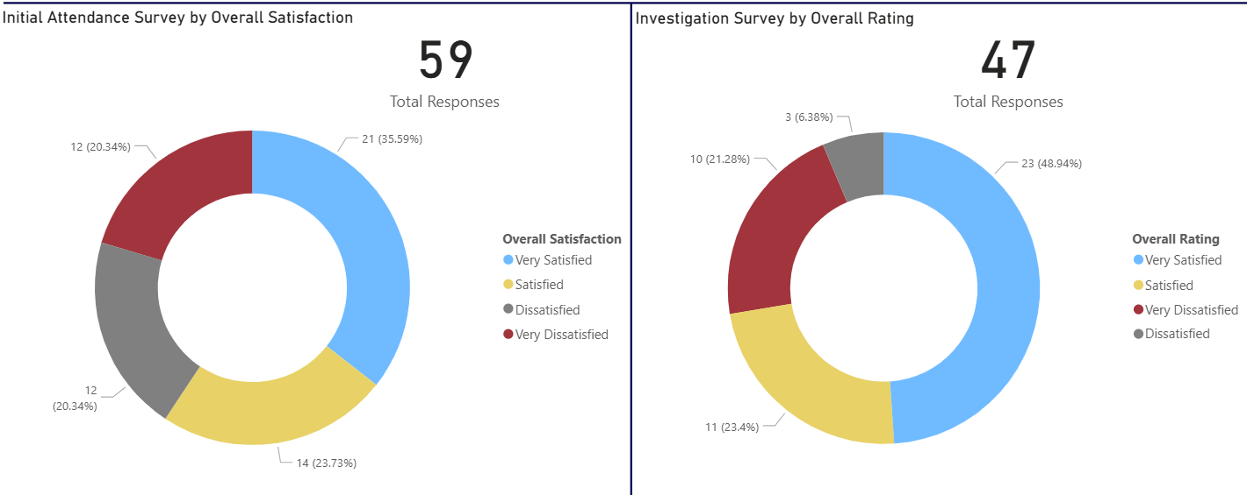
Victims at centre of the CJS
The PCC has requested information form the Force on a monthly basis surrounding Victim Satisfaction and how the Force deals with this and monitors this.
Victim Satisfaction
April
During April 2025, 59 Initial Attendance Surveys were completed and 47 Investigation Surveys.
Initial Attendance Surveys ~ 59.3% satisfaction rate. (Very satisfied + satisfied)
Investigation Surveys ~ 72.3% satisfaction rate.

Slide 16
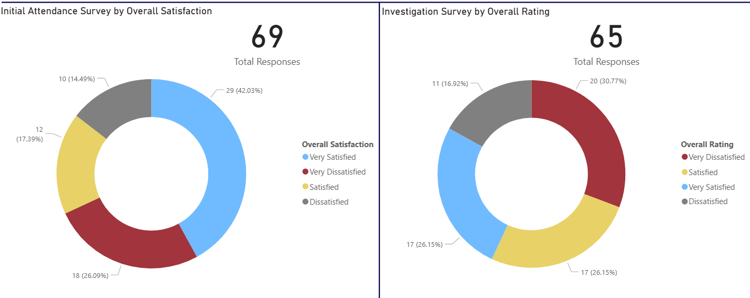
Victims at centre of the CJS
Victim Satisfaction
May
During May 2025, 69 Initial Attendance Surveys were completed and 65 Investigation Surveys.
Initial Attendance Surveys ~ 59.4% satisfaction rate. (Very satisfied + satisfied)
Investigation Surveys ~ 52.3% satisfaction rate.

Slide 17
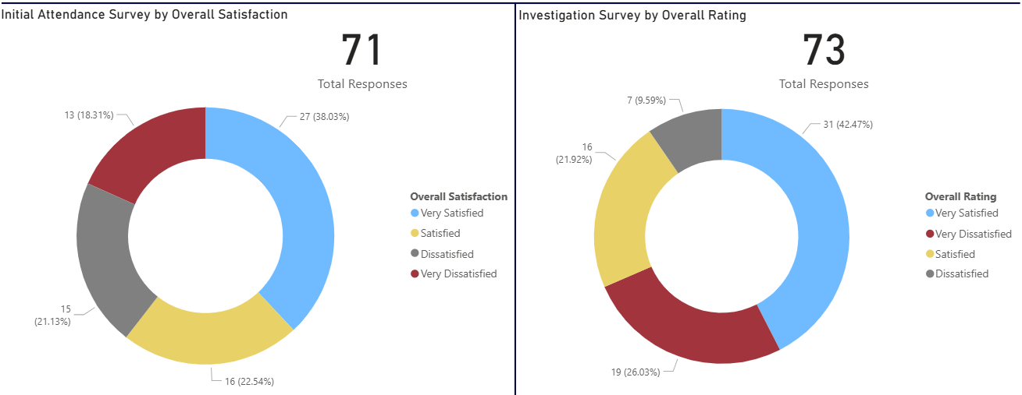
Victims at centre of the CJS
Victim Satisfaction
June
During June 2025, 71 Initial Attendance Surveys were completed and 73 Investigation Surveys.
Initial Attendance Surveys ~ 60.5% satisfaction rate. (Very satisfied + satisfied)
Investigation Surveys ~ 63.4% satisfaction rate.

Slide 18
Victims at centre of the CJS
The PCC has requested information form the Force on a monthly basis surrounding Victim Satisfaction and how the Force deals with this and monitors this.
The force is developing its IT solution to automated victim satisfaction surveys and this is progressing well against the project plan. In the meantime, the force has limited capacity to complete such surveys, however can report:
Victim Dissatisfaction
Orange – Enquiries Recorded
Blue - Dissatisfaction Recorded

Slide 19
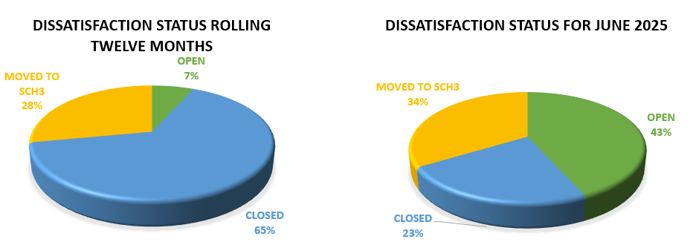
Victims at centre of the CJS.
Victim Dissatisfaction

Slide 20
Victims at centre of the CJS
Victim Dissatisfaction

Slide 21
Victims at centre of the CJS
Victim Dissatisfaction

Slide 22
Victims at centre of the CJS
Victim Dissatisfaction

Slide 23
Victims at centre of the CJS
Victim Dissatisfaction

Slide 24
Victims at centre of the CJS
Victim Dissatisfaction

Slide 25
Victims at centre of the CJS
Victim Dissatisfaction

Slide 26
Victims
The PCC has also requested for additional information to aid transparency of the Force and they fall under different headings in line with the pledge of being Transparent.
The PCC pledged that he would ensure that appropriate services are in place for victims within the power of the OPCC.
Clare’s Law
The Domestic Violence Disclosure Scheme(DVDS), also known as “Clare’s Law” enables the police to disclose information to a victim or potential victim of domestic abuse about their partner’s or ex-partner’s previous abusive or violent offending.
Clare's Law - number of requests and average length of time to respond to requests are on the next slide.

Slide 27
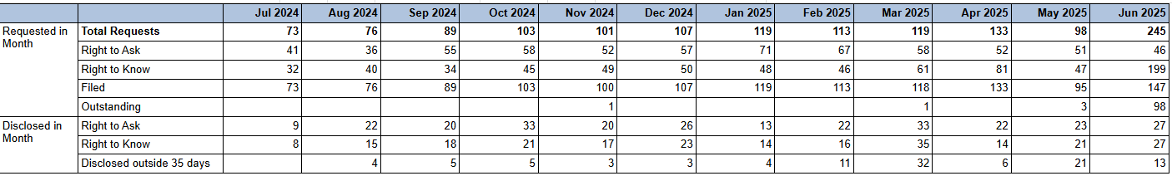

Slide 28
Excellence: an excellent police service
Force - Response times - 101 and 999 calls, March 2025
11,392 - 999 call answered, 380 average per day, 89.1% answered in 10 secs, 7s average wait time
3,916 - 101 Priority, 131 average per day, 2m 4s average wait time
5,853 - 101 Non-Priority, 195 average per day, 7m 7s average wait time
999 performance data | Police.uk (www.police.uk)

Slide 29
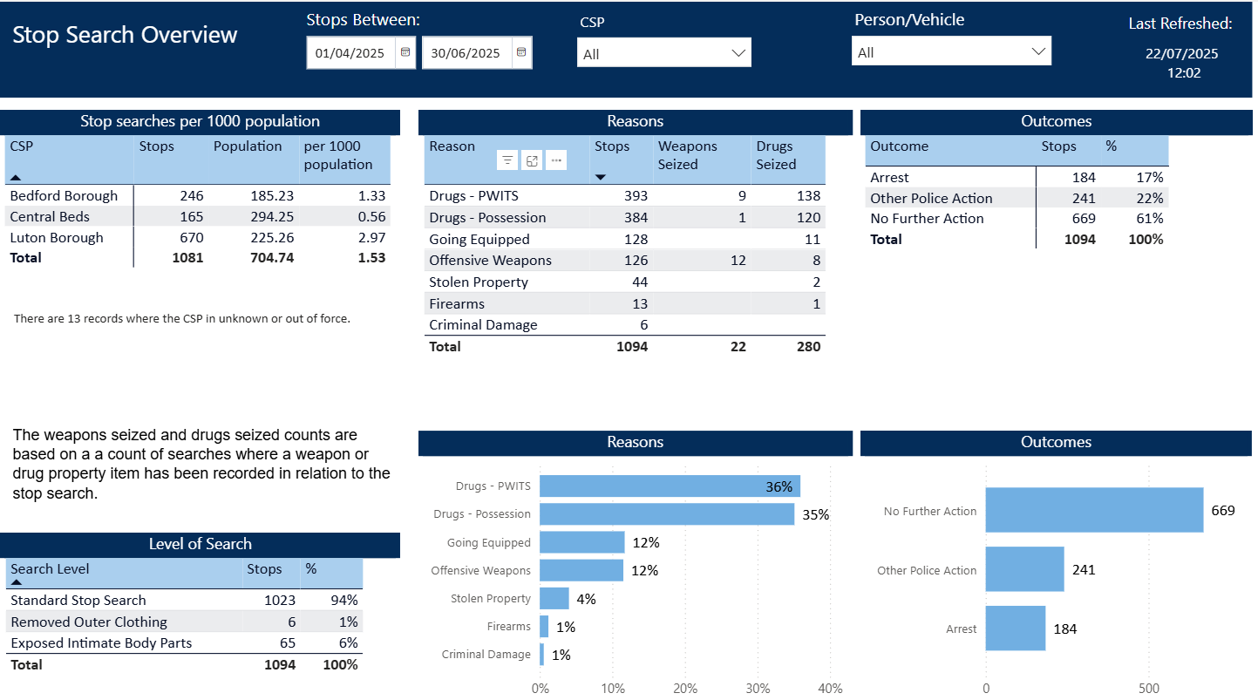
Excellence: an excellent police service
The PCC has also requested for additional information to aid transparency of the Force and they fall under different headings in line with the pledge of being Transparent.
Stop and Search Data (Q1 25-26)
Stop and search | Police.uk (www.police.uk)
Updated quarterly

Slide 30
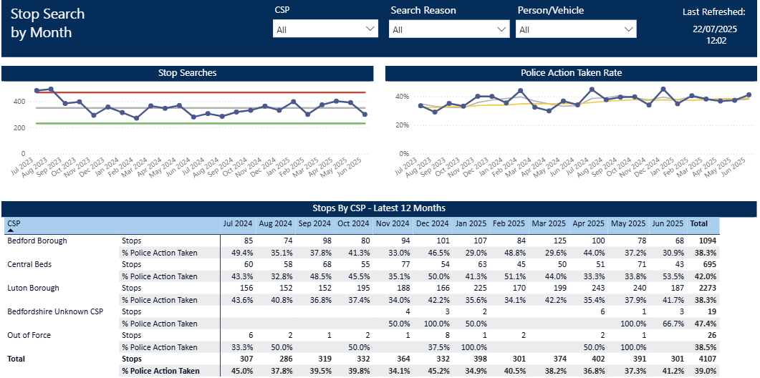
Updated quarterly

Slide 31
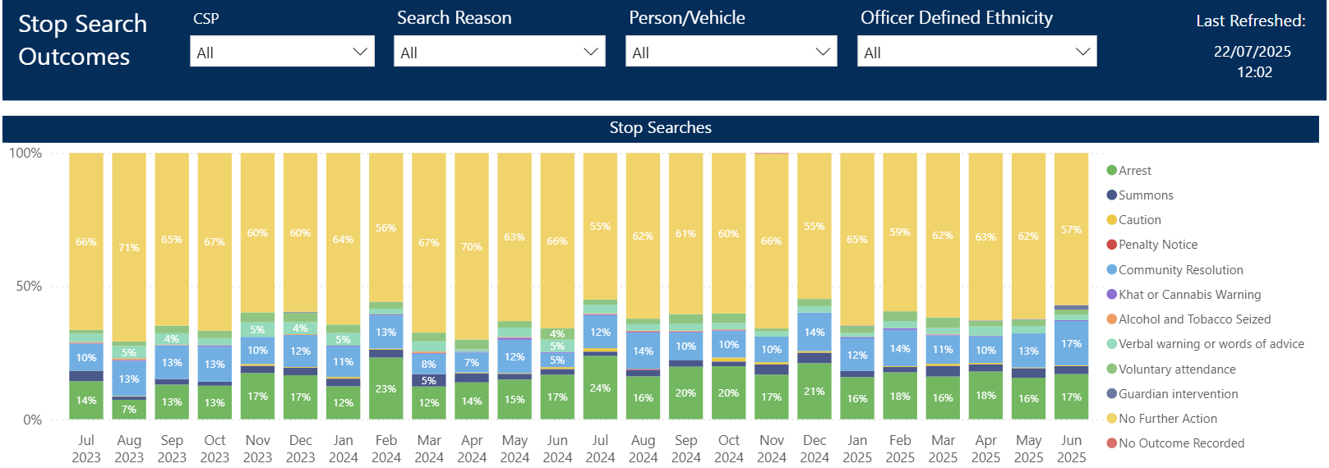
Updated quarterly

Slide 32
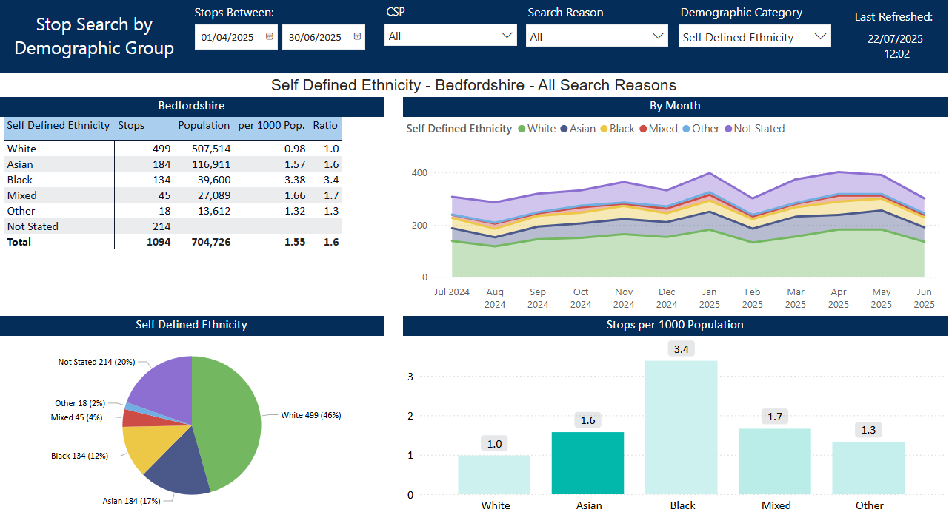
Updated quarterly

Slide 33
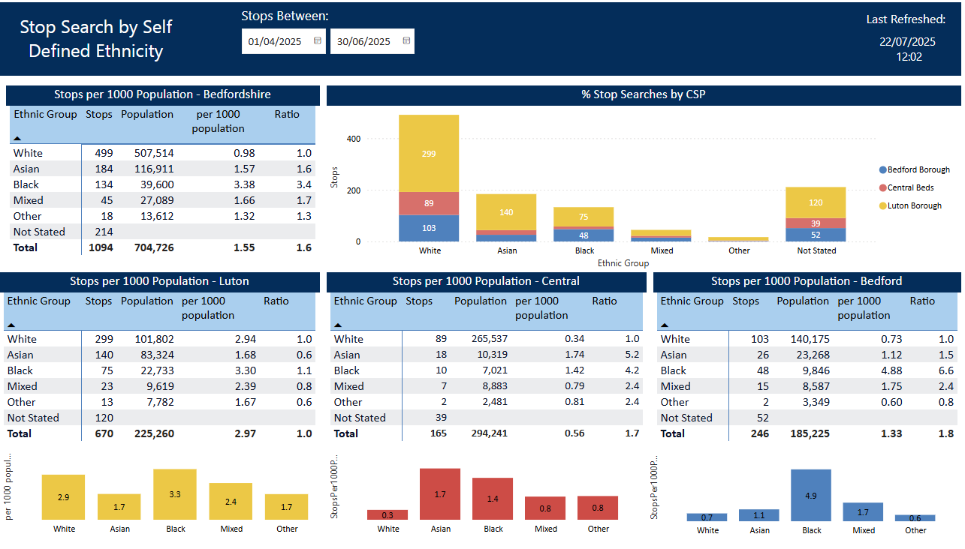
Updated quarterly

