Slide 1
Office of the Police and Crime Commissioner Information Document for
November 2024
Author: Office of the Police and Crime Commissioner
Sign Off – Force Exec : Fiona Dawson

Slide 2
Specified Information Order
Police and Crime Commissioners (PCCs) are required to publish certain information to allow the public to hold them to account.
Section 11(1) and (2) of The Police Reform and Social Responsibility Act 2011 requires an elected local policing body to publish any information specified by the Secretary of State by order.
The Elected Local Policing Bodies (Specified Information) Order 2011 (‘the Order’) sets out the information that must be published. Guidance on the order is published on gov.uk - Guidelines for PCCs on publishing information - GOV.UK (www.gov.uk)

Slide 3
Specified Information Order
Specified Information Order

Slide 4
Specified Information Order
The Elected Local Policing Bodies (Specified Information) (Amendment) Order 2021 (’the amending Order), which will come into force on 31 May 2021 provides that information relating to the force’s performance against the Government’s national priorities for policing.
National priorities for policing
The national priorities for policing are specified in the Police and Crime Measures:
reduce murder and other homicide;
reduce serious violence;
disrupt drugs supply and county lines;
reduce neighbourhood crime;
tackle cyber crime;
and improve satisfaction among victims with a particular focus on victims of domestic abuse.

Slide 5
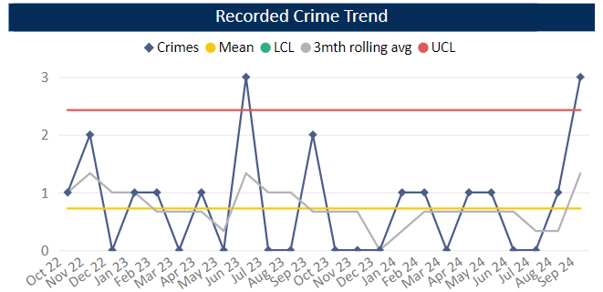
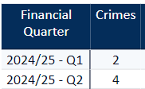
Reduce Murder and Other Homicide
Measure Summary
Local Measures | Trend / Outlook | Benchmark
Police recorded Homicide offences | Deterioration
Planned Action to Drive Performance
1. Homicide and joint Serious Violence reduction strategy has been collated into one and sits within the Serious Violence Board – strands include Mental Health, DA and Serious Violence.
2. The Force now has the Crest Advisory Homicide Review, and the conclusions/recommendations are being actioned via the Homicide and Serious Violence Reduction group and SV Board
3. Op Salus is the new operational name to combating Serious Violence and ASB jointly, implementing hotspot policing.
Comments
1. Four Homicides recorded in Q2, averaging around one per month in 24-25.
2. Same number of Homicides recorded in 2024-25 so far compared to the previous year.
This is in comparison to the previous quarter, as there were two homicides.
As of July the force in ranked 28th – 12mths to July 2024. In the OPCC report Q1 24-25 we were reporting being 30th so have seen an improvement in our ranking.
Caveat: this data is based on local Bedfordshire force data and may not match nationally published data (police.uk or published stats from HO)

Slide 6
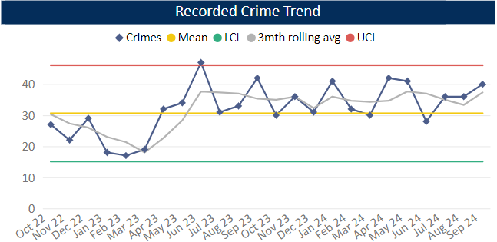
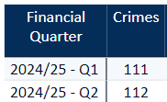
Reduce Serious Violence
Measure Summary
Local Measures | Trend / Outlook | Benchmark
Police recorded Most Serious Violence offences | Increasing
Solved Crimes | Deterioration
Planned Action to Drive Performance
1. Op SOTERIA implementation is progressing to address Rape and SSO
2. VERU - Deploying Outreach Workers in park areas across Beds during the Summer. Reactivate Workers to target 18-25yrs whilst in custody to discuss pathways available to them to divert away from violence. Now have a Youth Intervention Adviser and VERU had a summer calendar of activities to divert youths away from violence and ASB
Comments
1. Most Serious Violence levels have remained high over the year so far, averaging 37 crimes per month.
2. Levels over the year have consistently been higher than average.
3. Beds is now equal to the MSG average.
Caveat: this data is based on local Bedfordshire force data and may not match nationally published data (police.uk or published stats from HO)

Slide 7
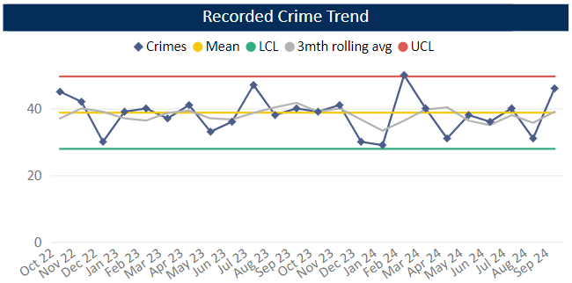
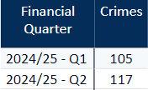
Disrupt Drugs Supply and County Lines
Measure Summary
Local Measures | Trend / Outlook | Benchmark
Number of Drug Trafficking offences | Reflects policing activity
Planned Action to Drive Performance
1. Op JOULES - County line initiative.
2. Op COSTELLO dedicate team continues to enforce on large scale drug activity, with key focus on the professional enablers, linking into SOC Op KOALA
Trafficking of Drugs
Comments
1. Q2 recorded 117 Trafficking of Drugs offences, averaging 37 crimes per month 24/25. This is up on the previous quarter but down on same time the previous year. Trafficking offences reflects proactive police activity.
2. Bedfordshire currently has 24 OCGs – this is an increase on Q1 24-25 where 22 were recorded. The number of Street Gangs has increased from 11 to 14 (as at the end of Sept 24).
3. Currently there are 77 groups operating 80 county lines, 12mth average is 66 lines.
Caveat: this data is based on local Bedfordshire force data and may not match nationally published data (police.uk or published stats from HO)
There has been a lot of change over the past few months with new lines coming in under Op Joule (where we actively scan for and identify new lines). From now on in, it is likely that these numbers will stabilise.

Slide 8
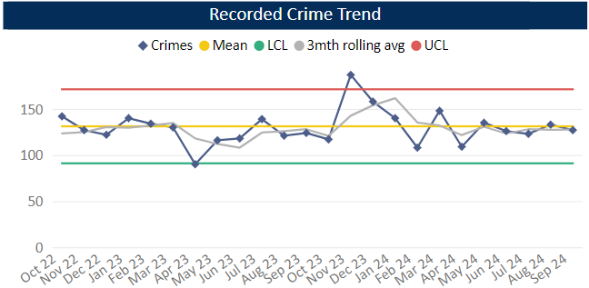
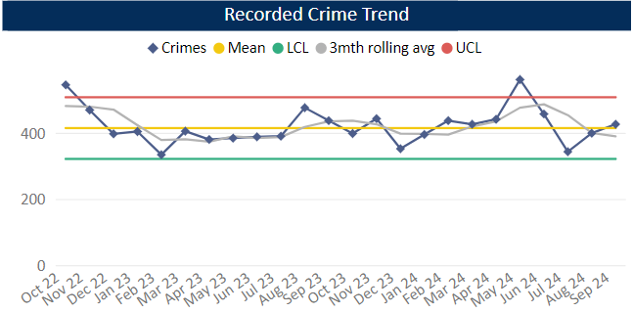
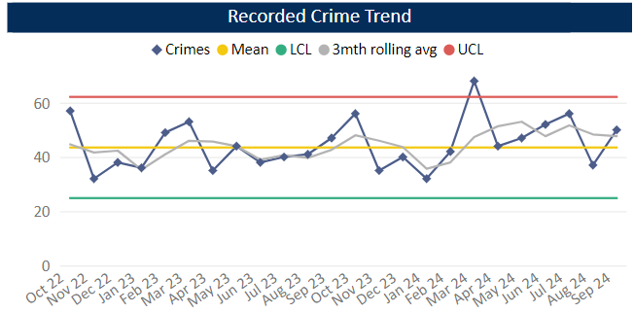
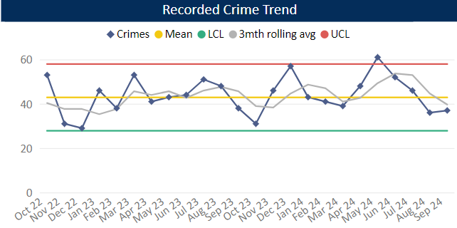
Reduce Neighbourhood Crime
Measure Summary
Local Measures | Trend / Outlook | Benchmark
Police recorded Residential Burglary offences (pre-April 23 definition) | Stable
Police recorded Vehicle Crime offences | Decreasing
Police recorded Personal Robbery offences | Stable
Police recorded Theft from Person offences | Decreasing
Planned Action to Drive Performance
1. Co-chaired Neighbourhood Crime meeting, focused on problem solving.
2. Op Troyes is the current force priority tackling Robberies across Luton and Bedford
Comments
1. Q2 recorded 383 Residential Burglaries averaging 126 crimes a month 24/25. This is higher than the previous quarter and equal to the same period in the previous year. Solved rate for Q2 24-25 was 14.1%.
2. Vehicle Crime has decreased compared to Q1, but comparable with previous quarters. Average 438 crimes per month 24/25.
3. Personal Robbery is similar to Q1. Q2 was higher than the same quarter in the 23-24 year. Average 48 crimes per month 24/25. Solved rate for Q1 24-25 was 2.8%.
4. 119 Theft from a Person during Q2, this is an decrease compared to Q1 and below this time in the previous year. Levels have been around the average across the quarter as a whole.
Burglary Residential
Vehicle Crime
Personal Robbery
Theft from Person

Slide 9
Tackle Cyber Crime
Measure Summary
Local Measures | Trend / Outlook | Benchmark
Investigate 100% of all cyber dependant crime disseminated to force | Stable [100%] | Not available
Provide 100% of all cyber dependant crime victims with specialist advice | Stable [100%] | Not available
Action Fraud offences | Stable [100%] | Not available
Planned Action to Drive Performance
1. A month trial of Fraud Advice Clinics are running through October. Alternate weeks at HQ or LPS. Available for the entire organisation to have a dedicated fraud investigator to offer advice on lines of enquiry.
2. Fraud Triage review for September and October regarding crime recording standards not being adhered too. Once data compiled meeting between Crime Bureau to take place.
Comments
1. CPS charging decisions are now coming through for the long-term investigations that have been sat with the SFIU since it started in April 2021. OP JACOBS – charges for conspiracy to commit fraud. 26 rogue trader frauds. OP WARBIRD – Facebook marketplace fraud. Suspect - guilty plea at court. R v GOULDEN – Fraud by False representation against deceased family member – guilty plea at court.
2. OP HENHOUSE – planning for the bid to the NCA and NECC for a month of action in February.
3. SFIU DI and DS attending the National User Group (NUG) in November 2024 around the new FCRASS system being implemented by Action Fraud.

Slide 10
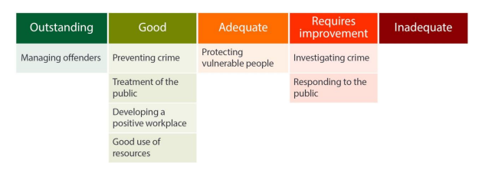
Specified Information Order
HMICFRS reporting
The amending Order requires PCCs to publish the most recent HMICFRS force-level report on the effectiveness, efficiency and legitimacy of the police force.
The Order requires that PCCs publish the PEEL report for their force on their website, within one calendar month of its publication by HMICFRS.
https://www.bedfordshire.pcc.police.uk/hmic-reports/

Slide 11
Specified Information Order
Complaints handling
The Order provides that PCCs must publish the most recent IOPC quarterly complaints data for their force and the IOPC annual statistics report, alongside a narrative setting out how the PCC is holding the chief officer to account, and the PCC’s assessment of their own performance in carrying out their other complaints handling functions.
Holding the chief officer to account
It is recommended that the narrative should include:
• How the force is measuring complainant satisfaction.
• Progress updates on implementing relevant recommendations made by the IOPC and/or HMICFRS in relation to complaints handling, or where recommendations were not accepted an explanation as to why.
• A summary of any mechanisms put in place to identify and act on themes or trends in complaints.
• A summary of systems in place to monitor and improve performance in the timeliness of complaints handling.
• The number of written communications issued by the force under regulation 13 of the Police (Complaints and Misconduct) Regulations 2020 where an investigation has not been completed within a “relevant period”.
• Quality Assurance mechanisms in place to monitor and improve the quality of its responses to complaints.
• Details of the administrative arrangements the PCC has put in place to hold the chief constable to account for complaints handling e.g. frequency of meetings and a summary of discussions.

Slide 12
Specified Information Order
Complaints handling
Holding Bedfordshire police to account
Complaints Police and Crime Commissioner

Slide 13
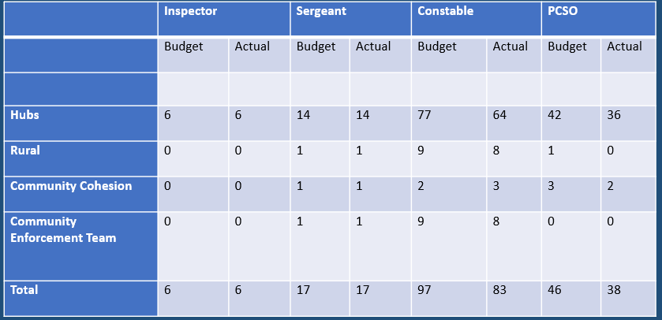
Community policing
Community Policing Numbers:
Education and Diversion Team - budgeted spaces of 1 x sergeant, 8 x constable, 6 x PCSO. Their filled spaces total 1 x sergeant, 5 x constable, 3 x PCSO at present (2 x PC awaiting release dates).

Slide 14
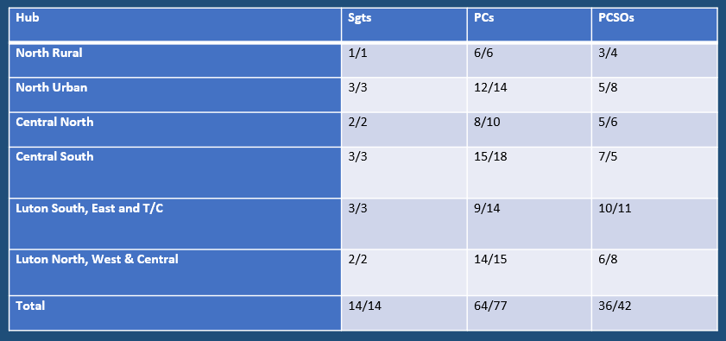
Community policing
Community Hubs
In addition, there are currently 13 student officers on their rotations with Community Policing until 01/12/24 and so there are an additional
3 at North Urban,
3 at North Central,
3 at South Central,
3 at Luton South, East &T/C and
1 at Luton North, West & Central

Slide 15
Community policing
The Special Constabulary is a force of warranted, uniformed volunteer police officers. A key strength is that these volunteer officers are warranted constables, with all the powers of a regular police officer. Special constables’ integration in the local communities in which they live, work and serve is a further strength, helping to build links between policing and communities.
We currently have established Special Constables in the following areas.
Bedfordshire Police currently has 58 Special Constables
SC - 52
Sgts – 2
Insp – 4
Hours in October 2024 = 1613

Slide 16
Community policing
Special Constabulary
Community North – 6
Community South – 11
Patrol North – 15
Patrol South - 11
LLA – 3
RPU – 2
Crime – 2
HQ – 1
Licencing – 1

Slide 17
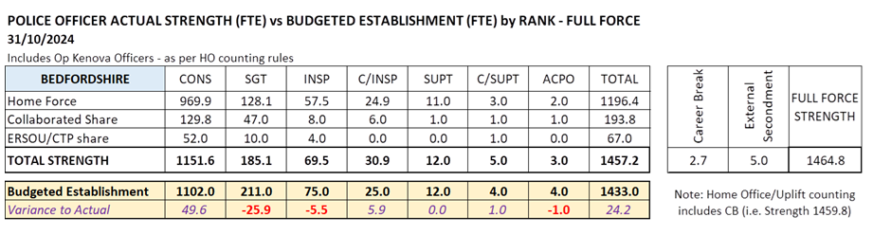
Recruitment and retention of police officers
Recruitment and Retention Numbers:
Police and Crime Commissioners have statutory responsibilities for delivering an efficient and effective police service. Our efficiency and effectiveness improves when the right level of resources are available and maximised.
The PCC wishes for his office to publish the monthly figures of the recruitment of officers.

Slide 18
Recruitment and retention of police officers
Recruitment and Retention Numbers:
Position Category | Total Starters Headcount | Starters (people from ethnic minority backgrounds) Headcount |  | Starters Female Headcount |  | Starters Under 24 Headcount |  | Starters 45+ Headcount |  | Starters (Declared Disability) Headcount
Officer | 7 | 2 | 28.57% | 3 | 42.86% | 5 | 71.43% | 1 | 14.29% | 0 | 0.00%
Staff | 20 | 6 | 30.00% | 15 | 75.00% | 2 | 10.00% | 4 | 20.00% | 2 | 10.00%
Special | 1 | 0 | 0.00% | 0 | 0.00% | 1 | 100.00% | 0 | 0.00% | 0 | 0.00%
SUM: | 28 | 8 | 28.57% | 18 | 64.29% | 8 | 28.57% | 5 | 17.86% | 2 | 7.14%
Position Category | Total Leavers Headcount | Leavers (people from ethnic minority backgrounds) Headcount |  | Leavers Female Headcount |  | Leavers Under 24 Headcount |  | Leavers 45+ Headcount |  | Leavers (Declared Disability) Headcount
Officer | 15 | 1 | 6.67% | 10 | 66.67% | 3 | 20.00% | 3 | 20.00% | 2 | 13.33%
Staff | 11 | 0 | 0.00% | 5 | 45.45% | 1 | 9.09% | 8 | 72.73% | 2 | 18.18%
Special | 2 | 0 | 0.00% | 1 | 50.00% | 0 | 0.00% | 1 | 50.00% | 0 | 0.00%
SUM: | 28 | 1 | 3.57% | 16 | 57.14% | 4 | 14.29% | 12 | 42.86% | 4 | 14.29%

Slide 19
Victims at centre of the CJS
The PCC has requested information form the Force on a monthly basis surrounding Victim Satisfaction and how the Force deals with this and monitors this.
Victim Satisfaction
New surveying was being implemented so no data presented this month.

Slide 20
Victims at centre of the CJS
The PCC has requested information form the Force on a monthly basis surrounding Victim Satisfaction and how the Force deals with this and monitors this.
The force is developing its IT solution to automated victim satisfaction surveys and this is progressing well against the project plan. In the meantime, the force has limited capacity to complete such surveys, however can report:
Victim Dissatisfaction
Orange – Enquiries Recorded
Blue - Dissatisfaction Recorded

Slide 21
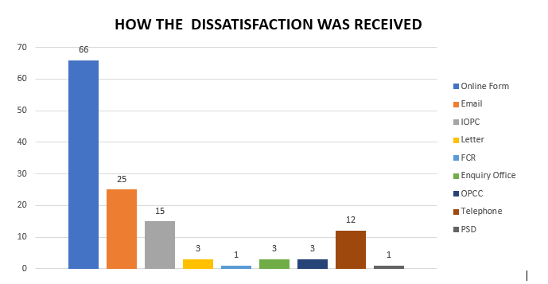
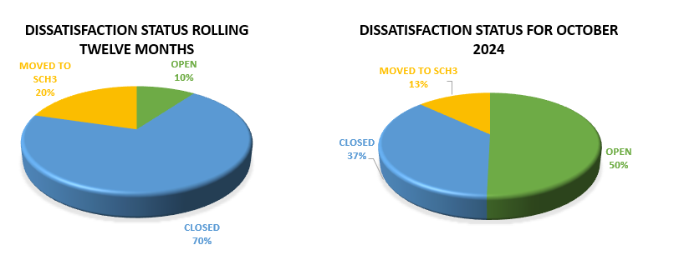
Victims at centre of the CJS.
Victim Dissatisfaction

Slide 22
Victims at centre of the CJS
Victim Dissatisfaction

Slide 23
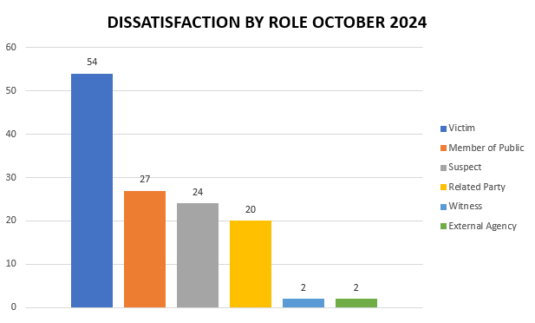
Victims at centre of the CJS
Victim Dissatisfaction

Slide 24
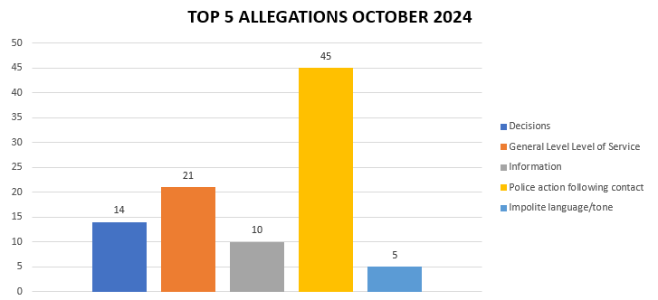
Victims at centre of the CJS
Victim Dissatisfaction

Slide 25
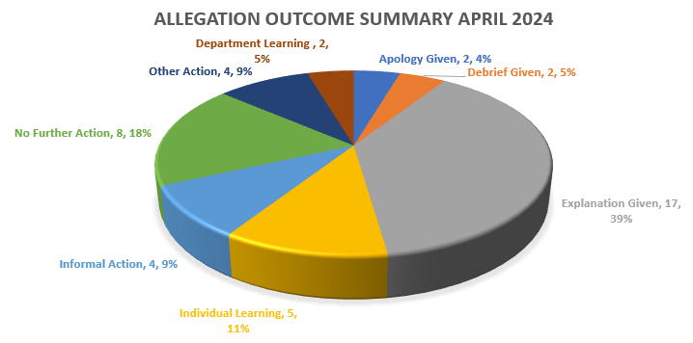
Victims at centre of the CJS
Victim Dissatisfaction

Slide 26
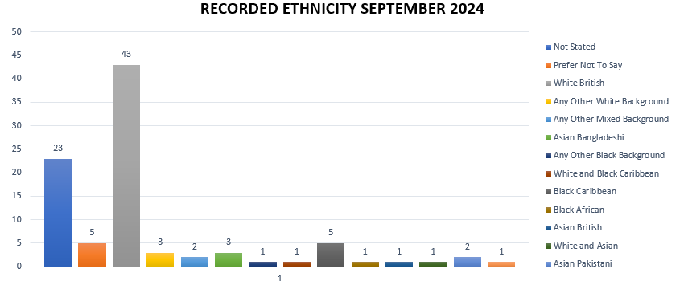
Victims at centre of the CJS
Victim Dissatisfaction

Slide 27
Victims at centre of the CJS
Victim Dissatisfaction

Slide 28
Transparency
The PCC has also requested for additional information to aid transparency of the Force and they fall under different headings in line with the pledge of being Transparent.
The PCC has pledged to invest to improve performance and wellbeing of staff in our Force Control Room
Force - Response times - 101 and 999 calls, October 2024
10,510 - 999 call answered, 339 average per day, 95.1% answered in 10 secs, 2s average wait time
3,514 - 101 Priority, 113 average per day, 1m 45s average wait time
7,206 - 101 Non-Priority, 232 average per day, 5m 13s average wait time
999 performance data | Police.uk (www.police.uk)

Slide 29
Transparency
The PCC has also requested for additional information to aid transparency of the Force and they fall under different headings in line with the pledge of being Transparent.
The PCC pledged that he would ensure that appropriate services are in place for victims within the power of the OPCC.
Clare’s Law
The Domestic Violence Disclosure Scheme(DVDS), also known as “Clare’s Law” enables the police to disclose information to a victim or potential victim of domestic abuse about their partner’s or ex-partner’s previous abusive or violent offending.
Clare's Law - number of requests and average length of time to respond to requests are on the next slide.

Slide 30
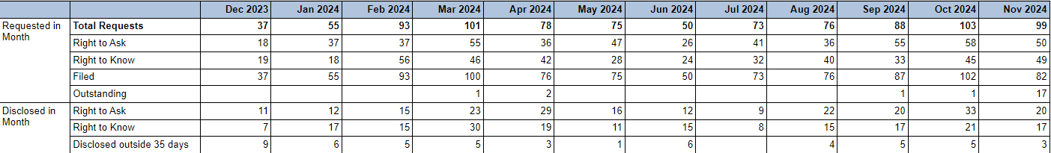

Slide 31
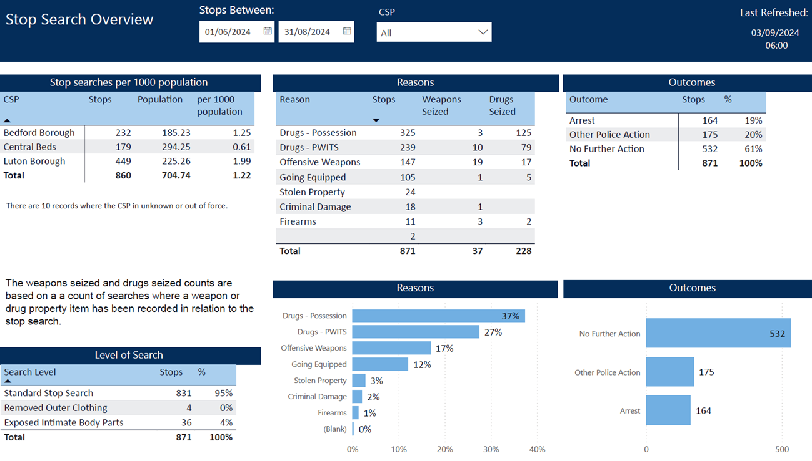
Scrutiny
The PCC has also requested for additional information to aid transparency of the Force and they fall under different headings in line with the pledge of being Transparent.
Stop and Search Data (Q2)
Stop and search | Police.uk (www.police.uk)
Updated quarterly

Slide 32
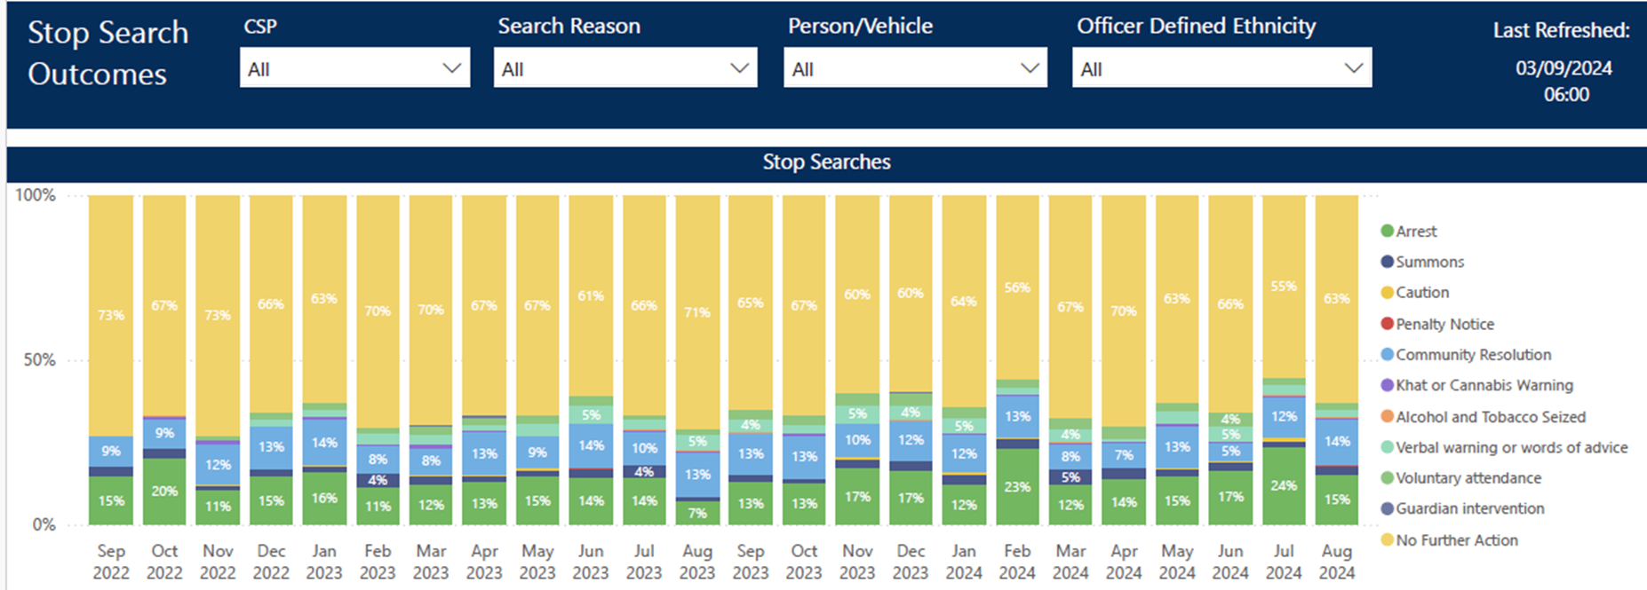
Updated quarterly

Slide 33
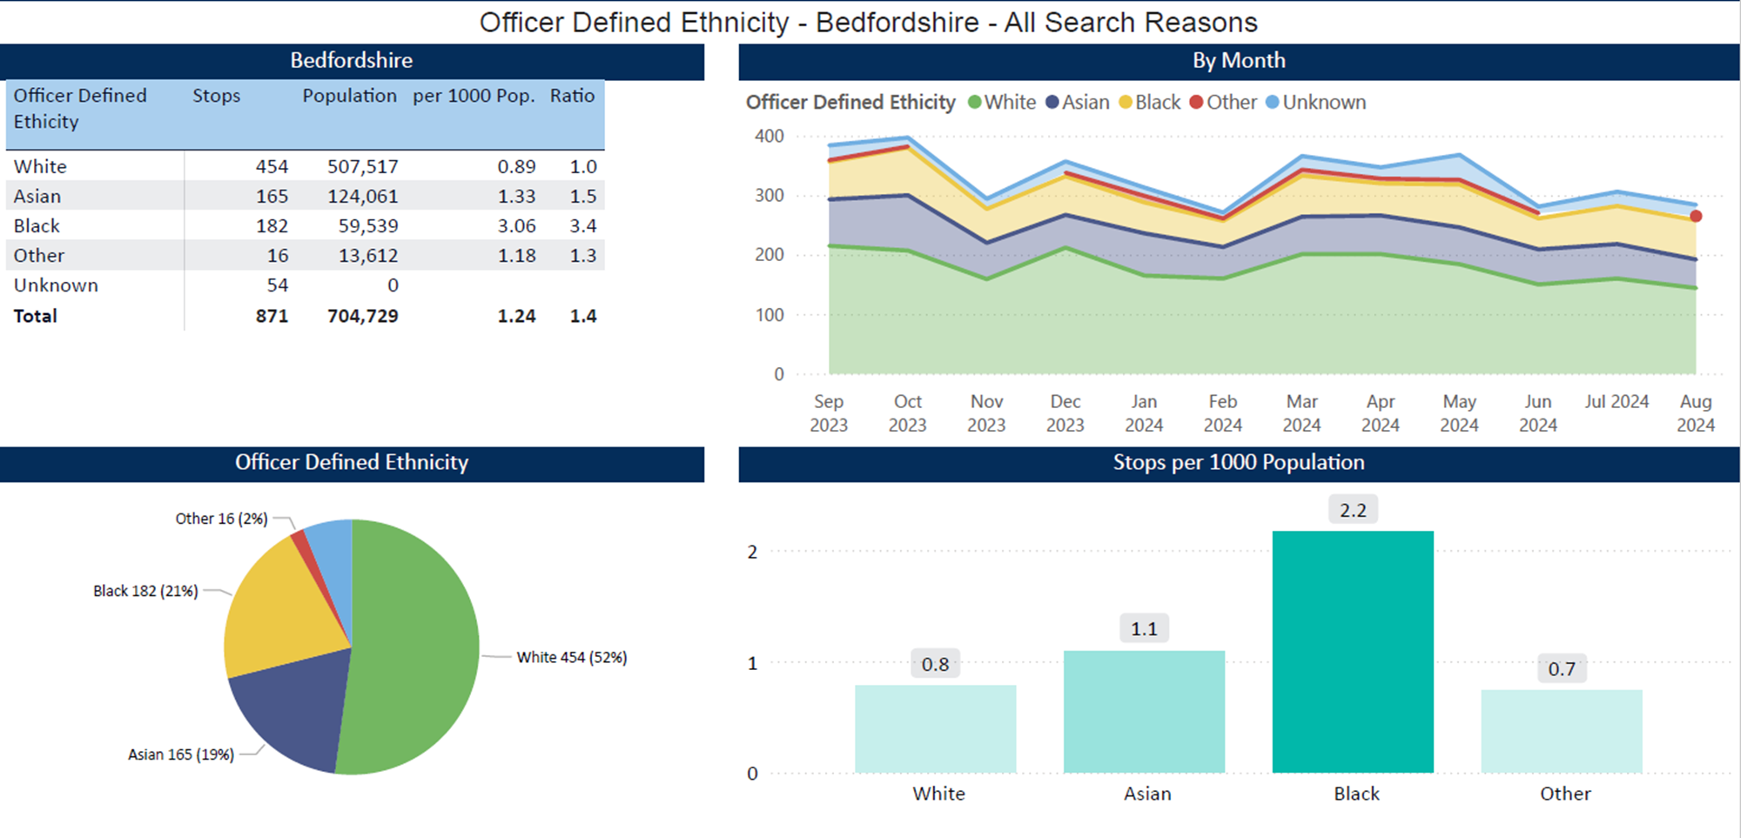
Updated quarterly

Slide 34
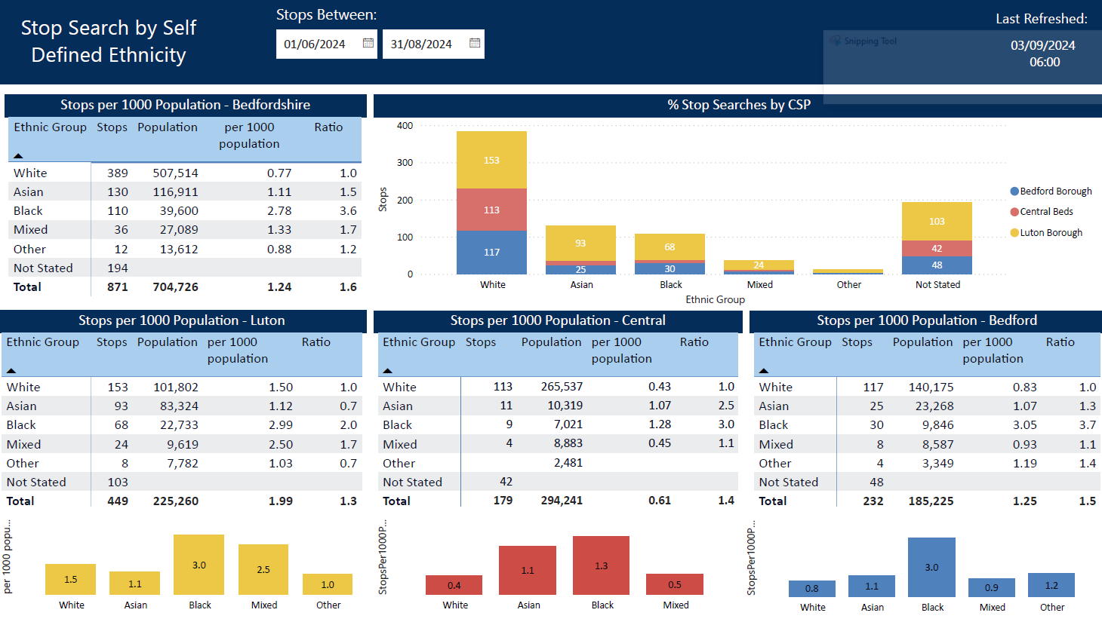
Updated quarterly

