Slide 1
Office of the Police and Crime Commissioner Information Document for
October 2025
Author: Office of the Police and Crime Commissioner
Sign Off – Force Exec : Fiona Dawson
Changed to quarterly publication in line with Performance and Governance Performance Meetings.

Slide 2
Specified Information Order
Police and Crime Commissioners (PCCs) are required to publish certain information to allow the public to hold them to account.
Section 11(1) and (2) of The Police Reform and Social Responsibility Act 2011 requires an elected local policing body to publish any information specified by the Secretary of State by order.
The Elected Local Policing Bodies (Specified Information) Order 2011 (‘the Order’) sets out the information that must be published. Guidance on the order is published on gov.uk - Guidelines for PCCs on publishing information - GOV.UK (www.gov.uk)

Slide 3
Specified Information Order
https://www.bedfordshire.pcc.police.uk/specified-information-order/

Slide 4
Specified Information Order
The Elected Local Policing Bodies (Specified Information) (Amendment) Order 2021 (’the amending Order), which will come into force on 31 May 2021 provides that information relating to the force’s performance against the Government’s national priorities for policing.
National priorities for policing
The national priorities for policing are specified in the Police and Crime Measures:
reduce murder and other homicide;
reduce serious violence;
disrupt drugs supply and county lines;
reduce neighbourhood crime;
tackle cyber crime;
and improve satisfaction among victims with a particular focus on victims of domestic abuse.

Slide 5
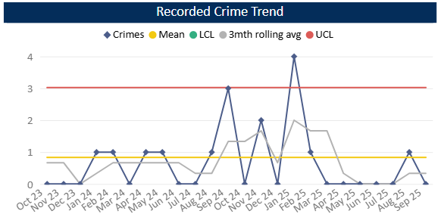
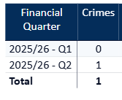
Reduce Murder and Other Homicide
Measure Summary
Local Measures | Trend / Outlook | Benchmark
Police recorded Homicide offences | Improving
Planned Action to Drive Performance
1. Homicide and joint Serious Violence reduction strategy has been collated into one and sits within the Serious Violence Board – strands include Mental Health, DA and Serious Violence.
2. Work under Op Salus continues with the number of hours increasing in August and September (Op Salus only). Reporting shows a variety of prevention work that has taken place – arrests and stop searches have been carried out and ASB powers have been used. There has also been a significant amount of engagement with the public.
Comments
1. There was one Homicide recorded in Q2 25-26.
2. By comparison, in the same period last year, we recorded 4 homicides.
This is in comparison to the previous quarter, where there were no homicides recorded.
The force in ranked 41st for the crime rate per 1000 population in the 12mths to July 2025. This is a small decrease in our ranking as in the previous OPCC report we were ranked 40th.
Caveat: this data is based on local Bedfordshire force data and may not match nationally published data (police.uk or published stats from HO)

Slide 6
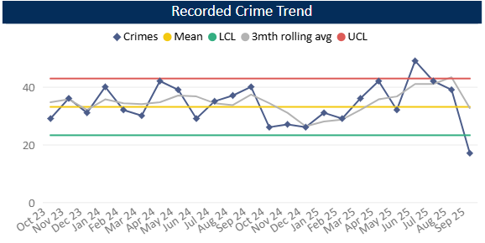
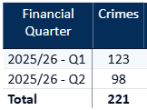
Reduce Serious Violence
Measure Summary
Local Measures | Trend / Outlook | Benchmark
Police recorded Most Serious Violence offences | Decreasing
Solved Crimes | Decreasing
Planned Action to Drive Performance
1. Quarterly review of HKC (Habitual Knife Carriers) – this is ongoing with offenders and issues raised to the relevant teams to action and problem-solve.
2. Knife Crime quarterly review - a revised version is provided for monthly interim meetings with trends and any emerging issues or intel highlighted.
3. Legislation is proactively being used to obtain warrants for possession of zombie knives and other weapons.
Comments
1. Most Serious Violence levels decreased during Q2 compared to Q1 and are now below the lower threshold. They are averaging 37 crimes per month.
2. Levels were previously below average from Oct 24 to Feb 25 but rose to above average from March onwards.
3. Beds is equal to the MSG average.
Caveat: this data is based on local Bedfordshire force data and may not match nationally published data (police.uk or published stats from HO)

Slide 7
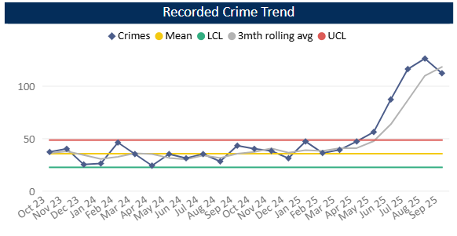
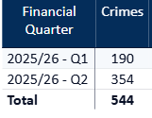
Disrupt Drugs Supply and County Lines
Measure Summary
Local Measures | Trend / Outlook | Benchmark
Number of Drug Trafficking offences | Reflects policing activity
Planned Action to Drive Performance
1. Op COSTELLO – this is a dedicated team which works on enforcements for large scale drug activity. A key focus for the team is professional enablers, linking into SOC
2. Scanning processes continue as business as usual in order to identify new lines.
3. The Drugs Focus Desk has now been running for one year and is ensuring the Force has a focus on complex drug line investigations. It plays a critical role in identifying offenders, gathering intelligence and coordinating enforcement against county lines, networks and emerging drug threats.
Trafficking of Drugs
Comments
1. Q2 recorded 354 Trafficking of Drugs offences, averaging 118 crimes per month in that quarter or 91 per month across 25-26 so far. This is up on the previous quarter and on the same time last year. Trafficking offences tend to reflect proactive police activity however some of this increase will be in relation to the recording of FAST Parcels.
2. Bedfordshire currently has 21 OCGs – this has increased since last quarter. The number of Street Gangs has decreased slightly to 10 (as at Oct 25) however an 11th gang is in the process of being mapped.
3. Currently there are 73 county lines. This increase is due to better identification of potential lines particularly by the Drugs Focus Desk and in the Central Beds area.
Caveat: this data is based on local Bedfordshire force data and may not match nationally published data (police.uk or published stats from HO)
There has been a lot of change over the past few months with some OCGs being archived.

Slide 8
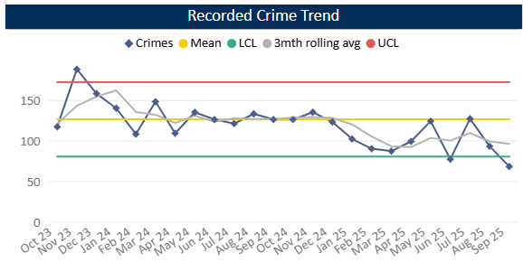
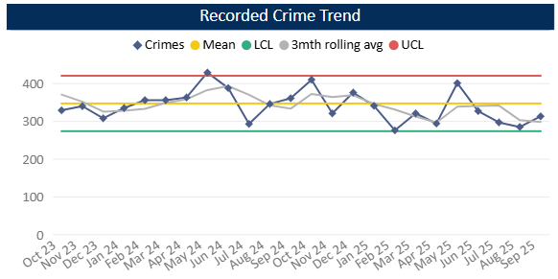
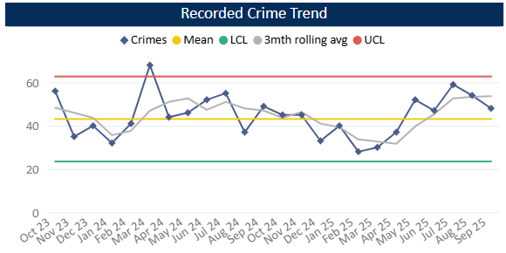
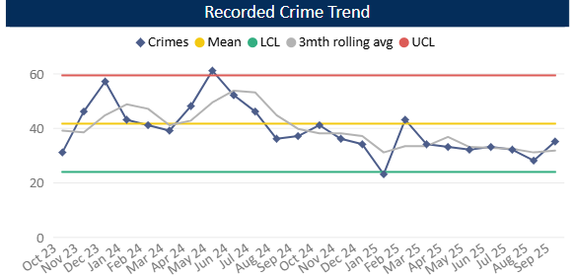
Reduce Neighbourhood Crime
Measure Summary
Local Measures | Trend / Outlook | Benchmark
Police recorded Residential Burglary offences (pre-April 23 definition) | Decreasing
Police recorded Vehicle Crime offences | Decreasing
Police recorded Personal Robbery offences | Increasing
Police recorded Theft from Person offences | Decreasing
Planned Action to Drive Performance
1. Identification of robbery issues through NHC Silver – robbery in Marsh Farm & Lewsey are currently a force priority
2. HSG continues as business as usual within the Neighbourhood Crime Silver Meeting.
3. Analysts have produced reports to identify the reasons for seasonal increases in robbery in October and residential burglary in Oct-Dec to support in crime prevention
Burglary Residential
Vehicle Crime
Comments
1. In Q2 288 Residential Burglaries were recorded, averaging 96 crimes a month. This is slightly below Q1 and around 100 fewer crimes than the same period in the previous year. Solved rate for Q2 25-26 was 8.3%.
2. Vehicle Crime has decreased compared to Q1 and is in fact the lowest volume seen since Q1 21-22. The average in Q2 is 297 crimes per month. The solved rate is equal to Q1 at 1.7%.
3. Personal Robbery has increased compared to Q1. Q2 was also higher (by around 20 crimes) than the same quarter in the 24-25 year. The average was 54 crimes per month in Q2 25-26 and the solved rate was 6.8%.
4. 95 Theft from a Person crimes were recorded during Q2, this is a slight decrease compared to Q1 and is below this time last year. Levels have been below average across the quarter as a whole.
Personal Robbery
Theft from Person

Slide 9
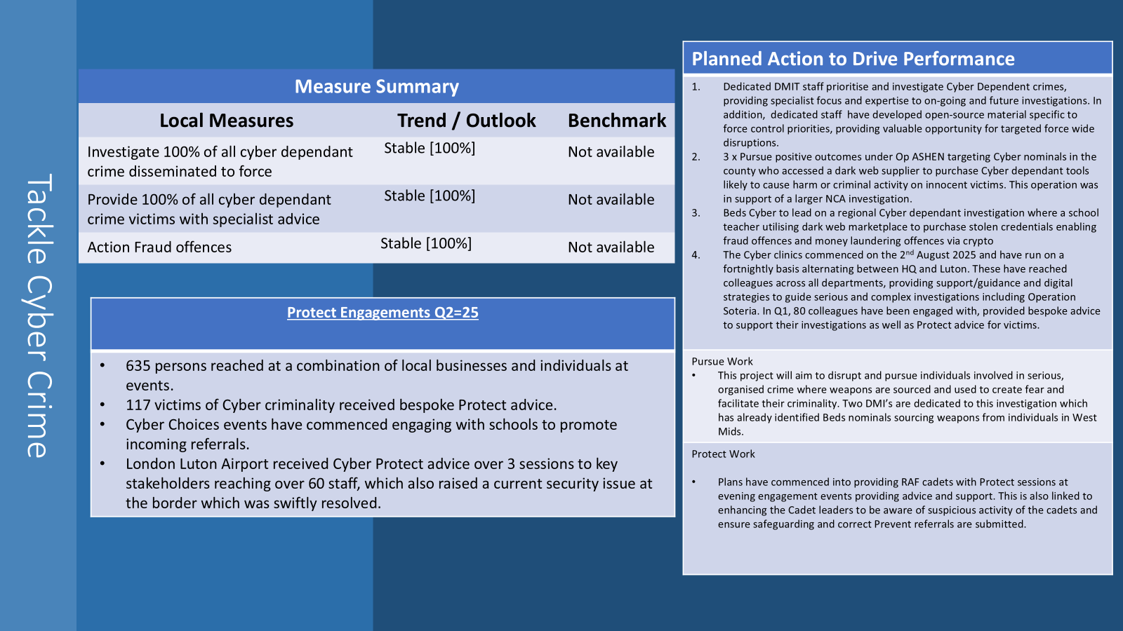
Tackle Cyber Crime
Planned Action to Drive Performance
Dedicated DMIT staff will prioritise and investigate Cyber Dependent crimes, providing specialist focus and expertise to on-going and future investigations. In addition, dedicated staff will develop open-source material specific to force control priorities, providing valuable opportunity for targeted force wide disruptions.
2. The cyber clinics commence on 2nd August 25 North providing support / guidance / digital strategies including Soteria, RASSO who are in the process of having inputs to all staff and supervisors There will be a formal news article on the intranet to advertise these clinics. This will improve Beds overall performance in Regional Cyber KPI monthly returns, which drives our funding into the next 3-year cycle commencing April 2026.
3- Protect Work A monthly Black Cat local radio slot has commenced for 45 mins per month for cyber related topics with online engagement. This will likely provide useful up-to date advice, guidance and signposting for those listeners.
Measure Summary
Local Measures | Trend / Outlook | Benchmark
Investigate 100% of all cyber dependant crime disseminated to force | Stable [100%] | Not available
Provide 100% of all cyber dependant crime victims with specialist advice | Stable [100%] | Not available
Action Fraud offences | Stable [100%] | Not available
Protect Engagements Q1=26
Audience reached 305 combination of local businesses and individuals at events 106 victims of Cyber criminality received bespoke Protect advice 1 Cyber Choices Referral 1 Cyber Choices investigation result and Cease and Desist notice Given

Slide 10
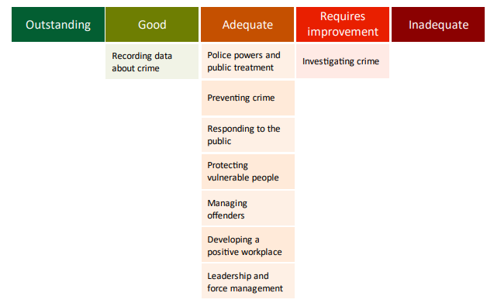
Specified Information Order
HMICFRS reporting
The amending Order requires PCCs to publish the most recent HMICFRS force-level report on the effectiveness, efficiency and legitimacy of the police force.
The Order requires that PCCs publish the PEEL report for their force on their website, within one calendar month of its publication by HMICFRS.
https://www.bedfordshire.pcc.police.uk/hmic-reports/

Slide 11
Specified Information Order
Complaints handling
The Order provides that PCCs must publish the most recent IOPC quarterly complaints data for their force and the IOPC annual statistics report, alongside a narrative setting out how the PCC is holding the chief officer to account, and the PCC’s assessment of their own performance in carrying out their other complaints handling functions.
Holding the chief officer to account
It is recommended that the narrative should include:
• How the force is measuring complainant satisfaction.
• Progress updates on implementing relevant recommendations made by the IOPC and/or HMICFRS in relation to complaints handling, or where recommendations were not accepted an explanation as to why.
• A summary of any mechanisms put in place to identify and act on themes or trends in complaints.
• A summary of systems in place to monitor and improve performance in the timeliness of complaints handling.
• The number of written communications issued by the force under regulation 13 of the Police (Complaints and Misconduct) Regulations 2020 where an investigation has not been completed within a “relevant period”.
• Quality Assurance mechanisms in place to monitor and improve the quality of its responses to complaints.
• Details of the administrative arrangements the PCC has put in place to hold the chief constable to account for complaints handling e.g. frequency of meetings and a summary of discussions.

Slide 12
Specified Information Order
Complaints handling
https://www.bedfordshire.pcc.police.uk/public-info/specified-information-order/complaints-handling-specified-information-order/
https://www.bedfordshire.pcc.police.uk/public-info/specified-information-order/holding-bedfordshire-police-to-account/

Slide 13
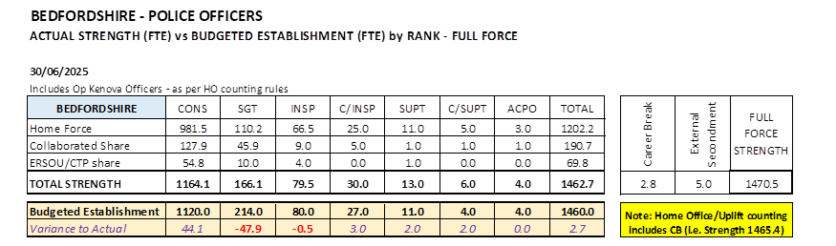
Reinvigorating local policing
Recruitment and Retention Numbers:
Police and Crime Commissioners have statutory responsibilities for delivering an efficient and effective police service. Our efficiency and effectiveness improves when the right level of resources are available and maximised.
The PCC wishes for his office to publish the monthly figures of the recruitment of officers.

Slide 14
Reinvigorating local policing
Recruitment and Retention Numbers:
Position Category | Total Starters Headcount | Starters (people from ethnic minority backgrounds) Headcount |  | Starters Female Headcount |  | Starters Under 24 Headcount |  | Starters 45+ Headcount |  | Starters (Declared Disability) Headcount
Officer | 73 | 4 | 5.48% | 37 | 50.68% | 40 | 54.79% | 3 | 4.11% | 4 | 5.48%
Staff | 5 | 1 | 20.00% | 5 | 100.00% | 0 | 0.00% | 0 | 0.00% | 1 | 20.00%
Special | 2 | 0 | 0.00% | 0 | 0.00% | 0 | 0.00% | 0 | 0.00% | 0 | 0.00%
SUM: | 80 | 5 | 6.25% | 42 | 52.50% | 40 | 50.00% | 3 | 3.75% | 5 | 6.25%
Position Category | Total Leavers Headcount | Leavers (people from ethnic minority backgrounds) Headcount |  | Leavers Female Headcount |  | Leavers Under 24 Headcount |  | Leavers 45+ Headcount |  | Leavers (Declared Disability) Headcount
Officer | 11 | 0 | 0.00% | 3 | 27.27% | 4 | 36.36% | 3 | 27.27% | 0 | 0.00%
Staff | 11 | 0 | 0.00% | 5 | 45.45% | 1 | 9.09% | 4 | 36.36% | 1 | 9.09%
Special | 1 | 0 | 0.00% | 1 | 100.00% | 0 | 0.00% | 0 | 0.00% | 0 | 0.00%
SUM: | 23 | 0 | 0.00% | 9 | 39.13% | 5 | 21.74% | 7 | 30.43% | 1 | 4.35%

Slide 15
Victims
The PCC has also requested for additional information to aid transparency of the Force and they fall under different headings in line with the pledge of being Transparent.
The PCC pledged that he would ensure that appropriate services are in place for victims within the power of the OPCC.
Clare’s Law
The Domestic Violence Disclosure Scheme(DVDS), also known as “Clare’s Law” enables the police to disclose information to a victim or potential victim of domestic abuse about their partner’s or ex-partner’s previous abusive or violent offending.
Clare's Law - number of requests and average length of time to respond to requests are on the next slide.

Slide 16
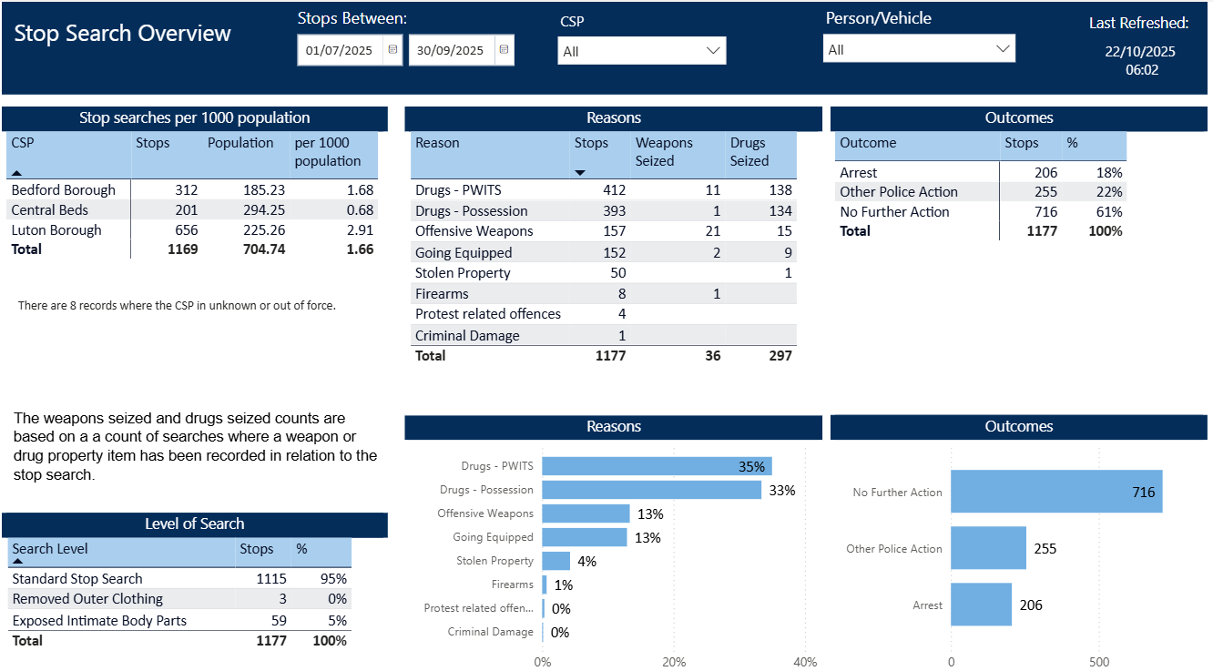
Excellence: an excellent police service
The PCC has also requested for additional information to aid transparency of the Force and they fall under different headings in line with the pledge of being Transparent.
Stop and Search Data (Q2 25-26)
Stop and search | Police.uk (www.police.uk)
Updated quarterly

Slide 17
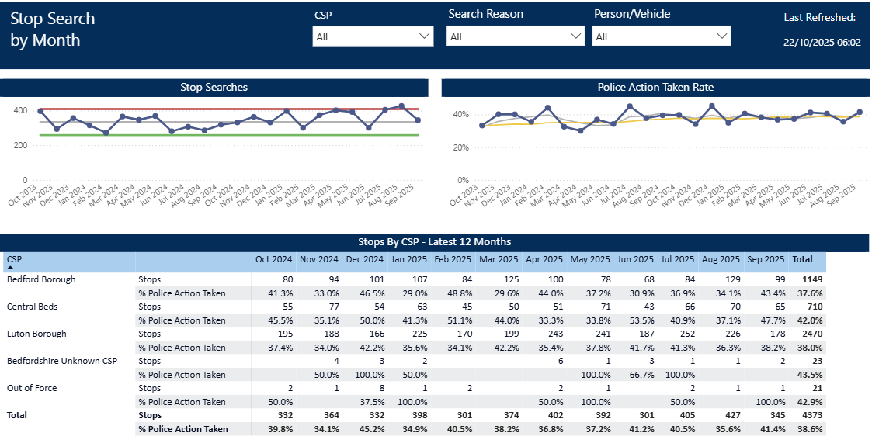
Updated quarterly

Slide 18
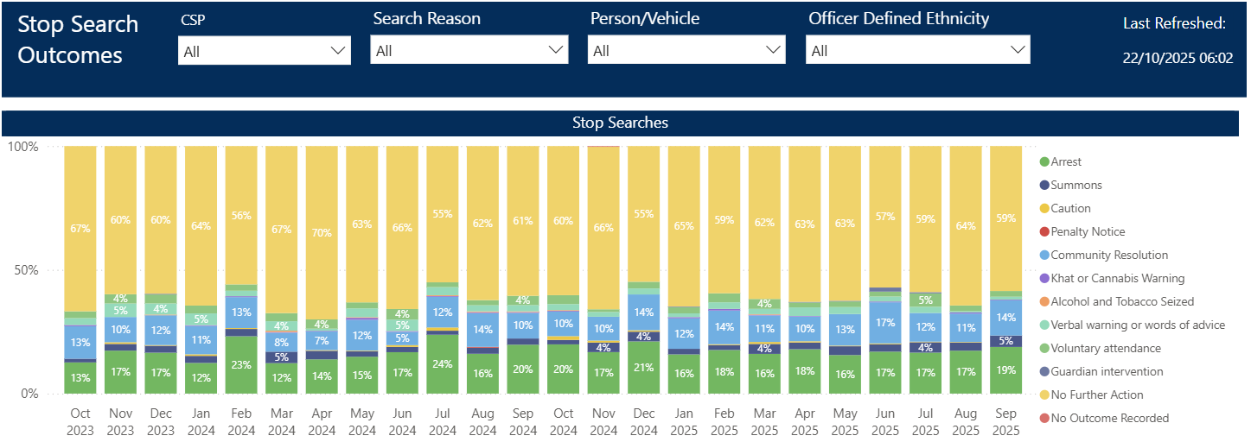
Updated quarterly

Slide 19
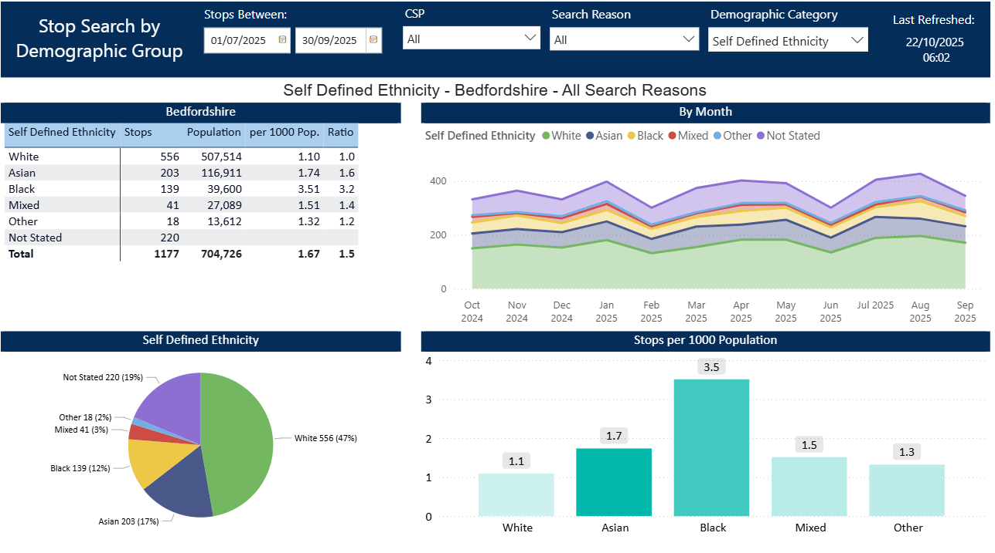
Updated quarterly

Slide 20
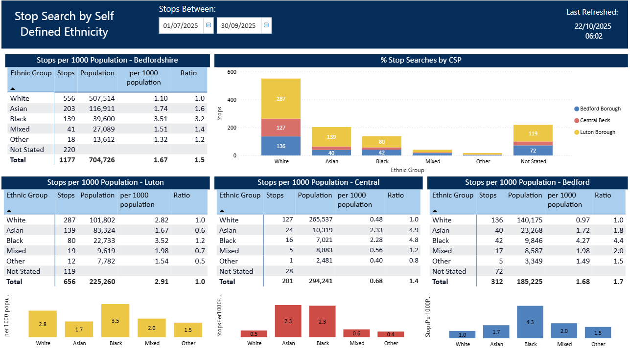
Updated quarterly

